Slide 1
Differential Datalog (DDlog)
A Programming Language for Incremental Computation
Ben Pfaff, Leonid Ryzhyk, Mihai Budiu
Researchers, OCTO
VI2316
#vmworld #2316

Slide 2
Disclaimer for All Presentations
This presentation may contain product features or functionality that are currently under development.
This overview of new technology represents no commitment from VMware to deliver these features in any generally available product.
Features are subject to change, and must not be included in contracts, purchase orders, or sales agreements of any kind.
Technical feasibility and market demand will affect final delivery.
Pricing and packaging for any new features/functionality/technology discussed or presented, have not been determined.
Notes:
Use this as a template

Slide 3
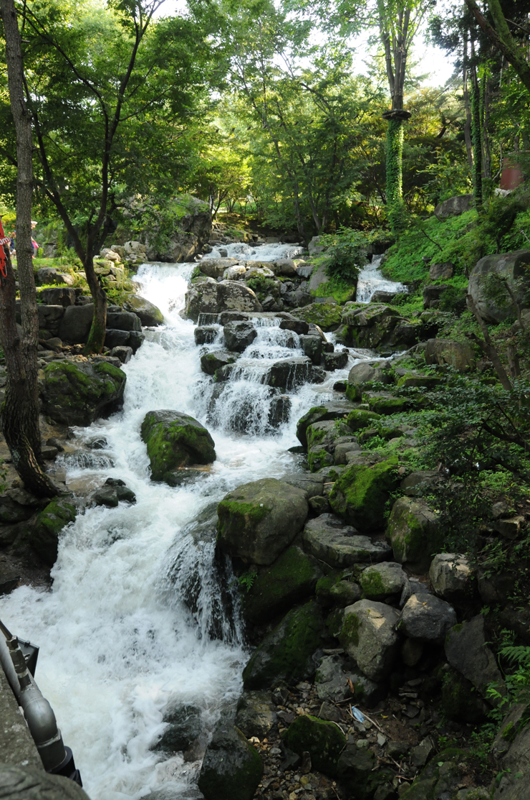
What is Differential Datalog?
A new programming language
Initiated by VMware Research
An open-source project
Used by several VMware products
Currently funded by VMware xLabs (incubation project)

Slide 4
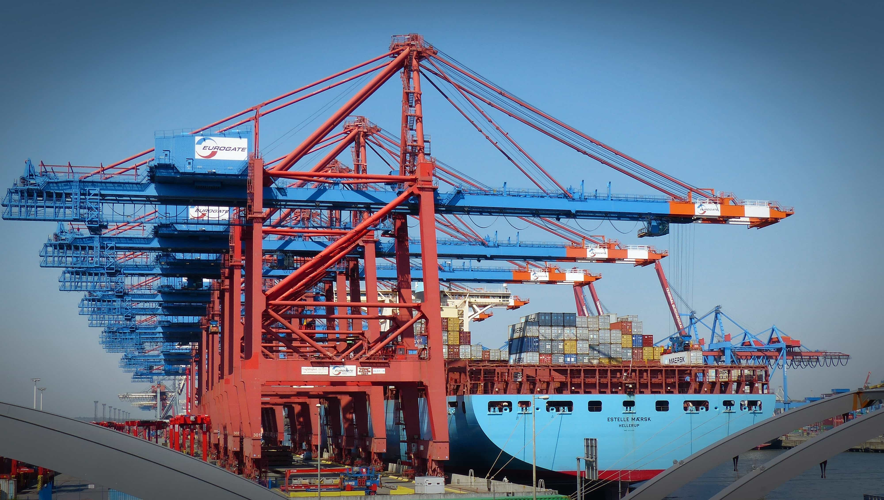
What is it good for?
Domain-specific programming language
Data-centric (~SQL)
Streaming
Automates change computations
Data-centric: main data structure is an in-memory database
Streaming: process data continuously
Change computation = incremental view update
Compute changes in the output when input change
Simplifies significantly some applications
Control-planes
Continuous query systems (including big-data)

Slide 5
Open-source
http://github.com/vmware/differential-datalog

Slide 6
Presentation outline
Introduction to DDlog
Declarative language
Imperative fragment
Implementation
3 Success stories
Conclusions

Slide 7
Datalog
Datalog
$$f$$
Input tables
Output tables
Inputs and outputs are tables (relations = sets of typed tuples)
$O=f(I)$

Slide 8
Differential Datalog
Datalog
$$Δf$$
Input tables
Output tables

Slide 9
Table manipulation = relational language
Select
Project
Join
Except
Filter
Map
Flatmap
Groupby
Aggregate
Recursion

Slide 10
DDlog programs are streaming systems
Stream of input changes
Datalog
Stream of output changes
$${ΔI}_{3}$$
$${ΔI}_{2}$$
$${ΔI}_{1}$$
$${ΔI}_{0}$$
$${ΔO}_{3}$$
$${ΔO}_{2}$$
$${ΔO}_{1}$$
$${ΔO}_{0}$$
…
…
$$Δf$$
transactions

Slide 11
Stateful stream processing
Datalog
$${ΔI}_{3}$$
$${ΔI}_{2}$$
$${ΔI}_{1}$$
$${ΔI}_{0}$$
$${ΔO}_{3}$$
$${ΔO}_{2}$$
$${ΔO}_{1}$$
$${ΔO}_{0}$$
…
…
In-memory state
Important consequences:
Data size is limited to memory size
In case of crash state needs to be reconstructed
Queries need to exist before data starts arriving
To migrate queries state needs to be migrated

Slide 12
Example: An undirected graph
typedef Node = bit<16>
input relation Edge(source: Node, dest: Node)
// Symmetric edges
relation SimEdge(source: Node, dest: Node)
SimEdge(n, m) :- Edge(n, m).
SimEdge(n, m) :- Edge(m, n).
Edge
SimEdge
source | dest
source | dest

Slide 13
Reachability
relation Reach(from: Node, to: Node)
Reach(n, m) :- SimEdge(n, _), var m = n.
Reach(n, m) :- SimEdge(n, m).
Reach(n, m) :- SimEdge(n, x), Reach(x, m).
Edge
SimEdge
Reach
source | dest
source | dest
from | to
Executes to fixpoint

Slide 14
Connected components
// Canonical representative of a connected component: // node with smallest value
output relation Canonical(node: Node, repr: Node)
Canonical(n, r) :- Reach(n, m), var r = (m).group_by(n).min().
~ SQL GroupBy-Aggregate
Reach
Canonical
from | to
node | repr

Slide 15
Connected components in DDlog
typedef Node = bit<16>
input relation Edge(source: Node, dest: Node)
// Symmetric edges
relation SimEdge(source: Node, dest: Node)
SimEdge(n, m) :- Edge(n, m).
SimEdge(n, m) :- Edge(m, n).
relation Reach(from: Node, to: Node)
Reach(n, m) :- SimEdge(n, _), var m = n.
Reach(n, m) :- SimEdge(n, m).
Reach(n, m) :- SimEdge(n, x), Reach(x, m).
// Canonical representative of a connected component: node with smallest value
output relation Canonical(node: Node, repr: Node)
Canonical(n, r) :- Reach(n, m), var r = (m).group_by(n).min().
The non-incremental algorithm is much simpler than the incremental one.
Try to write the incremental one by hand!

Slide 16
Demo
Graph
edges &
components
Graph
edges &
components
Graph
edges
Random graph
changes
Connected components
Web server
Web browser
serialize
deserialize
Java
Rust
Java
JavaScript+d3
compiler
ddlog

Slide 17
Imperative language fragment
Computing over values stored in tables

Slide 18
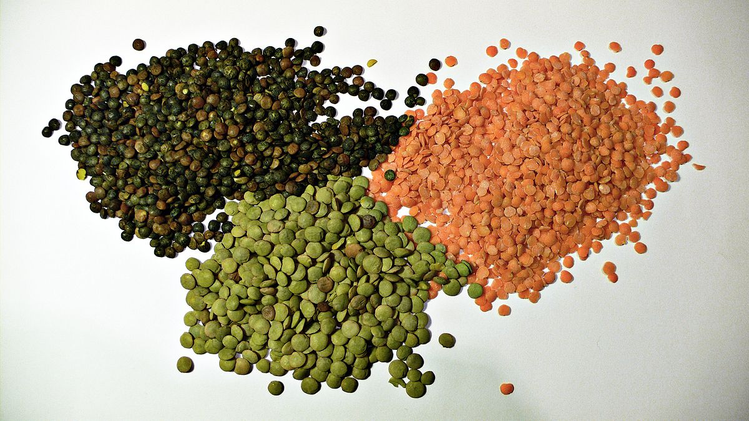
Rich type system
Base types
bit<17>, int<32>, bigint
double, float
string, bool
extern types (Rust)
Derived types
Tuples
Type-safe structs & unions
Recursive types (e.g., Json)
Generic types
typedef Option<'A> = None
| Some{x: 'A}
Function types
References

Slide 19
Rich expression language
Only deterministic computations supported
Arithmetic on all numeric types
Casts
Floating point libraries
Strings
Raw strings
Standard strings
String interpolation (like JavaScript) "result = ${a*b+3}"
Evaluated dynamically and converted to a string

Slide 20
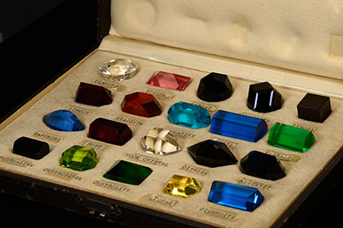
Built-in collections
Vec<'T>
Set<'T>
Map<'K,'V>
Group<'K,'V>
Functional immutable collections (COW)
Iterators
Collections can be elements in tables
Collection literals (constants)

Slide 21
Control-flow constructs
if/then/else (expression)
Iterator loops
break, continue, return
Pattern-matching deconstruction
Functions (recursive)
Lambda expressions
|x| { x * 2 }

Slide 22
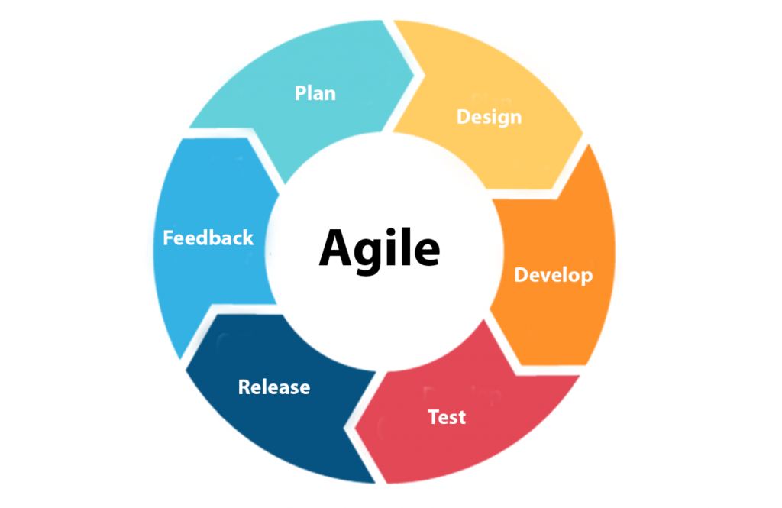
Software Engineering
Module system, libraries
Tracing, logging, record & replay
Profiling
Memory
CPU
Multi-core execution
Fast serialization (flatbuf)
Text-based CLI
APIs to interoperate with C, C++, Rust, Java, Go
Documentation (tutorial, language reference, examples)

Slide 23
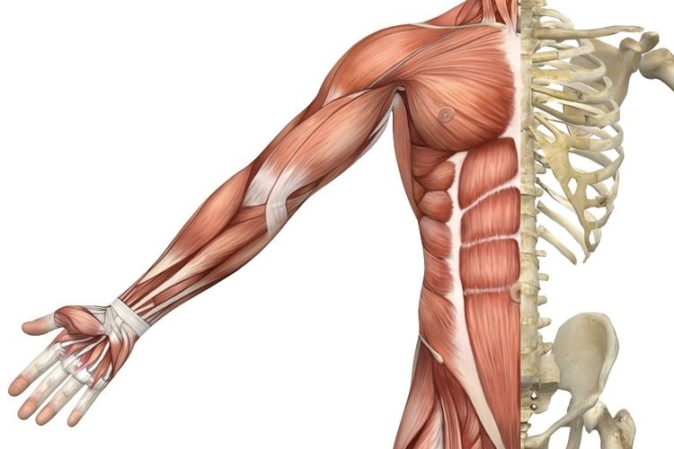
Implementation

Slide 24
DDlog
DDLog compiler
$$f$$
$$Δf$$
you write
simpler
you get
faster
Try to write incremental reachability by hand!
In any language you choose.

Slide 25
DDlog
DDLog compiler
$$f$$
$$Δf$$
$Δf$ much faster than $f$
Ideally $O\left(\left|I\right|/\left|ΔI\right|\right)$ times faster
$f$ much simpler than $Δf$

Slide 26
DDlog System architecture
Input changes
DDLog
program
DDLog compiler
Rust
Program
$$Δf$$
Rust compiler
Native library
$$f$$
Haskell
Output changes
Differential dataflow
library

Slide 27
DDlog compiler
Written in Haskell
Relatively simple (so far)
Parsing
Simple front-end IR
Validation
Type inference
Optimizations
Code generation
Currently no back-end IR
Generates Rust source files

Slide 28
Executable is Rust
Safe language
Not a managed language (no GC required)
Generates native code
Really FAST
Ownership type system:
Avoids data races
Avoid data copies
Broad ecosystem of libraries (crates)
We make it very easy to expose Rust as Ddlog
extern types and extern function declarations
Downside: slow compilation

Slide 29
DDlog compilation result is a library
DDlog program sources
Compile
main program
ddlog
runtime library
Input table changes
Output table changes
threads

Slide 30
C API example
#include "ddlog.h"
int main() {
ddlog_prog prog = ddlog_run(…); table_id edgeTableID = ddlog_get_table_id(prog, "Edge");
ddlog_record **struct_args = (ddlog_record**)malloc(2 * sizeof(ddlog_record*)); struct_args[0] = ddlog_int(0);
struct_args[1] = ddlog_int(5);
ddlog_record *edge = ddlog_struct("Edge", struct_args, 2);
ddlog_cmd *cmd = ddlog_insert_cmd(edgeTableID, edge);
ddlog_transaction_start(prog); ddlog_apply_updates(prog, &cmd, 1);
ddlog_delta* delta = ddlog_transaction_commit(prog); // list of all changes print_delta(delta); free(struct_args);
ddlog_stop(prog); }

Slide 31
Success stories
NSX Central Control Plane
OVN Open Virtual Network
Skyline proactive support

Slide 32
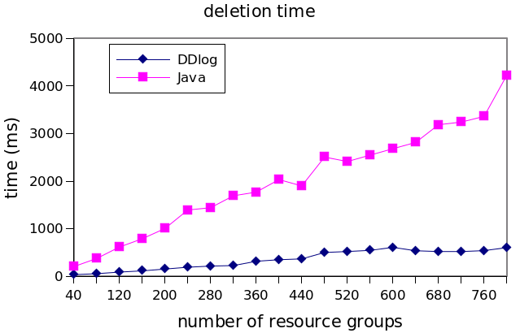
NSX Central Control Plane
Current shipped version contains 4 DDlog “apps”
First app was “span”, a variant of the “reachability” app in the demo
Java: 1800 LOC, subtle, buggy, not fully incremental
DDlog: 5 LOC, 50 LOC optimized, faster, no bugs

Slide 33
Why?
Management policies
Controller
Faster
Algorithm is ~ O(|state|/|$Δ$|) faster
Milliseconds instead of minutes
Less bandwidth
Much simpler code
Factors of 10-100x possible
Controller state
System state
View update
Managed entity
Configuration

Slide 34
OVN
Mature open-source project
Similar to NSX in functionality
Rewritten in 12,000 LOC of DDlog
From about the same amount of C
Result is fully incremental
Scalable to large network configurations
Intent is cleaner

Slide 35
VMware Skyline Proactive Intelligence
Proactively identifying and resolving potential issues before they occur
VMware online service
https://www.vmware.com/support/services/skyline.html
Supports VCF, vSphere, vSAN, NSX-v, NSX-T, vRops, vRA, Horizon
Expert-written rules detect and report issues (e.g., misconfigurations)
Customer installation
Skyline
service
DB UI
Configs
Upgrades
telemetry
Issues

Slide 36
VMware Skyline by Numbers
11K+ | Customer installations
78M+ | Objects with potential issues
600+ | Rules
43K | Lines of DDlog
2TB+ | Data/day (uncompressed)
3sec | 99.9th percentile latency normal customers
70sec | 99.9th percentile latency for huge customers
Notes:
With Skyline, customers can prevent issues before they occur, often enabling them to avoid opening Support Requests with VMware Tech Support. With fewer issues, customers’ environments are healthier: more productive, more reliable and more secure. They can avoid being in “firefighting” mode -- always addressing issues reactively -- and move to a proactive mode, where they’re able to focus on more pressing initiatives, like IT innovation and digital transformation.
By proactively identifying and preventing problems, Skyline is helping customers avoid costly downtime, availability and performance errors, as well as reduce the amount of staff hours dedicated to fixing issues. This is a huge benefit to customers, that translates into big cost savings and productivity gains.
To date, Skyline has identified more than 44 million objects in customer environments with potential issues. More than 60% of those have already been remediated by our customers.
Skyline also includes some reactive support features, such as Log Assist, which helps streamline time to resolution if a customer does open a Support Request. Log Assist enables automated upload of support log bundles to Tech Support, eliminating the time-consuming process of manually uploading logs. We have calculated that Log Assist is at least 17X faster than the manual upload process. That’s a lot of time savings for our customers!

Slide 37
DDlog use in Skyline
+/- findings
600+ queries
Data (JSON)
To DB/UI
Horizontally partitioned across tenants.
Consumes JSON (tens of MB/doc), produces JSON
Analyzes data in flight (no DB read/write)

Slide 38
In development
IDE integration (language server)
Debugging tools
Distributed runtime
SQL => DDlog compiler
Language extensions
Data streams (not just collections)
Window-based aggregations
Formalize semantics
Prove compiler correct
Compiler and runtime optimizations

Slide 39
Have we cured cancer?
No. DDlog is not a general-purpose language.
Some things you cannot/should not do:
Optimization (e.g. linear programming, SAT solving)
Call random() or getttimeofday()
Randomized algorithms
(But we can handle pseudo-random generators)
Do any kind of I/O (except logging)
Machine learning training
Hard real-time

Slide 40
Conclusions
DDlog: a new programming language
Data-centric
Incremental
Killer applications:
Control planes
Streaming computation
Incremental algorithms
Do you need one of these?
Would you like to contribute?
http://github.com/vmware/differential-datalog

Slide 41
Please take your survey.

Slide 42
Thank you!

