Slide 1

Incremental Computation
Rootconf special community edition on databases
Bengaluru, June 13, 2026
Mihai Budiu – feldera.com
Rootconf

Slide 2
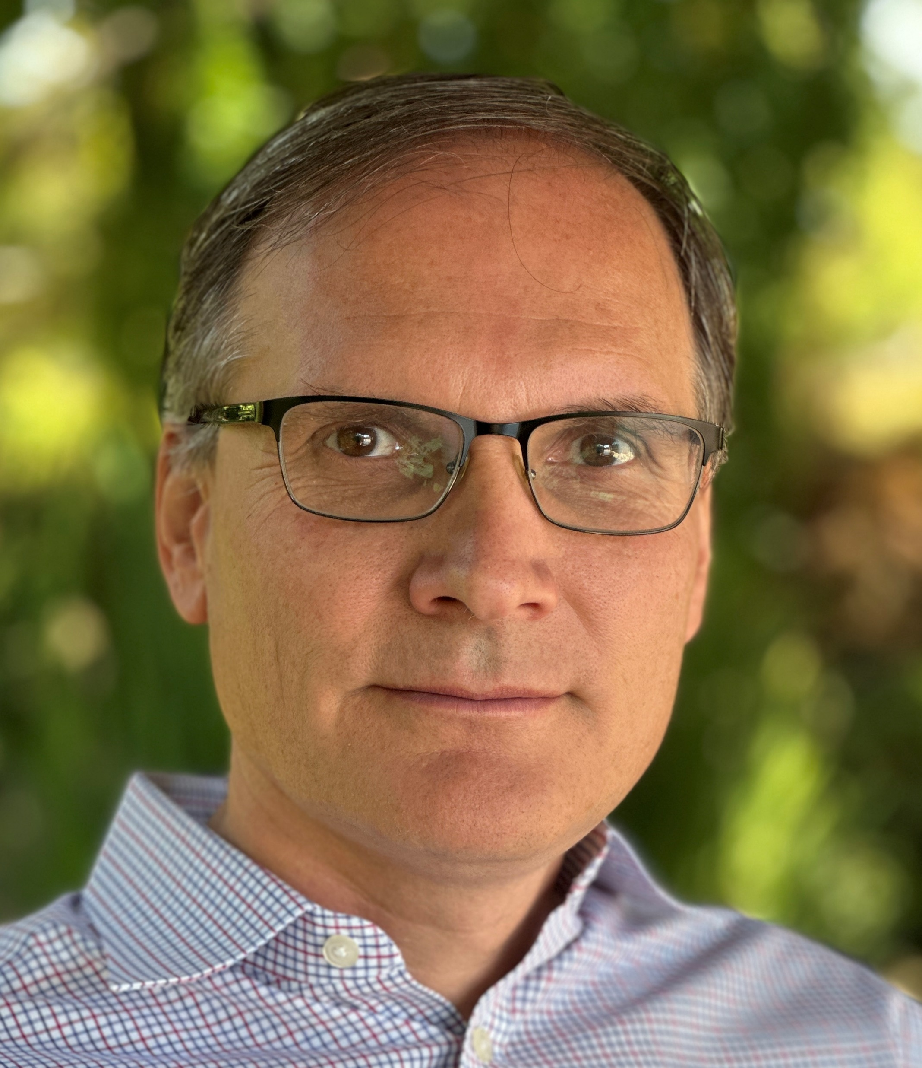
Mihai Budiu - Short bio
Ph.D. from Carnegie Mellon University
Currently:
feldera.com – chief scientist
Previous:
Microsoft Research Silicon Valley,
Barefoot Networks, VMware Research
Apache Calcite PMC chair
https://mihaibudiu.github.io

Slide 3

Roadmap
Incremental view
maintenance
Streams
Changes
Incremental
computation
VLDB
2023

Slide 4
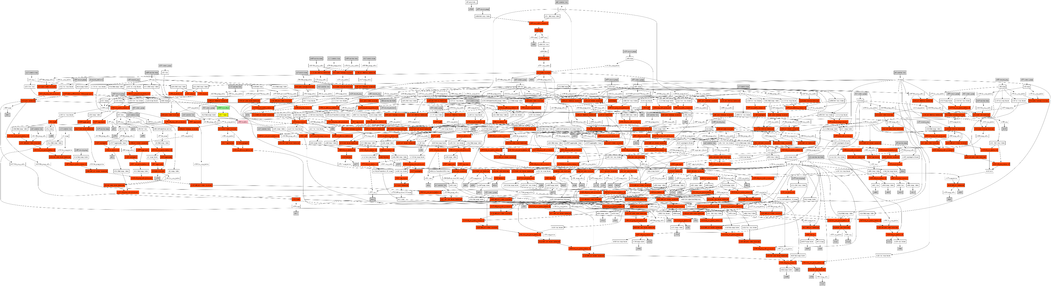
It works!
Incremental dataflow graph from a customer SQL program
  20K lines of SQL
  61 tables, 33 views
  217 joins, 27 aggregates, 287 other operators

Slide 5
250M records, 200 GB of data
Spark
  60 machines
  20 minutes refresh time
Feldera
  1 machine, using 15GB RAM
  200 milliseconds mean update latency

Slide 6

1. Incremental computation

Slide 7
Example: a query from your bank
CREATE TABLE transactions(
customer UUID,
ts TIMESTAMP,
-- amount may be negative for a withdrawal
amount DECIMAL(10, 2)
);
SELECT customer, SUM(amount)
FROM transaction
GROUP BY customer;

Slide 8

Setting: A database and a query
$$Q$$

Slide 9
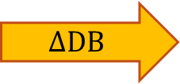
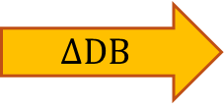
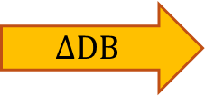
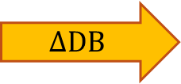
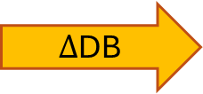
Keep the result up-to-date
CREATE VIEW V AS …
V
V
V
V
V
$$Q$$
$$Q$$
$$Q$$
$$Q$$
$$Q$$
$Δ$DB
$$ΔDB$$
$$ΔDB$$
$$ΔDB$$
$$ΔDB$$
~100 rows
~1B rows
Time
transactions

Slide 10

Incremental computation
When a new deposit occurs
  Update the funds for the
  corresponding person
  Remember what you did before
Do not recompute funds
for everyone

Slide 11
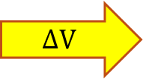
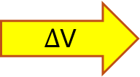
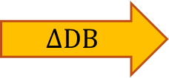
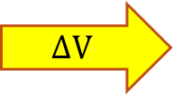
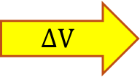

Incremental View Maintenance
1B / 100 = 10 million times less work!
V
V
V
V
V
$$ΔV$$
$$ΔV$$
$$ΔV$$
$$ΔV$$
$Δ$V
$$Q$$
$$Q^{Δ}$$
$$Q^{Δ}$$
$$Q^{Δ}$$
$$Q^{Δ}$$
$$Q^{Δ}$$
$$ΔDB$$
$$ΔDB$$
$$ΔDB$$
$$ΔDB$$
$$ΔDB$$
Time

Slide 12


We need to understand…
V
$$ΔV$$
…changes
$$Q$$
$$Q^{Δ}$$
…incremental queries
(not simple queries, but streaming systems)
$$ΔDB$$

Slide 13

2. Changes

Slide 14


Slide 15


Slide 16
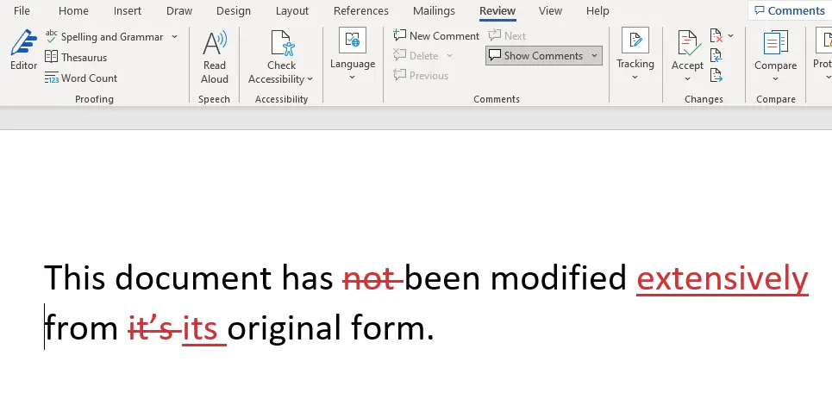

Slide 17
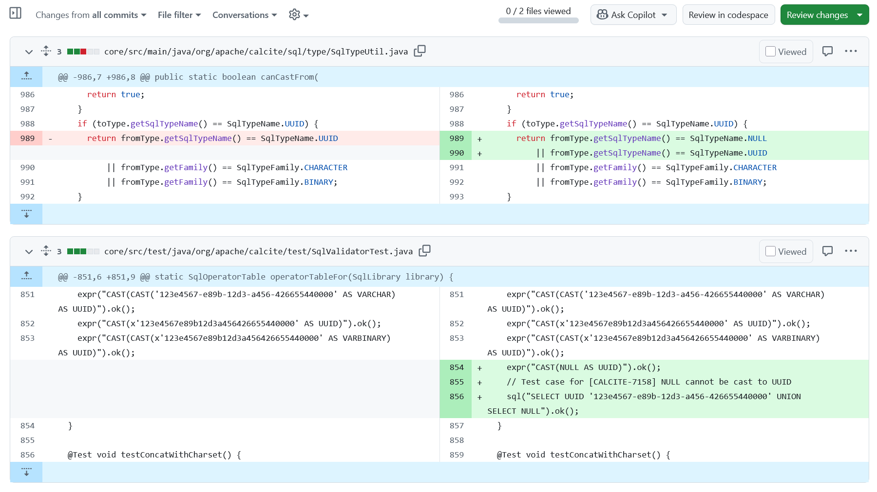

Slide 18
INSERT INTO transactions
VALUES('Mihai', NOW(), 100.00, );
INSERT INTO transactions
VALUES('Mihai', NOW(), -60.00);
Change in account value
May be negative!

Slide 19


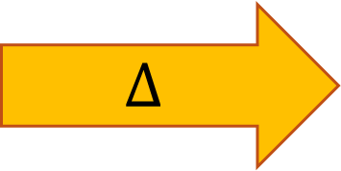
Table changes
$$Δ$$
Table
Change
Table
Databases understand these
But struggle with these

Slide 20

Z-sets = tables + weights
Each row has an integer ($ℤ$) weight
  How many copies of the row are in the table
The weight can be positive, zero, or negative
Just a table with an extra column
Name | Age
Mike | 10
John | 12
Amy | 8
Chris | 10
Name | Age | Weight
Mike | 10 | 1
John | 12 | 3
Amy | 8 | -1
Chris | 10 | 2
rows

Slide 21
Z-set union (addition)
Name | Weight
Mike | 1
John | 3
Amy | -1
Chris | 2
Name | Weight
Mike | -1
Dan | 1
Chris | 1
Name | Weight
Dan | 1
John | 3
Amy | -1
Chris | 3
Mike | 0
+
=
Match rows, add weights
Rows with weight 0 can be removed

Slide 22

Z-sets are magic
Can represent both tables and changes to tables
  Positive weights = rows added
  Negative weights = rows removed

Slide 23
A standard table is a Z-set too!
Name | Age | Weight
Mike | 10 | +1
John | 12 | +1
Amy | 8 | +1
Chris | 10 | +1

Slide 24

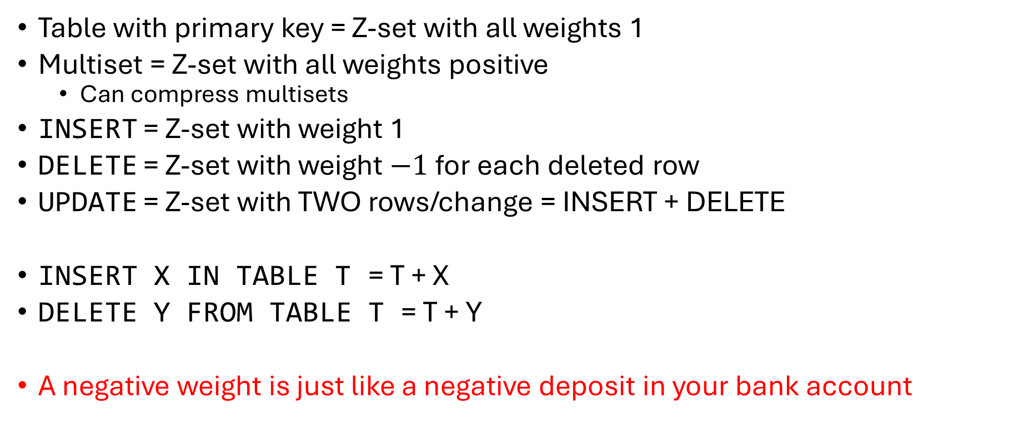
Z-sets are expressive
Table with primary key = Z-set with all weights 1
Multiset = Z-set with all weights positive
  Can compress multisets
INSERT = Z-set with weight 1
DELETE = Z-set with weight $−1$for each deleted row
UPDATE = Z-set with TWO rows/change = INSERT + DELETE
INSERT X IN TABLE T = T + X
DELETE Y FROM TABLE T = T + Y
A negative weight is just like a negative deposit in your bank account

Slide 25

3. Streams

Slide 26
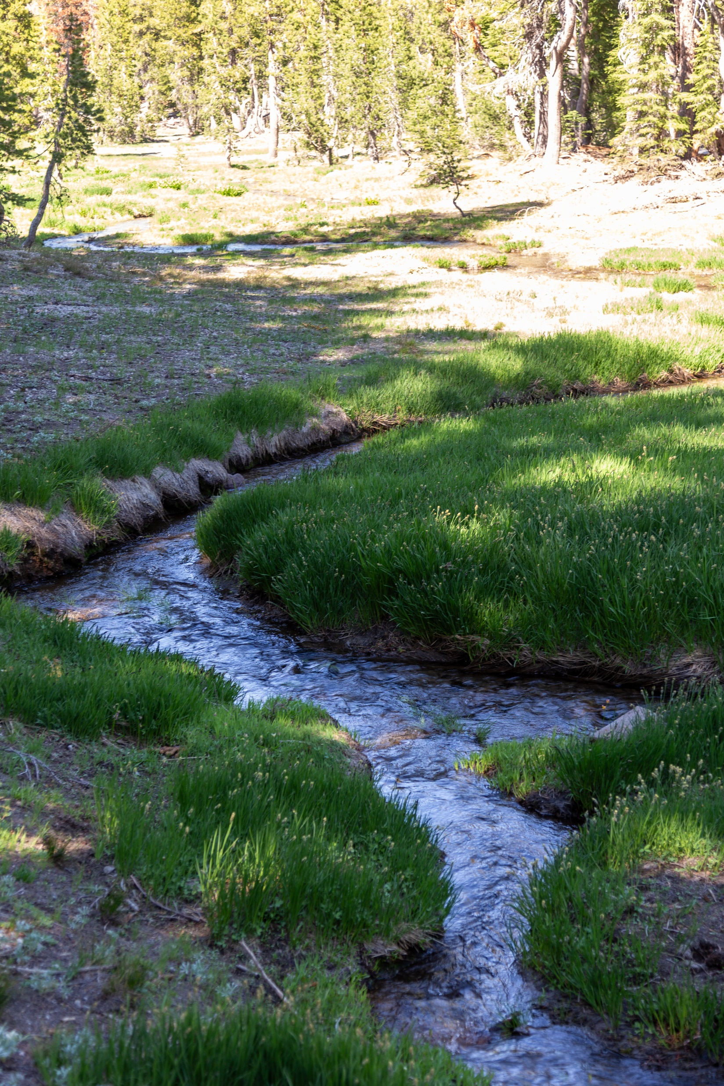
Streams
Infinite sequences
…
-2
-1
0
1
2
1
Time

Slide 27
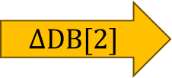
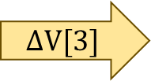
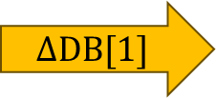

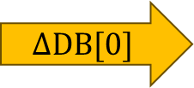
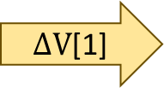
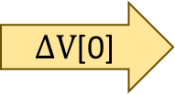
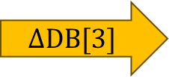
Some interesting streams
Stream of database
snapshots
DB[0]
DB[1]
DB[2]
DB[3]
$$ΔDB[0]$$
$$ΔDB[1]$$
$$ΔDB[2]$$
$$ΔDB[3]$$
… transactions
V[0]
V[1]
V[2]
V[3]
… view
snapshots
$ΔV$[0]
$ΔV$[1]
$$ΔV[2]$$
$$ΔV[3]$$
… view
changes

Slide 28












Stream computations
Inputs and outputs are streams
  double arrows
…
$$i_{2}$$
$$i_{1}$$
$$i_{0}$$
$$σ$$
$$⋈$$
…
$$o_{2}$$
$$o_{1}$$
$$o_{0}$$
…
$$j_{2}$$
$$j_{1}$$
$$j_{0}$$
$$π$$

Slide 29
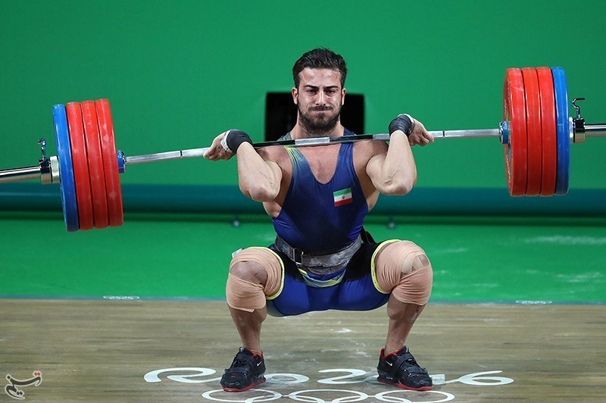








Lifting a function $f$
…
$$c$$
$$b$$
$$a$$
$$↑f$$
…
$$f(c)$$
$$f(b)$$
$$f(a)$$

Slide 30
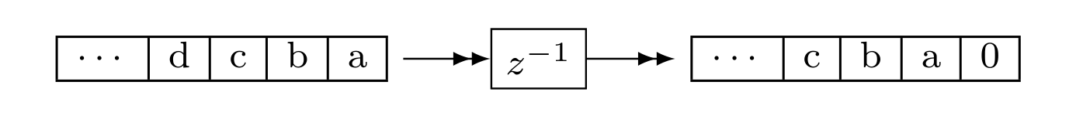

The Delay Stream Operator ($z^{−1}$)
Output is input stream delayed by one step
First value is 0
Stores internal state (the only operator with state)

Slide 31
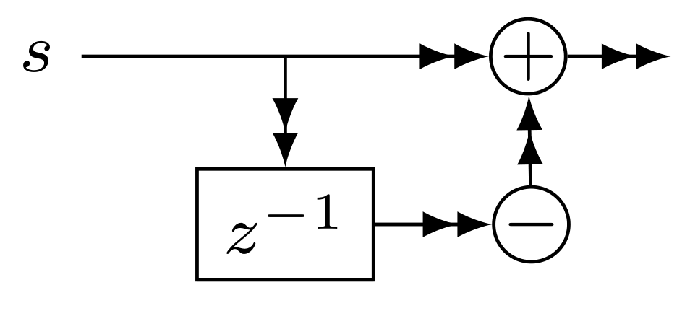








Computing changes (deltas)
Differentiation
$$o\left[t\right]=s\left[t\right]–s\left[t−1\right]$$
$$D$$
$$o$$
o is the stream of changes of s
…
$$2$$
$$3$$
$$2$$
1
$$D$$
…
$$−1$$
$$1$$
$$1$$
1
stream of deltas

Slide 32
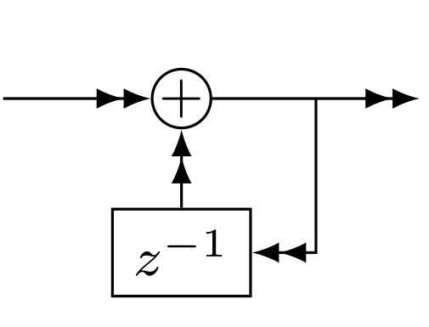








Integration
$$I$$
$$s$$
$$o$$
If s is a stream of changes…
… then o is the original stream
$$o=o+s$$
…
$$−1$$
$$1$$
$$1$$
1
$$I$$
…
$$2$$
$$3$$
$$2$$
1
stream of deltas

Slide 33



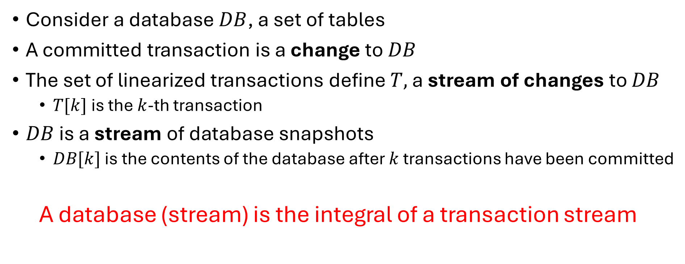






All databases are streaming databases!
Consider a database $DB$, a set of tables
A committed transaction is a change to $DB$
The set of linearized transactions define $T,$ a stream of changes to $DB$
  $T[k]$is the $k$-th transaction
$DB$ is a stream of database snapshots
  $DB[k]$ is the contents of the database after $k$ transactions have been committed
  A database (stream) is the integral of a transaction stream
…
$$T_{3}$$
$$T_{2}$$
$$T_{1}$$
$$T_{0}$$
$$I$$
…
$${DB}_{3}$$
$${DB}_{2}$$
$${DB}_{1}$$
$${DB}_{0}$$

Slide 34

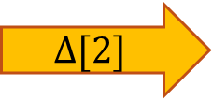

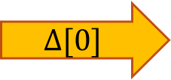
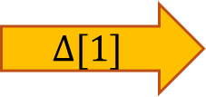
You are an integrator!
DB+= $Δ$
$$Δ[2]$$
$$Δ[1]$$
$$Δ[0]$$
Stream of experiences

Slide 35

Putting the pieces together

Slide 36
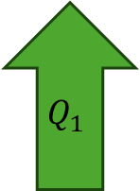

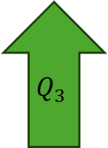

Any query is a composition of primitives
$$Q$$
$$Q_{3}$$
=
$$Q_{2}$$
e.g, select, project,
join, filter, etc.
$$Q_{1}$$

Slide 37




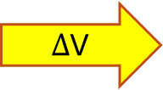

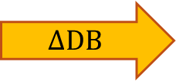











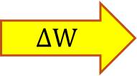






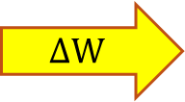

The chain rule
W
W
W
W
W
$$ΔW$$
$$ΔW$$
$$ΔW$$
$$ΔW$$
$$ΔW$$
$$Q_{1}$$
$$Q_{1}^{Δ}$$
$$Q_{1}^{Δ}$$
$$Q_{1}^{Δ}$$
$$Q_{1}^{Δ}$$
$$Q_{1}^{Δ}$$
V
V
V
V
V
$$ΔV$$
$$ΔV$$
$$ΔV$$
$$ΔV$$
$Δ$V
$$Q_{0}$$
$$Q_{0}^{Δ}$$
$$Q_{0}^{Δ}$$
$$Q_{0}^{Δ}$$
$$Q_{0}^{Δ}$$
$$Q_{0}^{Δ}$$
$$ΔDB$$
$$ΔDB$$
$$ΔDB$$
$$ΔDB$$
$$ΔDB$$

Slide 38
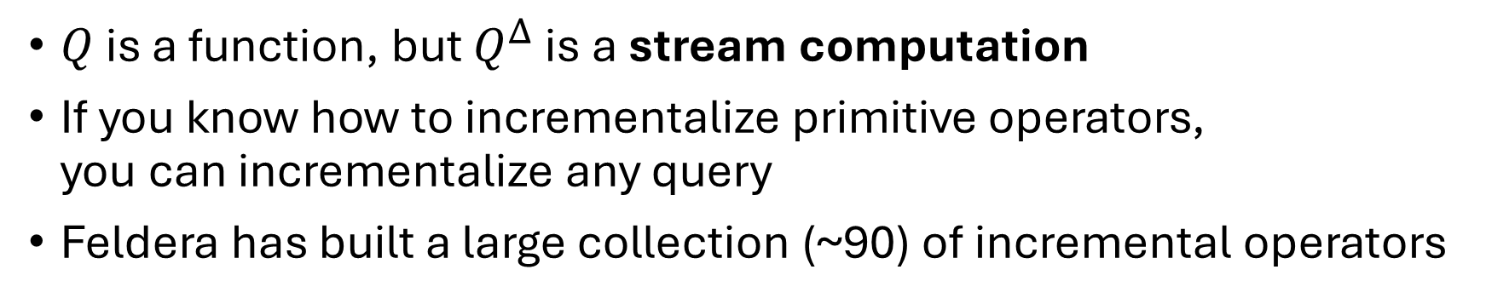





Algorithm for $Q^{Δ}$
$$Q_{1}$$
$$Q_{1}^{Δ}$$
Compiler
$$Q_{2}$$
$$Q_{2}^{Δ}$$
$Q$ is a function, but $Q^{Δ}$ is a stream computation
If you know how to incrementalize primitive operators,
you can incrementalize any query
Feldera has built a large collection (~90) of incremental operators

Slide 39
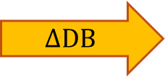
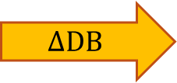

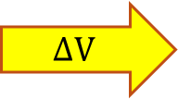
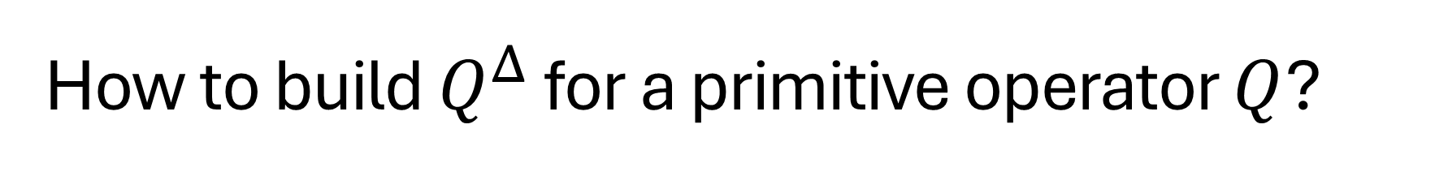



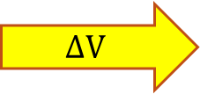

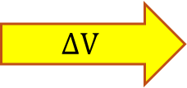

How to build $Q^{Δ}$ for a primitive operator $Q$?
$$ΔV$$
$$ΔV$$
$$ΔV$$
$$Q$$
$$Q^{Δ}$$
$$Q^{Δ}$$
$$Q^{Δ}$$
$$ΔDB$$
$$ΔDB$$
Much easier if you
have all the data
and the change
$$I$$
$$ΔDB$$

Slide 40
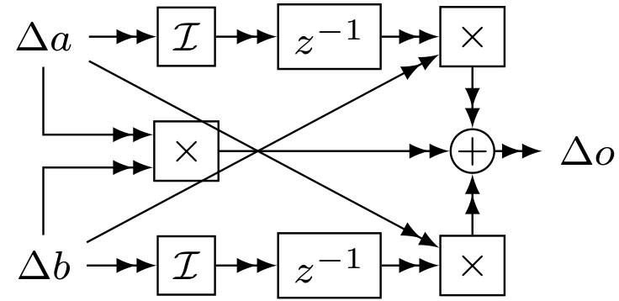




Incremental Cartesian Product (Join)
$$a Δa$$
$$(a+Δa)×b$$
1
2
3
4
5
6
7
1
2
3
4
5
6
7
1
2
3
4
5
6
7
$$b$$
1
2
3
4
5
6
7
1
2
3
4
5
6
7
1
2
3
4
5
6
7
$$b$$
1
2
3
4
5
6
$Δ\left(a×b\right)=\left(a×Δb\right)+\left(Δa×b\right)+\left(Δa×Δb\right)$

Slide 41








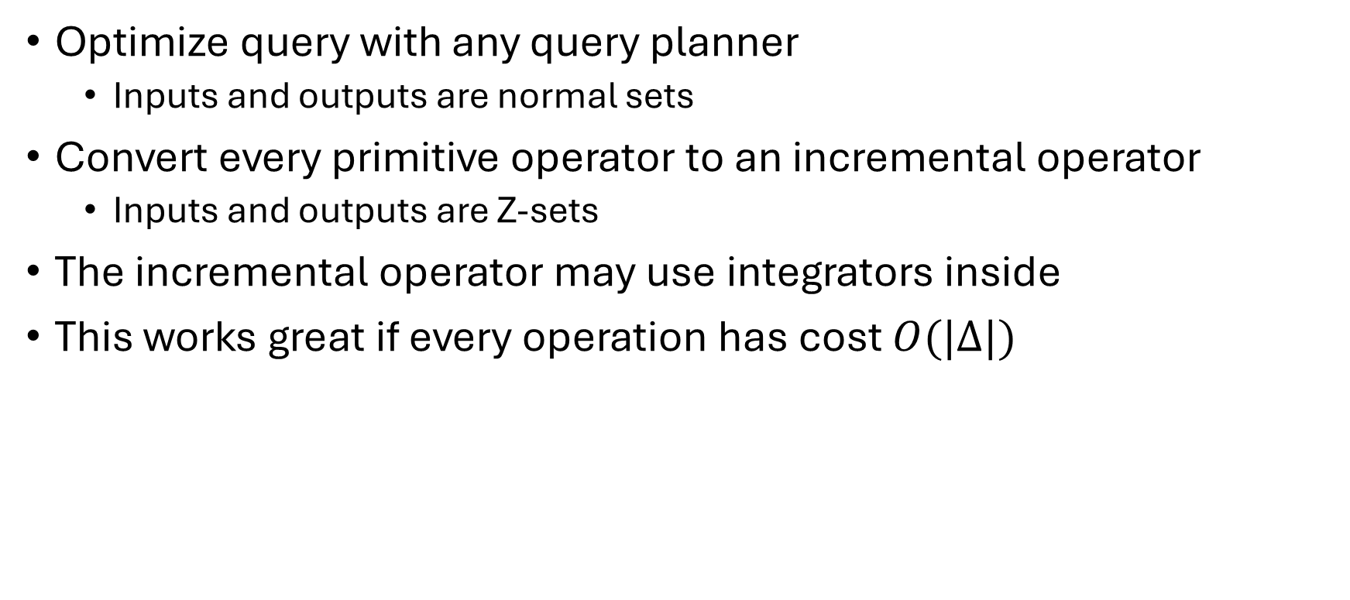











General incrementalization recipe
Optimize query with any query planner
  Inputs and outputs are normal sets
Convert every primitive operator to an incremental operator
  Inputs and outputs are Z-sets
The incremental operator may use integrators inside
This works great if every operation has cost $O(|Δ|)$
$$i1$$
$$σ$$
$$a$$
$$Δi1$$
$$σ^{Δ}$$
$$Δa$$
$${ ⋈}^{Δ}$$
$$I$$
$$a$$
$$⋈$$
o
Compiler
$$Δo$$
$$i2$$
$$π$$
$$Δi2$$
$$π^{Δ}$$
$$Δb$$
$$I$$
$$b$$
$$b$$

Slide 42

Core ideas
Z-sets: a simple table data format
  Table with an extra weight column
  Unifies change and data representation
Incremental computation
  Compute directly on changes
  Can be orders of magnitude more efficient
Streams
  Infinite sequences
  Integration is a stream operation

Slide 43










Incremental queries are streaming systems
$${Δi}_{0}$$
$${Δi}_{1}$$
$${Δi}_{2}$$
$${Δi}_{3}$$
…
$$Q^{Δ}$$
$$Δo_{0}$$
$$Δo_{1}$$
$$Δo_{2}$$
$$Δo_{3}$$
…
state
$Q^{Δ}$ is a streaming system:
it runs forever
it maintains internal state (even if $Q$ is stateless)
  In delay operators (inside integrals)
  Incremental computation is a time/space trade-off:
  use more space (indexes) to save time

Slide 44




try.feldera.com
github.com/feldera/feldera
www.feldera.com/community
Feldera is hiring!
feldera.com/careers

Slide 45
Extra slides

Slide 46
IVM
data
processing
system
Changes
Changes

Slide 47

This talk
Changes in database table data
We don't consider schema changes

Slide 48

A database transaction
is a change that
may span multiple tables

Slide 49


Z-sets could be everywhere!
V
V
Tables and views
Table and view changes
Change Data Capture streams
Database logs
INSERT and DELETE statements
Transactions
$$ΔV$$
$$Q$$
$$Q^{Δ}$$
$$ΔDB$$
Z-sets should be the standard data exchange format

Slide 50


Z-set Addition is very nice
Generalizes database multiset union $∪$
Commutative
Associative
There is a zero = Z-set with no rows
Commutative group
Great for concurrency
(Contrast with tombstones)

Slide 51

Data
Changes
https://delta.io/blog/2023-04-19-faster-aggregations-metadata/

Slide 52


Data lakes should use Z-sets!
Z-sets
Z-sets
Today
Tomorrow

Slide 53




Uniform access to data and deltas
Existing data
Append $Δ$
Write path
Read path
Compaction

Slide 54
Composable data systems
data
Z-sets
Z-sets
data
Today:
Data
source
input
adapter
streaming
engine
output
adapter
Data
sink
Example:
SQL
CDC
Flink
log
Data lake
Z-sets
Z-sets
Z-sets
Z-sets
streaming
engine
streaming
engine
streaming
engine
Tomorrow:

Slide 55

This box should not exist
It should be a service provided by the DB
These should use the same format

Slide 56

Changes should be first class-objects!

Slide 57



What is new?
DB-prev (DB)
$$Δ[2]$$
$$Δ[1]$$
$$Δ[0]$$
Communication Stream (ideas, words, sounds)

Slide 58









How to compute ${ Q}^{Δ}$ in 3 easy steps
Integrate
$$ΔDB$$
$$ΔDB$$
$$ΔDB$$
$$ΔDB$$
View
Changes
$ΔV$[0]
$ΔV$[1]
$$ΔV[2]$$
$$ΔV[3]$$

