Slide 1

A simple P4 demo: an L2/L3 switch in 170 LOC
netdev0.1
Ottawa, February 15, 2015
Mihai Budiu

Slide 2



Setup
Router control
Table access API
P4 program
h1
RPC
h2
P4 compiler
Tables
Data plane
P4 software switch
Mininet
Notes:
﻿cd p4factory/targets/simple_router
make behavioral
cd ../../..
﻿cd mininet-demo
sudo python 1sw_demo.py --behavioral-exe ../p4factory/targets/simple_router/behavioral-model

Slide 3

DEMO PART 1
Creating an basic ethernet+IPv4 switch from a P4 program
P4 program
Tables
P4 compiler
Data plane
P4 compiler
P4 software switch

Slide 4
Layer 3 packet forwarding
Control plane
IPv4.dst ->
nextHop.ipv4address,
outputPort,
ipv4.ttl
nextHop.ipv4address ->
ethernet.dst_addr
outputPort ->
ethernet.src_addr
Packet
Packet
Notes:
﻿mininet> h1 wireshark &
mininet> h1 ping h2 # this should fail
$ ﻿./simple_router_control --thrift-path ../p4factory/targets/simple_router/of-tests/pd_thrift < commands.txt
mininet> h1 ping h2 # this should succeed

Slide 5

Headers
header_type ethernet_t {
fields {
dstAddr: 48;
srcAddr: 48;
etherType: 16;
}
}
header_type ipv4_t { … }
// no options

Slide 6
Parser
﻿parser parse_ethernet {
extract(ethernet);
return select(latest.etherType) {
0x0800 : parse_ipv4;
default: ingress;
}}
…
parser parse_ipv4 { … }
calculated_field ipv4.hdrChecksum {
verify ipv4_checksum;
update ipv4_checksum;
}

Slide 7
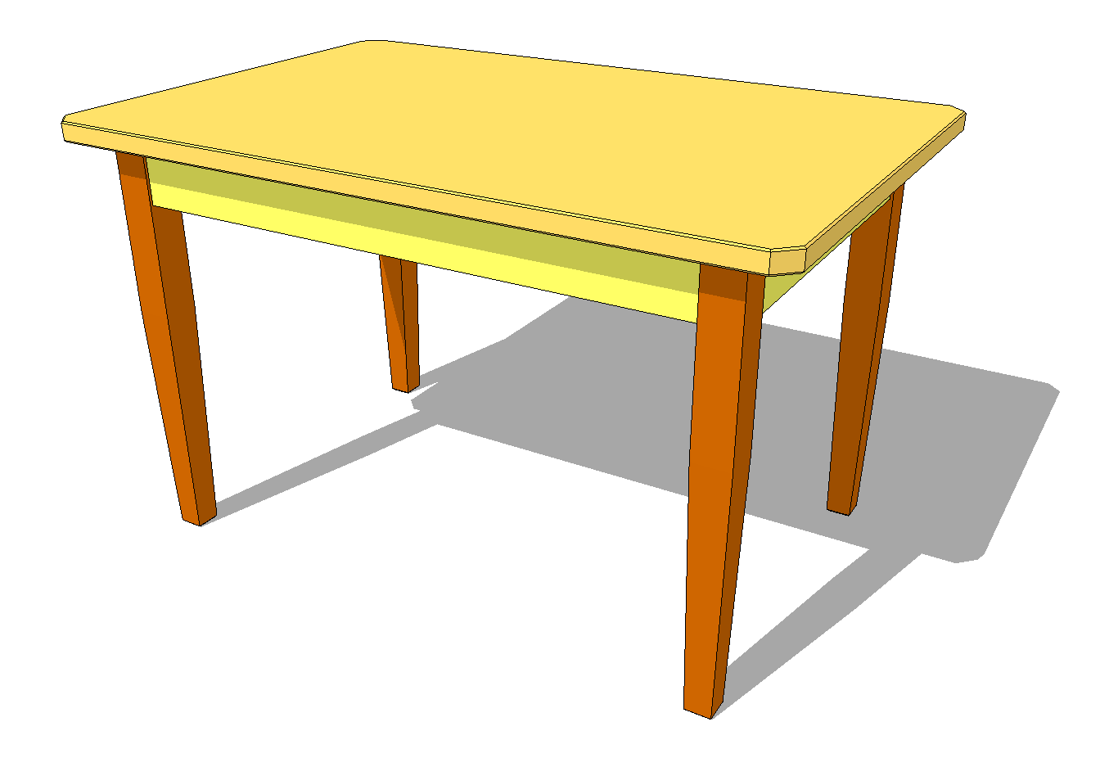
Last table
action rewrite_mac(smac) {
modify_field(ethernet.srcAddr, smac);
}
table send_frame {
reads { std_metadata.egress_port: exact; }
actions {
rewrite_mac;
drop;
}
size: 256;
}
outputPort ->
ethernet.src_addr

Slide 8

Complete pipeline
control ingress {
apply(ipv4_match);
apply(forward);
}
control egress {
apply(send_frame);
}

Slide 9
DEMO PART 2
Router control
Table access API
Populate switch tables
to enable forwarding
RPC
Tables
Data plane
P4 software switch

Slide 10

DEMO PART 3
Counters in the datapath

Slide 11
Adding counters to table entries
counter send_frame_bytes
{
type : bytes;
direct : send_frame;
}
output_port | Action
counter
Table send_frame

Slide 12

DEMO PART 4
Divert traffic

Slide 13
Diverting traffic
Divert traffic for specific destinations
to another destination
IPv4.dst ->
IPv4.dst
IPv4.dst ->
nextHop.ipv4address,
outputPort,
ipv4.ttl
nextHop.ipv4address ->
ethernet.dst_addr
outputPort ->
ethernet.src_addr
Notes:
$ ﻿./simple_router_control --thrift-path ../p4factory/targets/simple_router/of-tests/pd_thrift < divert.txt
Mininet> h1 ping h2 # this should fail, but wireshark shows packet coming back

Slide 14
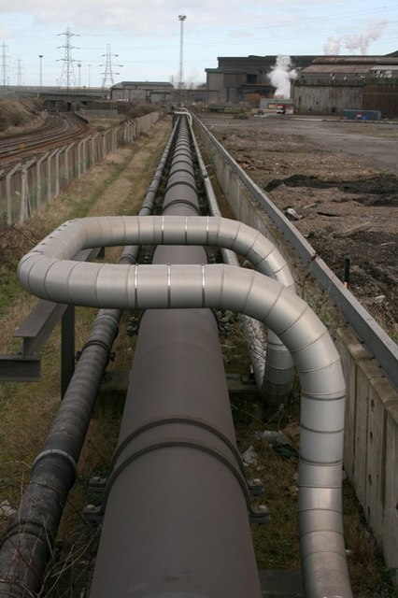
Modified pipeline
control ingress {
apply(divert);
apply(ipv4_match);
apply(forward);
}
control egress {
apply(send_frame);
}
Notes:
﻿./simple_router_control --thrift-path ../p4factory/targets/simple_router/of-tests/pd_thrift
SimpleRouter: get_ctr send_frame_bytes 0
<reply>
SimpleRouter: ^D

Slide 15
Diverting traffic
action replaceIp(ipdest) {
modify_field(ipv4.dstAddr, ipdest);
}
table divert {
reads { ipv4.dstAddr: exact;}
actions {
replaceIp;
nop;
}
size: 256;
}

Slide 16

Availability
All this code will be available
as FOSS
before March 31, 2015
on http://p4.org

