Slide 1
Streaming, incremental, finite-memory computations in SQL over unbounded streams
Mihai Budiu – .
February 20, 2025
meetup, Santa Clara, CA

Slide 2
Problem statement: streaming queries
CREATE VIEW V AS
SELECT DATE_TRUNC(timestamp, MONTH), AVG(price), item
FROM purchases
GROUP BY DATE_TRUNC(timestamp, MONTH), item
Standing
query
Grows
unbounded
month | item | …
Requires storing state indefinitely
if inputs come out of order
Assumption: inputs aren’t too much out of order
Solution: GC state that cannot affect any future outputs
purchases
updates
Data streams

Slide 3
What is new?
Well-known problem in streaming
A principled solution (provably correct)
One SQL to rule them all
Automatic

Slide 4
Outline
Incremental view maintenance as a streaming problem
Z-sets: a representation for data and changes
State garbage-collection

Slide 5
Setup: A database and a query
$$Q$$

Slide 6
Periodic query evaluation
CREATE VIEW V AS SELECT … FROM …
V
V
V
V
V
$$Q$$
$$Q$$
$$Q$$
$$Q$$
$$Q$$
$Δ$DB
$$ΔDB$$
$$ΔDB$$
$$ΔDB$$
$$ΔDB$$
Time
transactions

Slide 7
Incremental View Maintenance
We want work of $Q^{Δ}$ ~$|ΔDB|$
V
V
V
V
V
$$ΔV$$
$$ΔV$$
$$ΔV$$
$$ΔV$$
$Δ$V
$$Q$$
$$Q^{Δ}$$
$$Q^{Δ}$$
$$Q^{Δ}$$
$$Q^{Δ}$$
$$Q^{Δ}$$
$$ΔDB$$
$$ΔDB$$
$$ΔDB$$
$$ΔDB$$
$$ΔDB$$
Time

Slide 8
How to represent changes?
$$ΔV$$
$$ΔDB$$

Slide 9
Z-sets
Each row has an integer weight
The weight can be positive, zero, or negative
Name | Age | Weight
Mike | 10 | 1
John | 12 | 3
Amy | 8 | -1
Chris | 10 | 2
tuples

Slide 10
Z-sets are everywhere!
V
V
Tables and views
Table and view changes
Change Data Capture streams
Database logs
INSERT and DELETE statements
Transactions
$$ΔV$$
$$Q$$
$$Q^{Δ}$$
$$ΔDB$$
Z-sets should be a standard data exchange format

Slide 11
Standard operators work on Z-sets!
Boxes = computations
Arrows = values (Z-sets)
$$i1$$
$$σ$$
$$⋈$$
o
$$i2$$
$$π$$

Slide 12
Standard operators work on Z-sets!
streams of
…
$$i_{2}$$
$$i_{1}$$
$$i_{0}$$
$$σ$$
$$⋈$$
…
$$o_{2}$$
$$o_{1}$$
$$o_{0}$$
…
$$j_{2}$$
$$j_{1}$$
$$j_{0}$$
$$π$$

Slide 13
The delay stream operator
…
$$i_{2}$$
$$i_{1}$$
$$i_{0}$$
$$z^{−1}$$
…
$$i_{2}$$
$$i_{1}$$
$$i_{0}$$
$$0$$
Stores internal state (the only operator with state)

Slide 14
Integration
$$I$$
$$i$$
$$+$$
$$o$$
$$z^{−1}$$
$$o := o + i$$

Slide 15
DB+= $Δ$
$$Δ[2]$$
$$Δ[1]$$
$$Δ[0]$$
Stream of experiences

Slide 16
Forgetful integrator
$$FI$$
$$i$$
$$+$$
$$o$$
filter
$$σ$$
$$z^{−1}$$

Slide 17
Incremental DISTINCT
SELECT DISTINCT(*) FROM data
current change to
data
$$Δi$$
$$I$$
$$z^{−1}$$
previous
version of data
$$∈$$
$$Δo$$
rows added or removed from DISTINCT
Check for each row in $Δi$
whether it was present in
the previous version of data

Slide 18
Incremental queries are stateful streaming systems
…
$$i_{2}$$
$$i_{1}$$
$$i_{0}$$
$$Q^{Δ}$$
…
$$o_{2}$$
$$o_{1}$$
$$o_{0}$$
state
$Q^{Δ}$ is a streaming system:
it runs forever
it maintains internal state (even if $Q$ is stateless)

Slide 19
LATENESS annotations
CREATE TABLE data(
ts INTEGER LATENESS 5, …
);
data
ts
5
waterline
late item
Order/time of arrival

Slide 20
Computing the input waterline
LATENESS
value
result
waterline
$$a$$
$$Δ$$
$$π$$
$$Σ(max)$$
$$map(λx.x−5)$$
$$max(a,b)$$
$$b$$
Input
change
“timestamp”
column
largest value in
current change
waterline
of current
change
$$z^{−1}$$

Slide 21
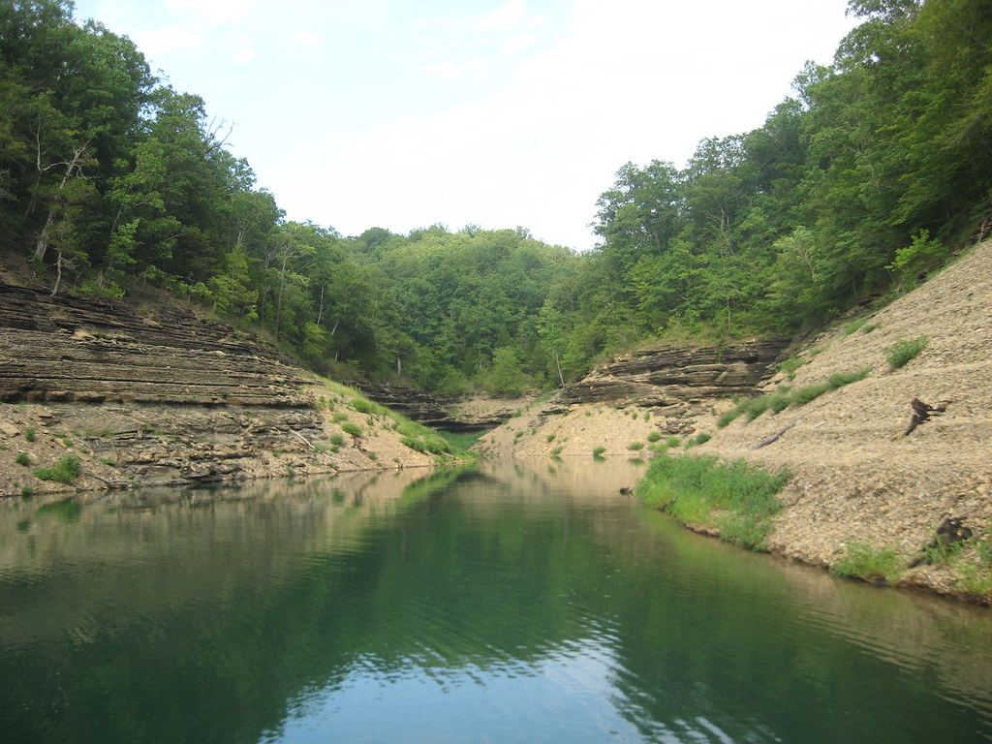
Waterline is a column property
A data stream can have multiple columns with lateness
Lateness has nothing to do with real time
It works on any data type that has a “minus” and a “greater than” operation
The waterlines of various columns move independently
Data arriving below waterline will be
thrown away
logged to an error stream

Slide 22
Monotone functions
SELECT (ts + 10)/5 AS ts1, … FROM DATA;
(ts + 10)/5 is a monotone function of the input value ts
(assuming no wrap-around arithmetic!)
The waterline is a monotone function of time
The ts1 column also has a waterline!
$$map(λx.\frac{x+10}{5})$$
$$π$$
Waterline of ts
waterline of ts1

Slide 23
Composition
$$σ$$
$$π$$
(streams of)
collections
$$⋈$$
singleton collections
data path
waterline

Slide 24
Incremental DISTINCT with GC
$$I$$
current change to
data
$$Δi$$
$$z^{−1}$$
rows that
added or removed from DISTINCT
$$∈$$
$$Δo$$

Slide 25
Incremental DISTINCT with GC
$$FI$$
$$+$$
current change to
data
$$σ$$
Controlled
filter
$$Δi$$
$$z^{−1}$$
$$z^{−1}$$
$$z^{−1}$$
Input
waterline
rows that
added or removed from DISTINCT
$$∈$$
$$Δo$$

Slide 26
Circuits with GC
$$σ$$
$$π$$
$$FI$$
$$FI$$
$$⋈$$
data path
waterline

Slide 27
What can we handle?
Construct | When can we do it
SELECT | Apply monotone functions to values with waterlines
WHERE | Input has waterline; compare against waterlines
NOW() | Has zero LATENESS
DISTINCT | Input has waterline
GROUP-BY/aggregate | GROUP BY key has waterline
JOIN | JOIN key has waterline; left side applies GC to right side of join
AS OF JOIN | MATCH_CONDITION has waterline
TUMBLE, HOP | Timestamp has waterline
WINDOW aggregate | ORDER BY column has waterline; any output column has a waterline
LAG/LEAD | WINDOW ordered by value with waterline

Slide 28
Summary
Incremental computations operate directly on changes
Data and changes can be represented using Z-sets
Incremental computations are stateful
State may grow unbounded
You are an integrator
LATENESS promises that inputs are “almost” ordered
Waterlines compute which data will never change
Forgetting things is a healthy behavior
State may be garbage-collected automatically

Slide 29
Extra slides

Slide 30
Data lake storage formats
Use two separate formats for data and changes
E.g. Parquet and JSON
Run compaction jobs to merge them
Scan both files on reads
Why not have a single format?
(at least for data changes)
Z-sets are commutative
Unlike tombstones
Partially compacted results are always correct

Slide 31
The chain rule
V
V
$$ΔV$$
You need to know $Q^{Δ}$ for all primitive operations $Q$ (e.g., select, project, join, etc.)
Just put them together!
$$Q2$$
$${Q2}^{Δ}$$
$$Q1$$
$${Q1}^{Δ}$$
$$ΔDB$$

Slide 32
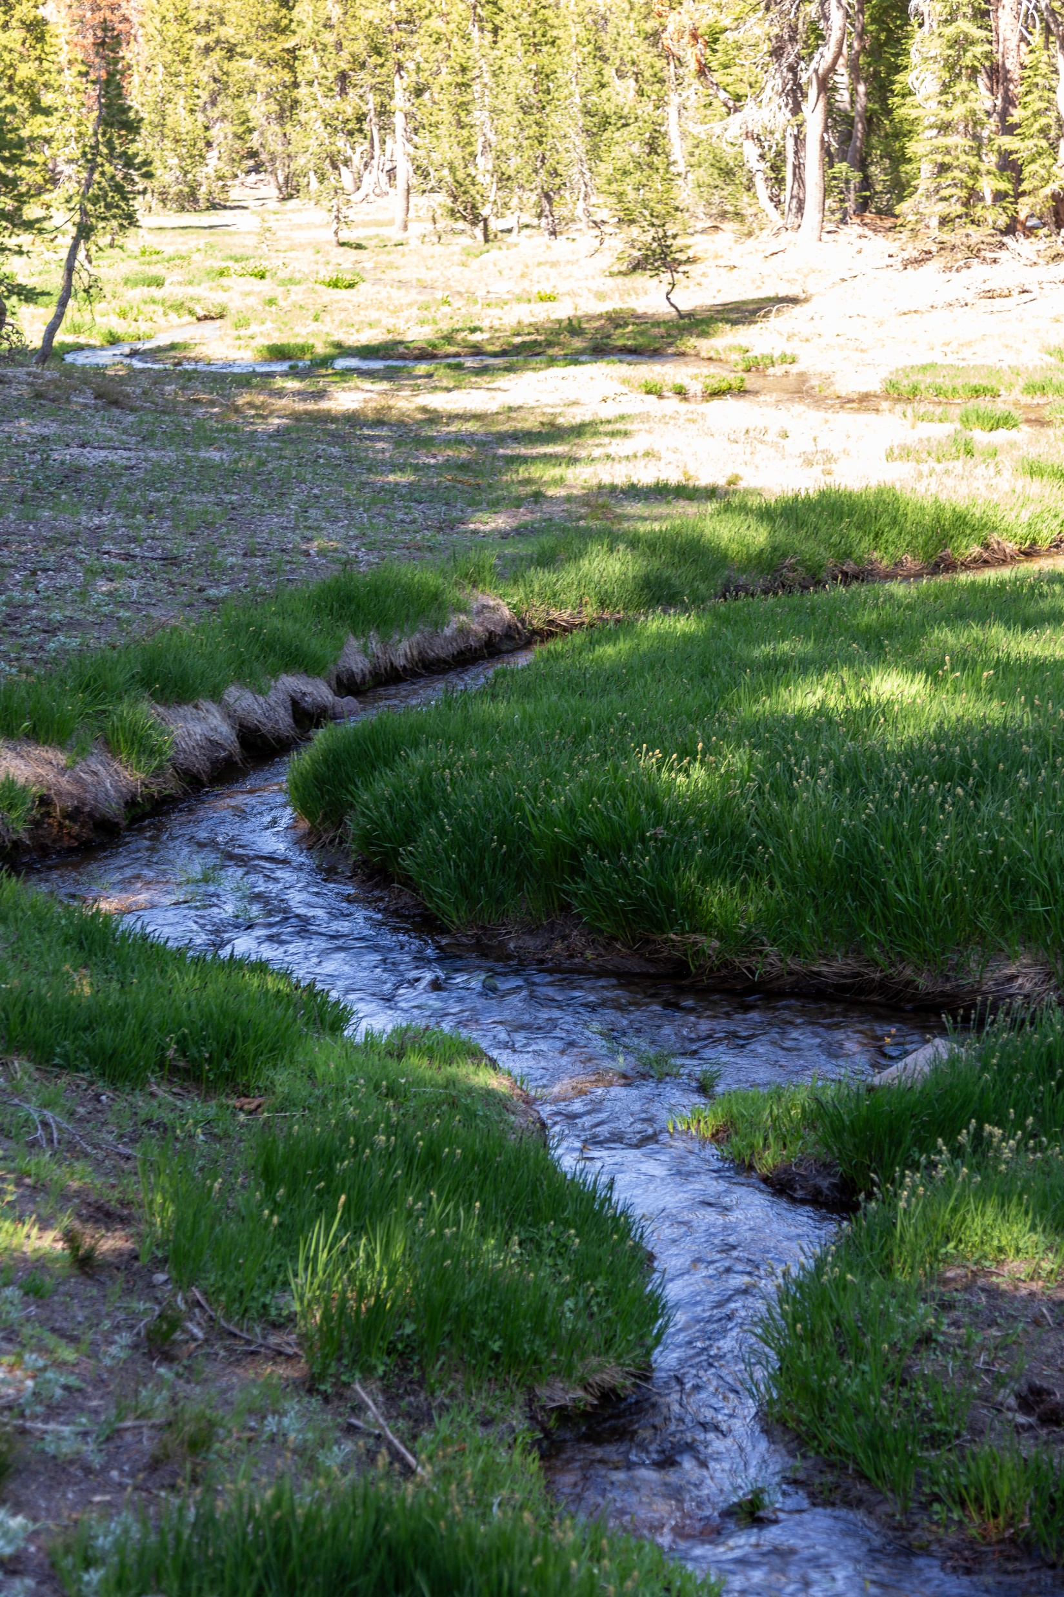
Streams
Infinite sequences
-1
-2
-1
0
1
2
1

Slide 33
Some interesting streams
Stream of database
snapshots
DB[0]
DB[1]
DB[2]
DB[3]
$$ΔDB[0]$$
$$ΔDB[1]$$
$$ΔDB[2]$$
$$ΔDB[3]$$
… transactions
V[0]
V[1]
V[2]
V[3]
… view
snapshots
$ΔV$[0]
$ΔV$[1]
$$ΔV[2]$$
$$ΔV[3]$$
… view
changes

Slide 34
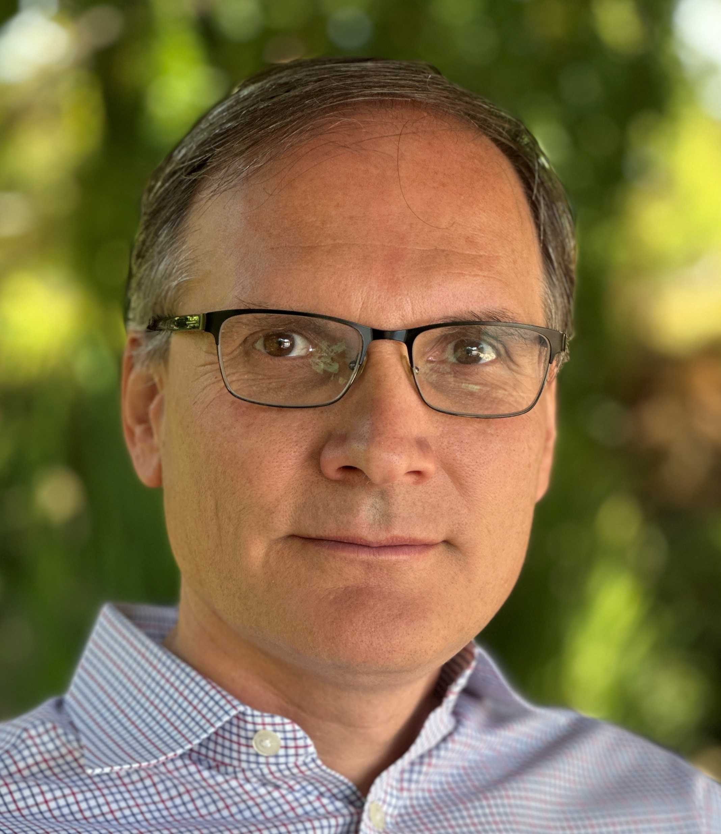
Mihai Budiu - Short bio
Ph.D. from Carnegie Mellon
Past: Microsoft Research, Barefoot Networks, VMware Research
feldera.com – chief scientist
Apache Calcite PMC member
https://mihaibudiu.github.io

Slide 35
Operators that require indexes
AGGREGATE (1 element/group)
DISTINCT (entire set)
JOIN (one index for each input)
ANTIJOIN, INTERSECT

Slide 36
Applying changes = Adding Z-sets
+
=
$$Δ$$
$$Δ$$
DB[0]
DB[1]
DB[0]
DB[1]
…
$Δ$[0]
$$Δ[1]$$
$Δ$[2]
DB[0]
DB[1]
DB[2]
DB[3]
DB[N]
+
+
+
+
…
=
$$Δ[0]$$
$$Δ[1]$$
$$Δ[2]$$
DB[0]
DB[N]
integration

Slide 37
Automatic Incremental View Maintenance
$$Q$$
V
V
$Q$ plan
$$ΔV$$
$$Q$$
$$Q^{Δ}$$
Compiler
$$ΔDB$$
$$ΔDB$$
$$ΔV$$
$$ΔDB$$
$$Q^{Δ}$$
plan
$$ΔV$$
$$ΔDB$$
$$Q^{Δ}$$
$$ΔV$$
$$ΔDB$$
$$ΔV$$

Slide 38
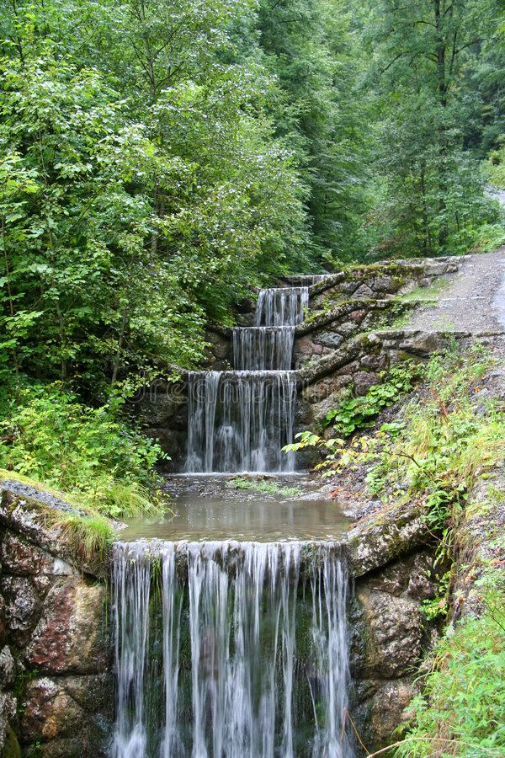
Idea #1
Databases,
transactions,
views, and
view changes
are streams

Slide 39
Idea #2: Z-sets
Can represent both tables and changes to tables
Positive weights = rows added
Negative weights = rows removed
Can represent sets and multisets
Classic DB table = Z-set where all weights are 1

Slide 40
Views are stream computations
$$Q$$
$Q$ plan
V
V
V
V
$Q$ plan

Slide 41
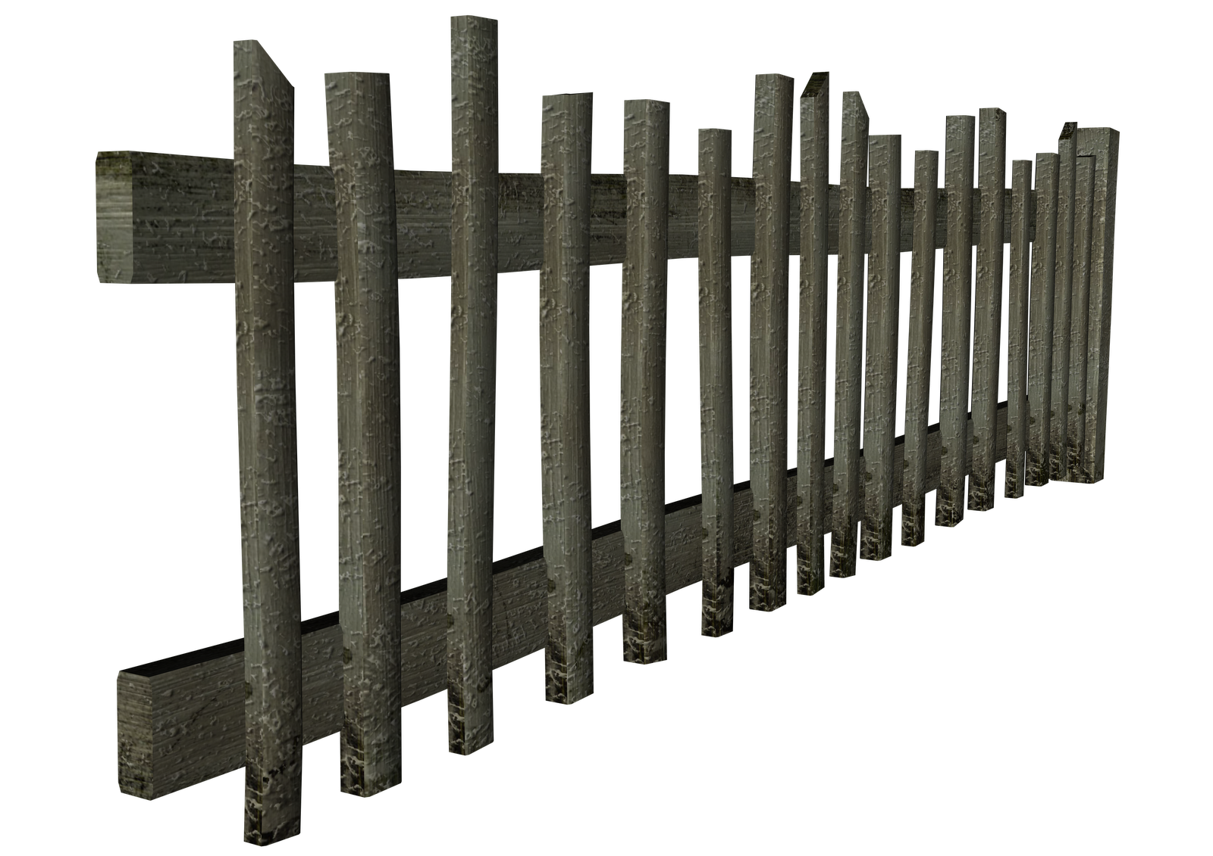
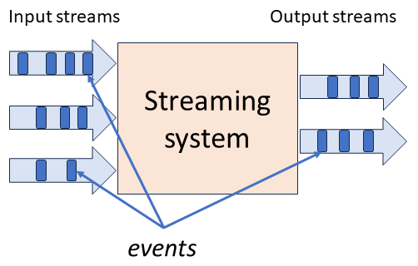
stream
DB
IVM
IVM
Database

Slide 42
Some incremental operators are easy
CREATE VIEW V AS SELECT * FROM T WHERE Age >= 10
V
V
$$Q$$
$$Δ$$
$$Q$$
$$Q^{Δ}$$
$$ΔV=$$
SELECT * FROM $Δ$T WHERE Age >= 10
?
$$Q^{Δ}$$
$$Δ$$

Slide 43
It’s not always obvious
CREATE VIEW V AS SELECT DISTINCT * FROM T WHERE Age >= 10
$$Q$$
?
$$Q^{Δ}$$

Slide 44
try.feldera.com
github.com/feldera/feldera
www.feldera.com/community

