Slide 1
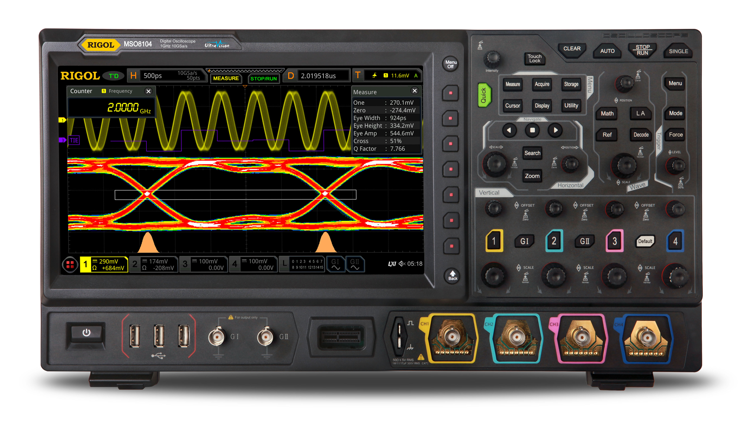
D^{B}SP Databases as signal processors (a formal model of streaming incremental computation)
Mihai Budiu, Leonid Ryzhyk - VMWare Research
Frank McSherry – Materialize.io
Val Tannen – University of Pennsylvania
October 6, 2021
VMware Research

Slide 2
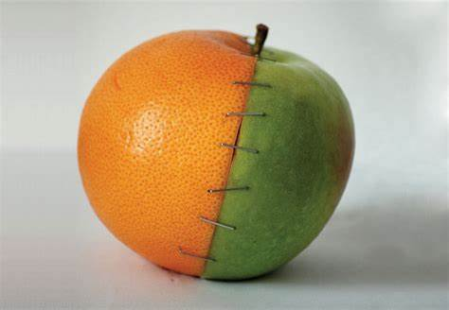
What will you see today
A simple mathematical model
Combining two well-known formalisms
Digital Signal Processing (DSP)
Relational Database Theory
The result is a model and a programming language for incremental and streaming computation
This formalism seems to be new
Simpler than alternative proposals
But this work has not been published or peer-reviewed yet

Slide 3
Outline
Basics of Digital Signal Processing
Incremental computation
Relational algebra as DSP
Incremental view maintenance
Efficient incremental computations

Slide 4
Analog and digital signals
Analog to digital conversion
Digital to analog conversion

Slide 5
Nyquist–Shannon sampling theorem
If a signal contains no frequencies higher than B hertz, it is completely determined by giving its values at a series of points spaced 1/(2B) seconds apart.
You can compute on the digital version without information loss
Our ears cannot hear more than 20khz
CDs sampling rate is 44.1khz

Slide 6
Streams
A stream is a discrete sequence of values
Aka, an unbounded vector
$s =$ …
Formally: a function $s: ℕ → ℝ$
We write $s[t]$instead of $s(t)$
For this example: $s[0] = 0$, $s\left[1\right]=1$
We can have streams with values of any type $A$
Type of streams over $A$ denoted by $S_{A}= ℕ →A$
Think of audio streams as values from $S_{ℝ}$
0
1
2
1
0
-1
-2
-1

Slide 7
Stream operators
Functions from streams to streams:$Q:S_{A}→ S_{B}$
Operators can have multiple inputs: $T:S_{A_{0}}×S_{A_{1}}→S_{B}$
Streams = arrows, operators = boxes
We only deal with deterministic operators: output fully determined by input (no random(), no hidden inputs)
$$i_{0}$$
$$i_{1}$$
$$i_{2}$$
…
$$Q$$
$$o_{0}$$
$$o_{1}$$
$$o_{2}$$
…
…
$$T$$
…
…

Slide 8
Lifting
We can convert any function $f:ℝ→ ℝ$ into a function $↑f$on streams
Just apply the function to each stream value
$↑f:Sℝ→Sℝ$ defined as $(↑f)\left(s\right)\left[t\right]=f\left(s\left[t\right]\right)$
In other words, $(↑f)\left(s\right)=f∘s$ (remember that a stream $s: ℕ→ ℝ$ is also a function)
$$a$$
$$b$$
$$c$$
…
$$↑f$$
$$f(a)$$
$$f(b)$$
$$f(c)$$
…

Slide 9
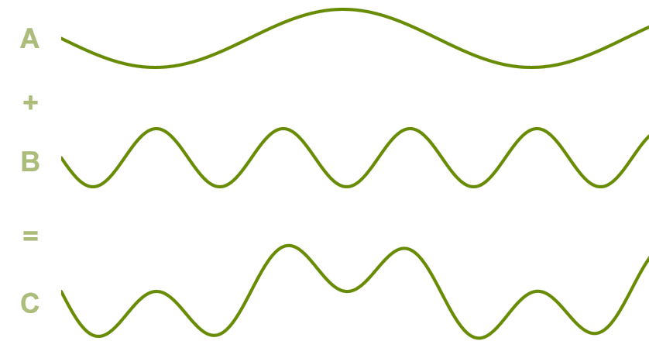
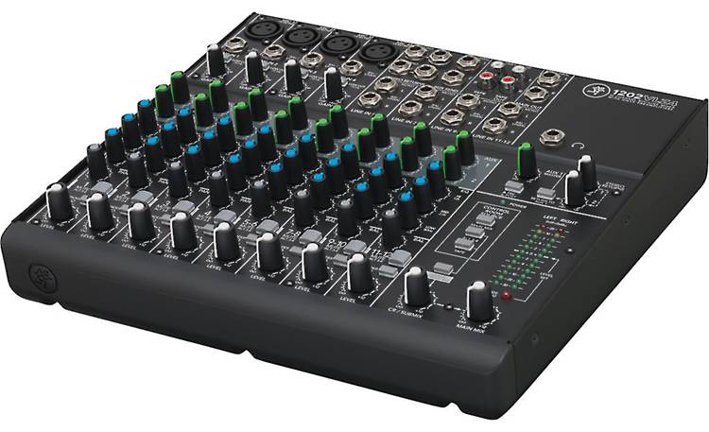
Addition
Given two (synchronized) streams we can add them pointwise
$+:S_{ℝ}×S_{ℝ}→S_{ℝ}$ by lifting $+: ℝ×ℝ→ℝ$
${(s}_{0} + s_{1})\left[t\right]= s_{0}\left[t\right]+ s_{1}[t]$
Audio mixing
$$1$$
$$2$$
$$3$$
…
+
5
7
$$9$$
…
$$4$$
$$5$$
$$6$$
…

Slide 10
Silence
There is a special stream 0$:S_{ℝ}, s\left[t\right]=0, ∀t∈ℕ$
This is the sound of silence
0 is the neutral element for stream addition

Slide 11
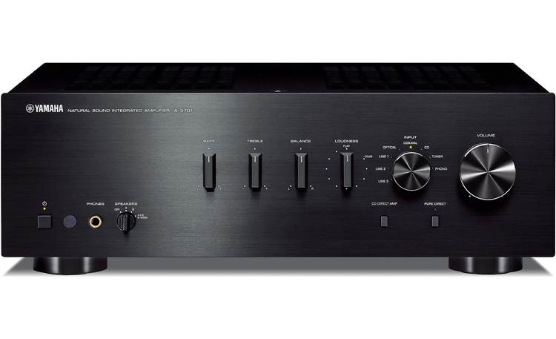
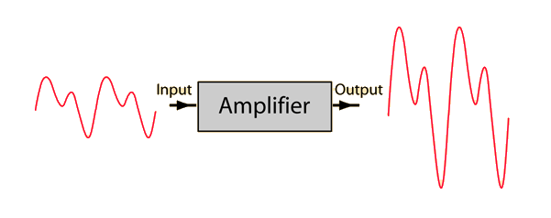
Amplification
Increase amplitude by a factor of $c$
Take the scaling function $a_{c}:ℝ→ℝ$, defined by $a_{c}(x)=cx$
Now lift this function to streams:
${↑ac: S}_{ℝ}→S_{ℝ}$ given by $((↑a_{c})\left(s\right))\left[t\right]=c⋅s[t]$
$$a$$
$$b$$
$$c$$
…
$$↑a_{c}$$
$$ca$$
$$cb$$
$$cc$$
…

Slide 12
Negation
Defined as the lifted version of unary minus
$−:S_{ℝ}→S_{ℝ}$
$\left(− s\right)\left[t\right]=−(s\left[t\right])$
$$a$$
$$b$$
$$c$$
…
$$−$$
$$−a$$
$$−b$$
$$−c$$
…

Slide 13
Delay ($z^{−1}$ )
Output is the input delayed by one time unit
First value is 0
The name $z^{−1}$ comes from the DSP literature (z-transform)
$z^{−1}:S_{ℝ}→S_{ℝ}$
$$z^{−1}\left(i\right)\left[t\right]=\left\{\begin{aligned}0, t=0 \\ &i[t−1], t>0\end{aligned}\right.$$
$$a$$
$$b$$
$$c$$
$$d$$
…
$$z^{−1}$$
$$0$$
$$a$$
$$b$$
$$c$$
…

Slide 14
Chaining operators into circuits
Chaining two operators is mathematically just function composition
$o=C(B(A\left(i\right)))$
One can see the composition of several operators as a mega-operator
i
$$A$$
$$B$$
$$C$$
o

Slide 15
Noise cancellation
Predict future values (easy for periodic signals)
Generate a negated stream
Add it to original stream
i
+
o
-

Slide 16
Circuit equivalence
We say that two circuits are equivalent if they compute the same result given the same inputs
Example: because function composition is associative, these two circuits are equivalent:
i
$$A$$
$$B$$
$$C$$
$$⇔$$
i
$$A$$
$$B$$
$$C$$

Slide 17
Time-invariance
A stream operator is time-invariant if does not “depend on time”
I.e., If you delay the input, you get a delayed output
$T$ below is time-invariant iff the two circuits shown equivalent:
We only use time-invariant operators
$↑f$ is time-invariant iff $f\left(0\right)=0$
Example of an operator which is not time-invariant: $Q\left(s\right)\left[t\right]= s\left[t\right]+ t mod 2$

Slide 18
Causal operators
A stream operator $Q$ is causal if $∀t . Q(i)[t]$ only depends on $i\left[0\right]… i\left[t\right]$ (past and present inputs) and not on $i[t+1]$, … (future inputs)
All our operators are causal
Example non-causal operator: play a song in reverse

Slide 19
Differentiation
What does this circuit compute?
$o\left[t\right]=s\left[t\right]–s\left[t−1\right]$
$o\left[0\right]=s\left[0\right]$
o is the derivative of s
The discrete version of the continuous derivative
o
We will denote this circuit by $D:S_{A}→S_{A}$
o is the stream of changes of s
$$1$$
$$2$$
$$3$$
$$2$$
…
$$D$$
$$1$$
$$1$$
$$1$$
$$−1$$
…
stream of changes

Slide 20
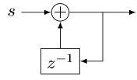
Integration
Denote this operator by $I: S_{A}→S_{A}$
If s is a stream of changes
Then o is the original stream
What does this circuit compute?
This looks weird: o is recursively defined!
But this is well-defined
$o[0] =s[0]$
$o[t] =s[t] + o[t−1]$
This has a unique solution: $o\left[t\right]=\sum_{k=0}^{t}{s\left[t\right]}$
$o$ is the integral of $s$
The discrete version of the continuous indefinite integral
o
$$1$$
$$1$$
$$1$$
$$−1$$
…
$$I$$
$$1$$
$$2$$
3
$$2$$
…
stream of changes

Slide 21
Some properties
$I$ and $D$ are
deterministic
causal
time-invariant
Theorem: $I∘D=D∘I=id$ (or $I=D^{−1}$)

Slide 22
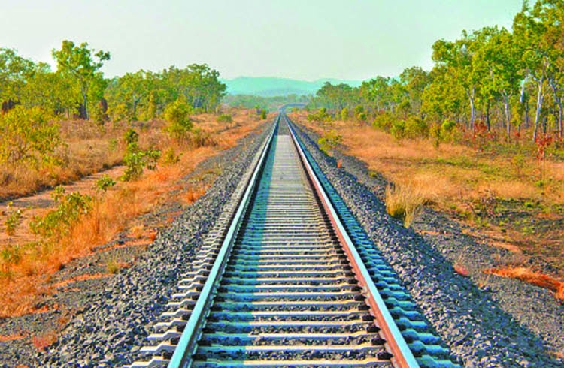
Linear operators
A unary stream operator $Q:S_{ℝ}→S_{ℝ}$ is linear if:
$$∀s,t∈S_{ℝ}.Q\left(s+t\right)=Q\left(s\right)+Q\left(t\right)$$
Theorem: amplification, $−$, $I$, $D$, $z^{−1}$ are linear
Theorem: the composition of linear operators is linear

Slide 23
Bilinear operators
A binary operator $T:S_{ℝ}×S_{ℝ}→S_{ℝ}$ is bilinear if it distributes over addition:
$$∀s,t, u,v∈S_{ℝ}$$
$$T\left(s+t, u\right)=T\left(s, u\right)+T\left(t, u\right)$$
$$T\left(s, u+v\right)=T\left(s, u\right)+T\left(s, v\right)$$
Example: the lifted version of multiplication: $T\left(s,u\right)\left[t\right]=s\left[t\right]×u[t]$

Slide 24
Incremental computation
Consider an arbitrary stream operator $Q:S_{A}→S_{B}$
Define the incremental version of $Q$ as $Q^{Δ}≝D∘Q∘I$
$Q^{Δ}$ is a “version” of $Q$ that computes on changes
$$Q^{Δ}$$
di
$$I$$
$$Q$$
D
do
Stream of input changes
Stream of output changes
Stream of inputs
Stream of outputs

Slide 25
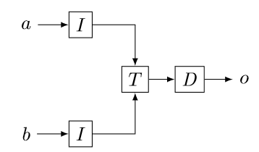
Incremental operators with multiple inputs
Everything generalizes to multiple inputs and circuits
E.g., for a binary stream operator $T:S_{A_{0}}×S_{A_{1}}→S_{B}$
$$T^{Δ}$$

Slide 26
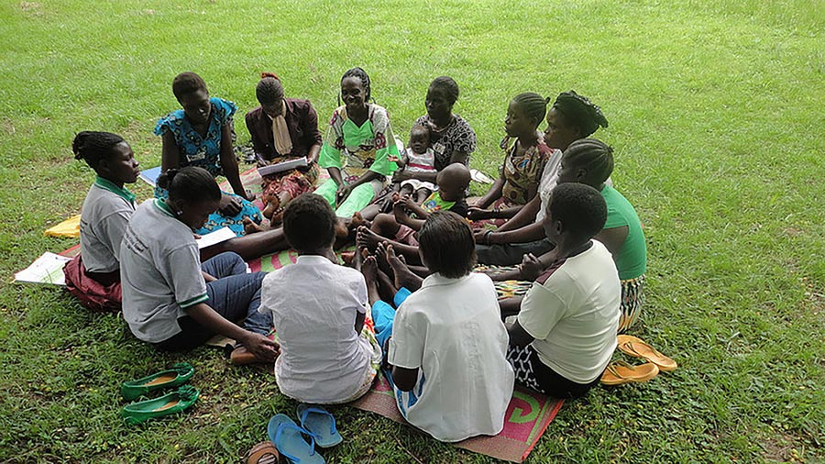
Streams as groups
Theorem: $S_{ℝ}$ is a commutative group
Recall that a group has 3 operations:
an associative addition operation: $a+b$
a neutral element for addition 0
and an inverse for each element (negation):$−a$
Generally: If $A$is a commutative group, $SA$ is also a commutative group
All streaming operations/properties described so far are well-defined/hold for an arbitrary commutative group $SA$
Time-invariance, determinism, causality, integration, differentiation, linearity, bilinearity, delay, incrementality, etc. (except amplification)

Slide 27
Outline
Basics of Digital Signal Processing
Incremental computations
Relational algebra as DSP
Incremental view maintenance
Converting DB queries to circuits
Efficient incremental computations

Slide 28
Databases
A relational database = collections of tables
A table = set of typed tuples
Table
Name | Age
Mike | 10
John | 12
Amy | 8
Chris | 10

Slide 29
Computing on tables
SQL queries are functions from tables to tables: $$Q:T_{0}×…×T_{n}→T$$
Table
Query
Query result
Name | Age
Mike | 10
John | 12
Amy | 8
Chris | 10
Name | Age
Mike | 10
John | 12
Chris | 10
SELECT * FROM Table WHERE Age >= 10

Slide 30
Views
A database VIEW is a virtual table described by a query
The view contents is automatically updated when the tables it depends on are changed
CREATE VIEW V AS
SELECT * FROM Table
WHERE Age >= 10
In most practical cases a change is much smaller than the table modified

Slide 31
Datalog
Essentially an alternative language to SQL for describing views (Datalog views are always sets – no duplicates allowed)
Differential Datalog (DDlog) is a dialect of Datalog with extra features
CREATE VIEW V AS
SELECT DISTINCT * FROM Table
WHERE Age >= 10
V(name, age) :- Table(name, age), age >= 10.
SQL
Datalog

Slide 32
Views as streaming databases
Let $Q$ be a query defining a view $V$ as a function of table $T$: $V=Q(T)$
An efficient computation of $Q$ should implement the streaming operator $Q^{Δ}=D∘Q∘I$which:
Given changes to $T$
Computes changes to $V$
$$Q^{Δ}$$
$$ΔT_{0}$$
$$ΔT_{1}$$
$$ΔT_{2}$$
$$ΔT_{3}$$
…
$$I$$
$$Q$$
D
$$ΔV_{0}$$
$$ΔV_{1}$$
$$ΔV_{2}$$
$$ΔV_{3}$$
…
Insertions or deletions in $T$ for each time
Insertions or deletions to $V$ for each time
$$V_{0}$$
$$V_{1}$$
$$V_{2}$$
$$V_{3}$$
…
Version of $V$ for each time
Version of $T$ for each time
$$T_{0}$$
$$T_{1}$$
$$T_{2}$$
$$T_{3}$$
…

Slide 33
Hold on! This is not well-defined!
The definitions of $I$, $D$ require streams over a commutative group
$I:S_{A}→S_{A}$ for some commutative group $A$
However, tables (sets, multisets) are not groups
E.g., there is no table negation
Small change of perspective needed (this is well-known DB stuff):
Generalize tables to obtain a commutative group

Slide 34
$ℤ$-Relations
Generalize sets so that each element has an integer weight
The weight can be positive, zero, or negative
You can think of a $ℤ$-relation as a key-value map where the key=tuple and value=weight
Formally a $ℤ$-relation over $T$ is a function $r$ with finite support $r: T→ℤ$
$T$ is the type of the tuples
Convenient notations:
$ℤ[T]$ for the type of $ℤ$-relation with elements of type $T$
$r[t]$ for the weight of tuple $t∈T$
Tuples in $T$ not shown have weight 0
Finite support = finite number of rows
Name | Age | Weight
Mike | 10 | 1
John | 12 | 3
Amy | 8 | -1
Chris | 10 | 2
tuples

Slide 35
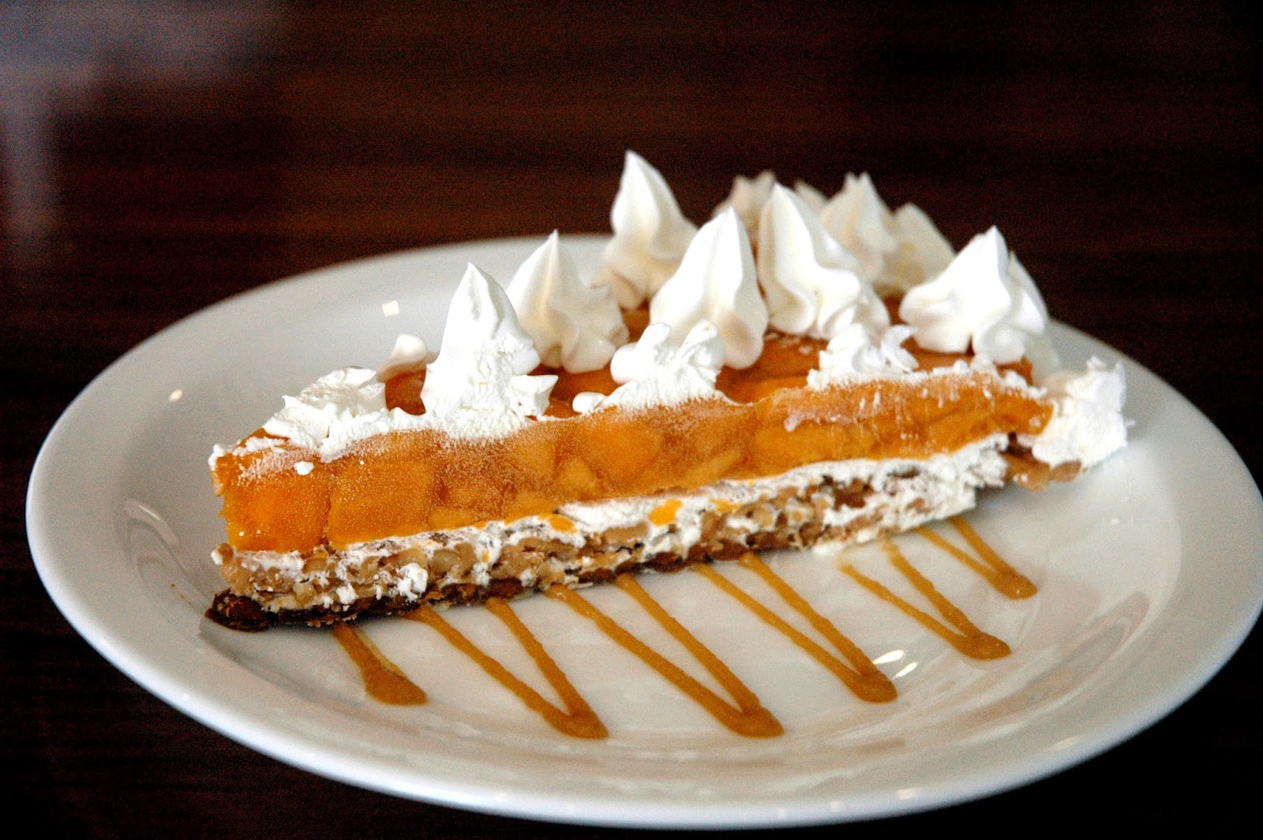
$ℤ$-Relations are good!
Can represent both tables and changes to tables
Positive weights = elements added
Negative weights = elements removed
Generalize sets and multisets
Classic DB table = $ℤ$-Relation where all weights are 1
Form a commutative group (because $ℤ$ is a group)
Addition is pointwise tuple weight addition
${(r}_{1}+ r_{2})[t]= r_{1}[t]+ r_{2}[t]$
Zero is an empty table
Negation just negates all weights

Slide 36
Example: adding two $ℤ$-Relations
Name | Age | Weight
Mike | 10 | 1
John | 12 | 3
Amy | 8 | -1
Chris | 10 | 2
Name | Age | Weight
Mike | 10 | -1
Dan | 13 | 1
Chris | 10 | 1
Name | Age | Weight
Dan | 13 | 1
John | 12 | 3
Amy | 8 | -1
Chris | 10 | 3
+
=

Slide 37
Recipe: Solving incremental view update
Translate each DB query $Q_{SQL}$ (or $Q_{DDlog})$ into an equivalent streaming circuit $Q$ on $ℤ$-relations
Convert the streaming circuit $Q$ into its incremental version $Q^{Δ}$
Efficiently implement $Q^{Δ}$
NOW
Done
Last part of talk

Slide 38
Definition of Differential Datalog
The Differential Datalog compiler
receives as input a query $Q$, written in Datalog
Produces as output an implementation of $Q^{Δ}$, written in Rust
stream of input changes
DDLog
program
DDlog compiler
Rust
Program
$$Q^{Δ}$$
Rust compiler
Native library
$$Q$$
stream of output changes
Differential dataflow
library

Slide 39
From queries to circuits
DB operators => computations on $ℤ$-Relations
This is a well-known part of DB theory
Basic relational algebra :
Select
Project
Cartesian products/joins
Set operations (union, difference, etc.)
In practice more needed: grouping, aggregates, anti-joins, etc. We handle these too, but not in this talk.

Slide 40
Multiset union (can have duplicates)
CREATE VIEW O AS SELECT * FROM table1 UNION ALL SELECT * FROM table2
From now on I will omit the “CREATE VIEW” part.
table1
+
o
table2

Slide 41
Eliminating duplicates: distinct
An operator to eliminate duplicates
$distinct:ℤ\left[T\right]→ℤ\left[T\right]$
$ℤ$-relation
tuple
weight
Name | Age | Weight
Mike | 10 | 1
John | 12 | 3
Amy | 8 | -1
Name | Age | Weight
Mike | 10 | 1
John | 12 | 1
$distinct$(
$$)=$$

Slide 42
Set union (no duplicates)
SELECT * FROM table1 UNION SELECT * FROM table2
O(x) :- Table1(x). O(x) :- Table2(x).
SQL
Datalog
table1
+
$$↑distinct$$
o
table2

Slide 43
Set difference
SELECT * FROM table1 EXCEPT SELECT * FROM table2
O(x) :- Table1(x), not Table2(x).
table1
+
$$↑distinct$$
o
table2
-
Note: distinct will remove elements with negative weights

Slide 44
Selection (filtering)
SELECT * FROM table WHERE predicate
O(t) :- Table(t), predicate(t).
Name | Age | Weight
Mike | 10 | 1
John | 12 | 3
Amy | 8 | -1
Chris | 10 | -2
Name | Age | Weight
Mike | 10 | 1
John | 12 | 3
Chris | 10 | -2
WHERE Age >= 10

Slide 45
Selection (filtering)
SELECT * FROM table WHERE predicate
O(t) :- Table(t), predicate(t).
$$σ:ℤ\left[T\right]→ℤ[T]$$
$$σ\left(m\right)[t]=\left\{\begin{aligned}m\left[t\right], if predicate(t) \\ 0, otherwise\end{aligned}\right.$$
$$table$$
$$↑σ$$
o
$σ$ keeps all tuples for which the predicate is true.

Slide 46
Query composition
SELECT … FROM (SELECT … FROM …)
E(y) :- Table(x),…. O(z) :- E(y),….
E
Table
$$Q_{1}$$
$$Q_{2}$$
O
Query composition is circuit chaining (function composition).

Slide 47
Cartesian products
O(t1, t2) :- Table1(t1), Table2(t2).
SELECT table1.*, table2.* FROM table1, table2
Name | Age | Weight
Mike | 10 | 1
John | 10 | 3
Amy | 10 | -1
Chris | 10 | 2
Mike | 12 | 3
John | 12 | 9
Amy | 12 | -3
Chris | 12 | 6
Name | Weight
Mike | 1
John | 3
Amy | -1
Chris | 2
Age | Weight
10 | 1
12 | 3
x
=
Multiply weights.

Slide 48
Cartesian products
O(t1, t2) :- Table1(t1), Table2(t2).
SELECT table1.*, table2.* FROM table1, table2
$m_{1}∈ℤ\left[T_{1}\right],$ $m_{2}∈ℤ\left[T_{2}\right]$, ($m_{1}×m_{2})\left[\left(t_{1}, t_{2}\right)\right]≝m_{1}\left[t_{1}\right]⋅m_{2}\left[t_{2}\right]$
table1
$$↑×$$
o
table2

Slide 49
(Equi)Joins
SELECT Name, Age FROM TABLE1 JOIN TABLE2 ON TABLE1.Name=TABLE2.Name
O(Name, Age) :- Table1(Name, Age), Table2(Name, _).
table1
$$↑×$$
$$↑σ$$
o
table2
Cartesian product followed by filtering.

Slide 50
Recursive computations
Reach(x, y) :- Edge(x, z), Reach(z, y).
Very nasty in SQL
This is very interesting, but I don’t have time to show it today.
It requires using some new, unusual circuit operators, and streams of streams…

Slide 51
Outline
Basics of Digital Signal Processing
Relational algebra as DSP
Efficient incremental computations

Slide 52
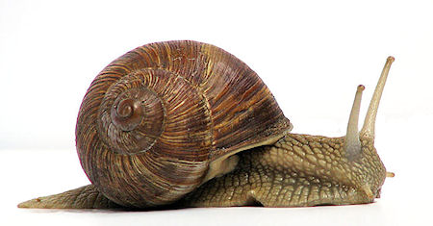
Is $Q^{Δ}$ efficient to compute?
$Q^{Δ}=D∘Q∘I$ is a definition of incremental computation
As written, it is very expensive to compute
It is even worse that just computing just $Q$:
It recomputes the whole input using $I$
However, we can often optimize the computation significantly

Slide 53
Linear operators
Theorem: For a linear operator $Q$ we have $Q=Q^{Δ}$
Theorem: Most operators used by SQL & DDlog are linear:
select, project, add, negate, filter, map, flatmap, etc.
Why is this better?
Original:
Optimized:
A speedup of $O(\left|T\right|/|ΔT|)$
$$ΔT_{0}$$
$$ΔT_{1}$$
$$ΔT_{2}$$
$$ΔT_{3}$$
…
$$I$$
$$Q$$
D
$$ΔV_{0}$$
$$ΔV_{1}$$
$$ΔV_{2}$$
$$ΔV_{3}$$
…
$$T_{0}$$
$$T_{1}$$
$$T_{2}$$
$$T_{3}$$
…
$$ΔT_{0}$$
$$ΔT_{1}$$
$$ΔT_{2}$$
$$ΔT_{3}$$
…
$$Q$$
$$ΔV_{0}$$
$$ΔV_{1}$$
$$ΔV_{2}$$
$$ΔV_{3}$$
…

Slide 54
Example of a linear query
CREATE VIEW O AS SELECT DISTINCT * FROM Table WHERE Age >= 10
You don’t need to know Table to compute the changes to O
If you change Table by adding/subtracting $Δ$T
This query: SELECT DISTINCT * FROM $Δ$T WHERE Age >= 10 computes $Δ$O

Slide 55
The chain rule
$(Q_{2}{∘Q_{1})}^{Δ}=Q_{2}^{Δ}∘Q_{1}^{Δ}$
Proof by pictures:
We can incrementalize a complex circuit by incrementalizing each component independently
For a chain of linear operators: $(Q_{2}{∘Q_{1})}^{Δ}=Q_{2}^{Δ}∘Q_{1}^{Δ}=Q_{2}∘Q_{1}$
$$⇔$$
$$⇔$$
$$⇔$$

Slide 56
Bilinear operators
Join, intersection, Cartesian product
From distributivity:$Δ\left(A×B\right)=\left(A×ΔB\right)+\left(ΔA×B\right)+\left(ΔA×ΔB\right)$
Speed-up is $O(\min\left(\left|ΔA\right|/\left|A\right|, \left|ΔB\right|/\left|B\right|\right))$

Slide 57
Related work
Incremental View Maintenance
Streaming Databases
Streaming languages
Functional Languages
Category theory
Dataflow machines
Synchronous circuits

Slide 58
Conclusions
DSP circuits are a nice model of streaming computation
Circuits can compute on $ℤ$-relations (changes to DBs)
Recipe for incremental view maintenance:
Translate a DB query into a streaming circuit $Q$
Build incremental version of circuit:
$$Q^{Δ}≝D∘Q∘I$$
Efficiently implement $Q^{Δ}$ by optimizing circuit:
$$(Q{∘R)}^{Δ}=Q^{Δ}∘R^{Δ}$$

