Slide 1
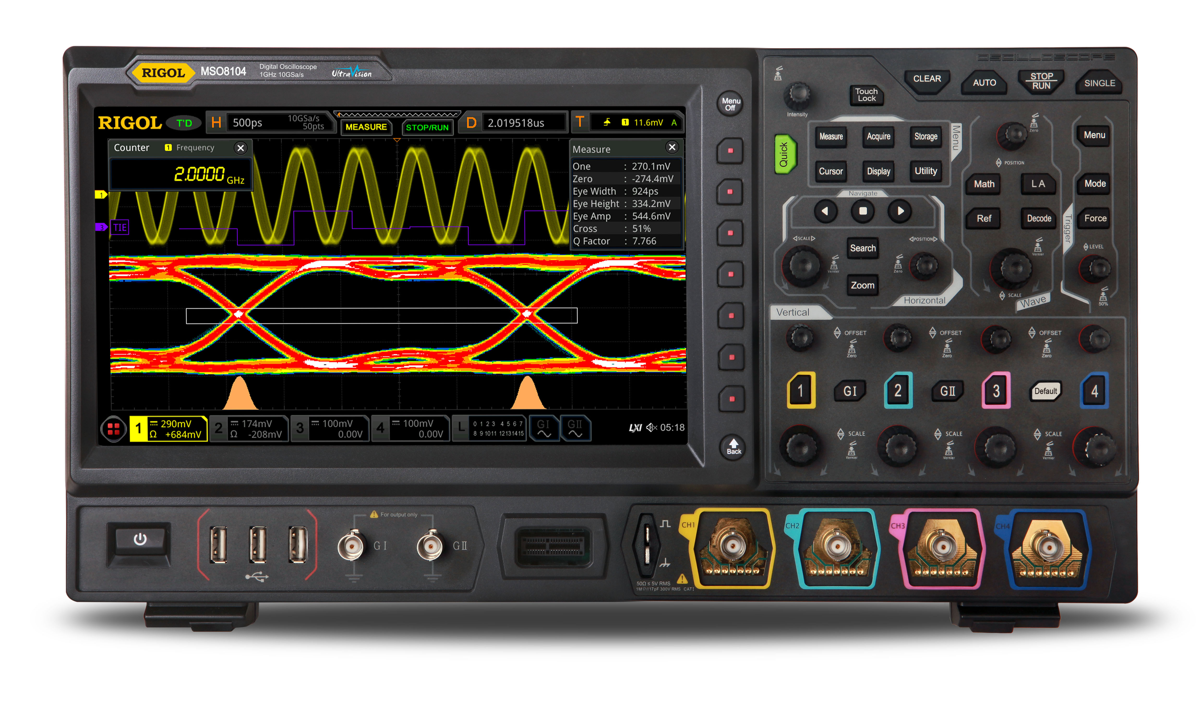
DBSP: incremental evaluation for arbitrarily complex queries on data streams
Mihai Budiu – .com
November 16, 2023
DANI seminar
Google

Slide 2
The theoretical treatment
Best paper award
DBSP: Automatic Incremental View Maintenance for Rich Query Languages Mihai Budiu, Tej Chajed, Frank McSherry, Leonid Ryzhyk, Val Tannen VLDB 2023

Slide 3
Outline
Incremental View Maintenance
Stream computations
Databases as streaming systems
Incremental computation on streams
Optimizing incremental circuits
DB queries in DBSP
Implementation

Slide 4
What is incremental computation?
Consider a program $P$
Change $I$ “slightly”
In general, this is hard to even define precisely
We need + and – operations to apply and compute changes
But it works great for databases:
Databases have a natural notion of “changes”
$P$ is a query, $I$ is a set of tables, and $ΔI$ is a transaction
Usually $\left|ΔI\right|≪|I|$ and $\left|ΔO\right|≪|O|$
Databases call this Incremental View Maintenance
$$I$$
$$P$$
$$O$$
reuse
$$I+ΔI$$
$$P$$
$$O+ΔO$$

Slide 5
Periodic query evaluation
$$Q$$
$$Q$$
Q
Q
Q
Changes ($Δ$)
$Δ$DB
$$ΔDB$$
$$ΔDB$$
$$ΔDB$$
$$ΔDB$$
100 rows
100 rows
100 rows
100 rows
100 rows
1B rows
Time

Slide 6
Views = Standing queries
V
$$Q$$
CREATE VIEW V AS SELECT * FROM T WHERE Age >= 10
A query $Q$
T

Slide 7
View maintenance
Work($Q$) $= O(|T|)$
$$Q$$
$$Q$$
$$Q$$
$$Q$$
$$Q$$
$$Δ$$
$$Δ$$
$$Δ$$
$$Δ$$
$$Δ$$
$$Δ$$
100 rows
100 rows
100 rows
100 rows
100 rows
1B rows
Time

Slide 8
Incremental View Maintenance
We would like Work($Q^{Δ}$) $= O(|ΔT|)$
V
V
V
V
V
$$Δ$$
$$Δ$$
$$Δ$$
$$Δ$$
$$Δ$$
$$Q$$
$$Q^{Δ}$$
$$Q^{Δ}$$
$$Q^{Δ}$$
$$Q^{Δ}$$
$$Q^{Δ}$$
$$Δ$$
$$Δ$$
$$Δ$$
$$Δ$$
$$Δ$$
$$Δ$$
100 rows
100 rows
100 rows
100 rows
100 rows
1B rows
Time

Slide 9
How to compute on changes?
CREATE VIEW V AS SELECT * FROM T WHERE Age >= 10
V
V
$$Q$$
$$Δ$$
$$Q$$
$$Q^{Δ}$$
$$ΔV=$$
SELECT * FROM $Δ$T WHERE Age >= 10
?
$$Q^{Δ}$$
$$Δ$$

Slide 10
This is what this work is about
$$Q$$
algorithm
$$Q^{Δ}$$
Work($Q^{Δ}$)/Work($Q$) = $O(|ΔT|/|T|)$
For essentially any query $Q$ you can write in any of the mainstream languages

Slide 11
It’s not always obvious
CREATE VIEW V AS SELECT DISTINCT * FROM T WHERE Age >= 10
$$Q$$
?
$$Q^{Δ}$$

Slide 12
Trade-offs
In general $Q^{Δ}$ can be much faster
But it may maintain a lot of internal state (indexes)
Time-space trade-off
$ΔV$ can be itself large
There is no easy way to change $Q$ itself
You can always use brute-force:
Feed the entire database as a big change

Slide 13
Outline
Incremental View Maintenance
Stream computations
Databases as streaming systems
Incremental computation on streams
Optimizing incremental circuits
DB queries in DBSP
Implementation

Slide 14
Streams
Infinite vectors
…
$S_{A}$= streams with elements of type $A$
We require $A$ to have $+, −, 0$
(a commutative group)
0
1
2
1
0
-1
-2
-1
time

Slide 15
Stream operators
Arrows = streams
boxes = operators
We only use deterministic operators
$$i_{0}$$
$$i_{1}$$
$$i_{2}$$
…
$$Q$$
$$o_{0}$$
$$o_{1}$$
$$o_{2}$$
…
…
$$T$$
…
…

Slide 16
Lifting
Convert a function $f:A→B$ into a stream operator $↑f:S_{A}→S_{B}$
$$a$$
$$b$$
$$c$$
…
$$↑f$$
$$f(a)$$
$$f(b)$$
$$f(c)$$
…

Slide 17
Chaining operators into circuits
“Dataflow graphs”
$$i1$$
$$A$$
$$B$$
$$C$$
o
$$i2$$
$$D$$

Slide 18
Delay ($z^{−1}$ )
Output is input stream delayed by one step
First value is 0
$$a$$
$$b$$
$$c$$
$$d$$
…
$$z^{−1}$$
$$0$$
$$a$$
$$b$$
$$c$$
…

Slide 19
Computing changes (deltas) Differentiation
$$o\left[t\right]=s\left[t\right]–s\left[t−1\right]$$
o
o is the stream of changes of s
$$1$$
$$2$$
$$3$$
$$2$$
…
$$D$$
$$1$$
$$1$$
$$1$$
$$−1$$
…
stream of deltas

Slide 20
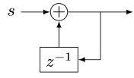
Integration
$o[0] =s[0]$
$o[t] =s[t] + o[t−1]$
$o\left[t\right]=s\left[0\right]+s\left[1\right]+ …+s[t]$
o
If s is a stream of changes…
… then o is the original stream
$$1$$
$$1$$
$$1$$
$$−1$$
…
$$I$$
$$1$$
$$2$$
3
$$2$$
…
stream of changes

Slide 21
$D$ and $I$ are inverses
$$Δs$$

Slide 22
Outline
Incremental View Maintenance
Stream computations
Databases as streaming systems
Incremental computation on streams
Optimizing incremental circuits
DB queries in DBSP
Implementation

Slide 23
All databases are streaming databases!
Consider a database $DB$, a set of tables
A committed transaction is a change to $DB$
The set of linearized transactions define $T,$ a stream of changes to $DB$
$T[k]$is the $k$-th transaction
$DB$ is a stream of database snapshots
$DB[k]$ is the contents of the database after $k$ transactions have been committed
$DB[k] = I(T)[k$]
A database (stream) is the integral of a transaction stream
$$T_{0}$$
$$T_{1}$$
$$T_{2}$$
$$T_{3}$$
…
$$I$$
$${DB}_{0}$$
$${DB}_{1}$$
$${DB}_{2}$$
$${DB}_{3}$$
…

Slide 24
Views are lifted queries
Let $Q$ be a query defining a view $V$, e.g.:
CREATE VIEW V AS SELECT * FROM T WHERE Age >= 10
$V[k]=Q\left(DB[k]\right)$
$V$ is a stream of view snapshots:
$$V= ↑Q(DB)$$
$$↑Q$$
$$V_{0}$$
$$V_{1}$$
$$V_{2}$$
$$V_{3}$$
…
Versions of $V$
Versions of $DB$
$${DB}_{0}$$
$${DB}_{1}$$
$${DB}_{2}$$
$${DB}_{3}$$
…

Slide 25
Outline
Incremental View Maintenance
Stream computations
Databases as streaming systems
Incremental (DB) computations
Optimizing incremental circuits
DB queries in DBSP
Implementation

Slide 26
Incremental view maintenance of view $V$
$${(↑Q)}^{Δ}$$
$$T_{0}$$
$$T_{1}$$
$$T_{2}$$
$$T_{3}$$
…
$$I$$
$$↑Q$$
D
$$ΔV_{0}$$
$$ΔV_{1}$$
$$ΔV_{2}$$
$$ΔV_{3}$$
…
Changes to $DB$
Changes to $V$
$$V_{0}$$
$$V_{1}$$
$$V_{2}$$
$$V_{3}$$
…
Versions of $V$
Versions of $DB$
$${DB}_{0}$$
$${DB}_{1}$$
$${DB}_{2}$$
$${DB}_{3}$$
…

Slide 27
Incremental view maintenance
${(↑Q)}^{Δ}≝ D∘(↑Q)∘I$
This is our definition of IVM
This definition is much better:
It is compositional
Inputs and outputs are both deltas
$${(↑Q)}^{Δ}$$
$$T_{0}$$
$$T_{1}$$
$$T_{2}$$
$$T_{3}$$
…
$$I$$
$$↑Q$$
D
$$ΔV_{0}$$
$$ΔV_{1}$$
$$ΔV_{2}$$
$$ΔV_{3}$$
…
Changes to $DB$
Changes to $V$
$$V_{0}$$
$$V_{1}$$
$$V_{2}$$
$$V_{3}$$
…
Versions of $V$
Versions of $DB$
$${DB}_{0}$$
$${DB}_{1}$$
$${DB}_{2}$$
$${DB}_{3}$$
…

Slide 28
Incremental queries are streaming systems
$${Δi}_{0}$$
$${Δi}_{1}$$
$${Δi}_{2}$$
$${Δi}_{3}$$
…
$$Q^{Δ}$$
$$Δo_{0}$$
$$Δo_{1}$$
$$Δo_{2}$$
$$Δo_{3}$$
…
state
$Q^{Δ}$ is a streaming system:
it runs forever
it maintains internal state (even if $Q$ is stateless)
the state is stored in the delay operators (inside $I$ and $D$)

Slide 29
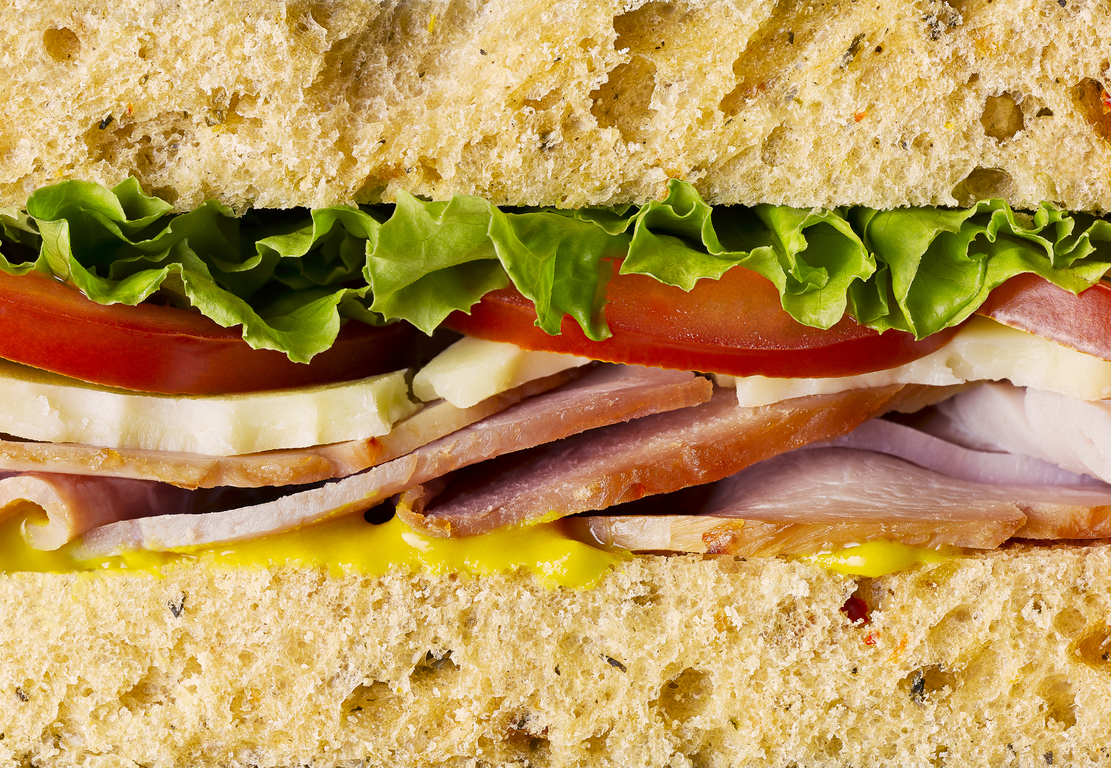
Definition of Incremental View Maintenance
$$Q^{Δ}=D∘Q∘I$$
As written, $Q^{Δ}$ is expensive to compute
However, we can often optimize the computation significantly

Slide 30
Outline
Incremental View Maintenance
Stream computations
Databases as streaming systems
Incremental (DB) computations
Optimizing incremental circuits
DB queries in DBSP
Implementation

Slide 31
Linear operators
Theorem: For a linear stream operator $Q$ we have $Q=Q^{Δ}$
Original:
Optimized:
$$T_{0}$$
$$T_{1}$$
$$T_{2}$$
$$T_{3}$$
…
$$I$$
$$Q$$
D
$$ΔV_{0}$$
$$ΔV_{1}$$
$$ΔV_{2}$$
$$ΔV_{3}$$
…
$${DB}_{0}$$
$${DB}_{1}$$
$${DB}_{2}$$
$${DB}_{3}$$
…
$$T_{0}$$
$$T_{1}$$
$$T_{2}$$
$$T_{3}$$
…
$$Q$$
$$ΔV_{0}$$
$$ΔV_{1}$$
$$ΔV_{2}$$
$$ΔV_{3}$$
…

Slide 32
A linear query
CREATE VIEW V AS SELECT * FROM T WHERE Age >= 10
“Shardable” queries
You don’t need to know what’s in T to compute the changes to V
Most relational queries use linear operators!

Slide 33
The chain rule (structural recursion)
$$(Q_{2}{∘Q_{1})}^{Δ}=Q_{2}^{Δ}∘Q_{1}^{Δ}$$
Proof by pictures:
$$⇔$$
$$⇔$$
$$⇔$$

Slide 34
Bilinear operators
(Lifted) join, intersection, Cartesian product
From distributivity:$Δ\left(A×B\right)=\left(A×ΔB\right)+\left(ΔA×B\right)+\left(ΔA×ΔB\right)$
Speed-up is $O(\frac{\left|A\right|}{\left|ΔA\right|}+\frac{\left|B\right|}{\left|ΔB\right|})$
$$⇔$$

Slide 35
Incremental operators
$(Q_{2}{∘Q_{1})}^{Δ}=Q_{2}^{Δ}∘Q_{1}^{Δ}$
If we know $Q^{Δ}$ for all primitive operations… …then we can incrementalize any query
For all standard primitive DB operations we know efficient incremental versions

Slide 36
Outline
Incremental View Maintenance
Stream computations
Databases as streaming systems
Incremental computation on streams
Optimizing incremental circuits
DB Queries in DBSP
Implementation

Slide 37
Hold on! This is not well-defined!
The definitions of $I$, $D$ require streams over a commutative group
However, tables (sets, multisets) are not groups
E.g., there is no table negation
Solution:
Generalize tables to obtain a commutative group

Slide 38
$ℤ$-sets (also called $ℤ$-relations)
Each row has an integer weight
The weight can be positive, zero, or negative
Name | Age | Weight
Mike | 10 | 1
John | 12 | 3
Amy | 8 | -1
Chris | 10 | 2
tuples

Slide 39
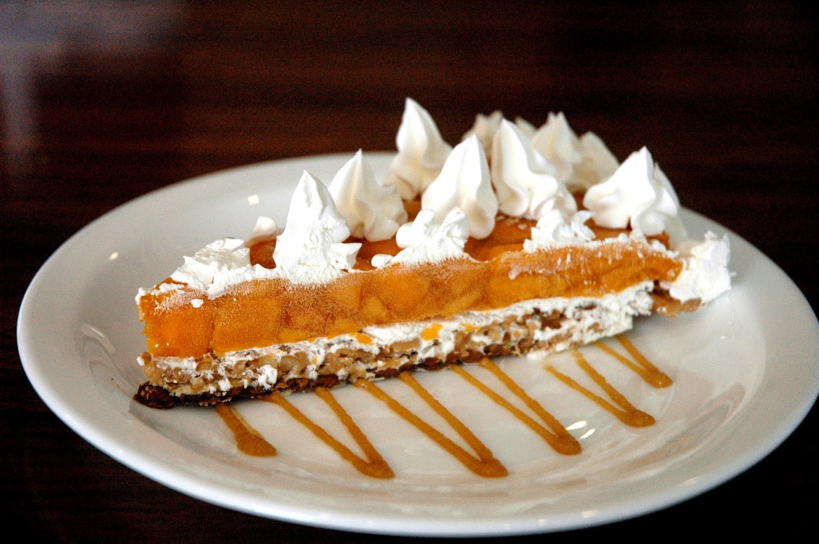
$ℤ$-sets are yummy!
Can represent both tables and changes to tables
Positive weights = elements added
Negative weights = elements removed
Generalize sets and multisets
Classic DB table = $ℤ$-set where all weights are 1
Form a commutative group (because $ℤ$ is a group)
Bonus: efficient duplicate handling

Slide 40
$ℤ$-set addition
Name | Weight
Mike | 1
John | 3
Amy | -1
Chris | 2
Name | Weight
Mike | -1
Dan | 1
Chris | 1
Name | Weight
Dan | 1
John | 3
Amy | -1
Chris | 3
+
=

Slide 41
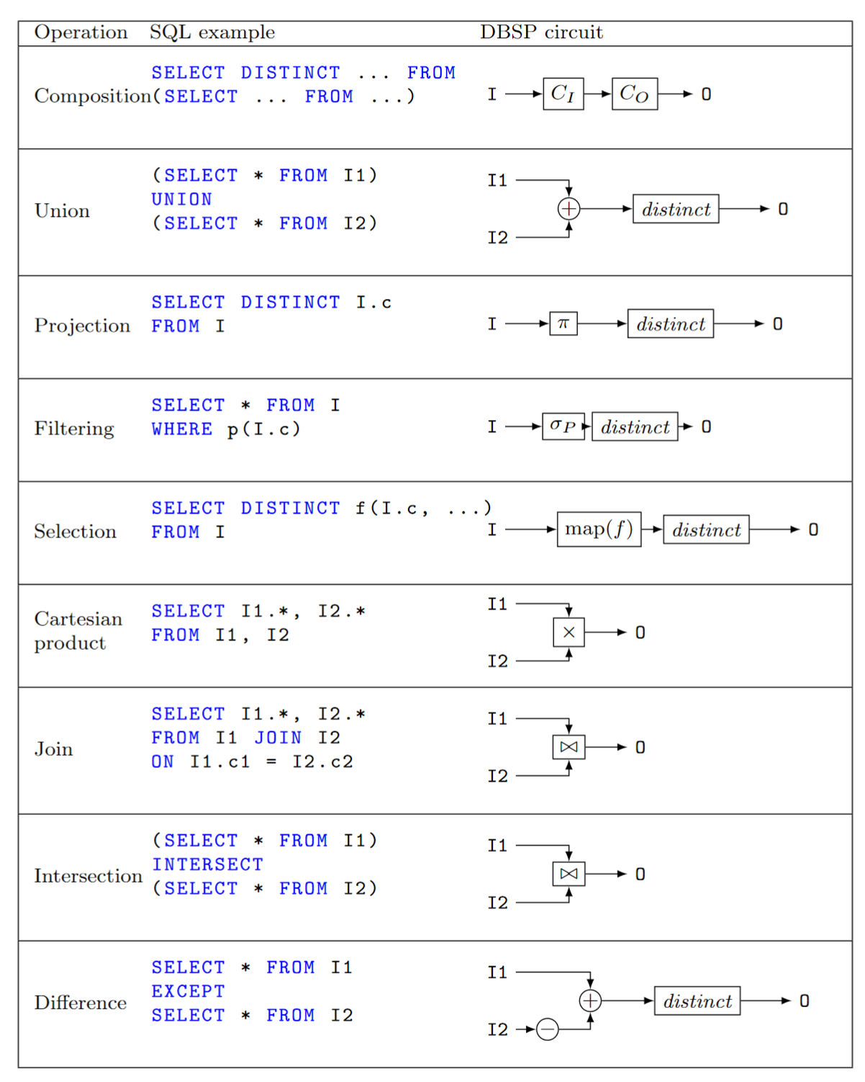
Relational algebra using $ℤ$-set operations
Recursively defined on query structure
Many operations require a $distinct$
(But many can be removed)
The other operations are all linear or bilinear

Slide 42
Algorithm for incremental view maintenance
Translate recursively a DB query into a circuit $Q$ on $ℤ$-sets
Lift circuit to compute on streams: $↑Q$
Build incremental version of lifted circuit:
$${(↑Q)}^{Δ}≝D∘↑Q∘I$$
Optimize $Q^{Δ}$ using structural recursion:
$$(Q{∘R)}^{Δ}=Q^{Δ}∘R^{Δ}$$
This algorithm is deterministic. There are no heuristics.

Slide 43
DBSP can also express
Nested collections
Group-by (linear!)
Flatmap (linear!)
Aggregation
Recursive queries (fixed points)

Slide 44
Example
CREATE VIEW V AS SELECT DISTINCT a.x, b.y FROM ( SELECT t1.x , t1.id FROM t1 WHERE t1.a > 2 ) a JOIN ( SELECT t2.id , t2.y FROM t2 WHERE t2.s > 5 ) b ON a.id = b.id
Inputs and outputs are collections, not streams

Slide 45
Example: Remove distinct calls
⬄
⬄
⬄

Slide 46
Example: Lift and incrementalize
Inputs and outputs are streams
Inputs and outputs are streams of changes

Slide 47
Example: optimize incremental circuit
Chain rule and linearity
Expand join and distinct

Slide 48
Outline
Incremental View Maintenance
Stream computations
Databases as streaming systems
Incremental computation on streams
Optimizing incremental circuits
DB Queries in DBSP
Implementation

Slide 49
Formal verification
Theory was verified using the Lean theorem prover
https://github.com/tchajed/database-stream-processing-theory
First formally-specified and formally-verified theory of incremental view maintenance
We know exactly what we need to build

Slide 50
DBSP Library
https://crates.io/crates/dbsp
MIT license
Rust framework to describe DBSP circuits
Support for relational algebra, nested relations, aggregates, etc.
Basic incremental and non-incremental operators (~70)
Multi-core execution
Currently in-memory

Slide 51
SQL to DBSP compiler
https://github.com/feldera/feldera/tree/main/sql-to-dbsp-compiler
MIT license
Generates Rust/native code programs using DBSP as a runtime
Based on Apache Calcite
Passes all 5+ million Sql Logic Test tests

Slide 52
Early-stage start-up to build this software stack
Founded May 2023
Seed fund by Costanoa Ventures
Building the software stack
Core runtime
SQL compiler
Documentation
Fault-tolerance
Scale-out
Cloud service
Connectors to other systems (Kafka, CDC, Snowflake, etc.)
Web user interface

Slide 53
Summary
Streaming systems run forever
A table is the integral of a stream
A transaction is the delta of a database
The right definition of IVM: computing changes to views given changes to tables
IVM systems are streaming systems
Almost any query has an efficient incremental implementation
The algorithm to incrementalize a given query is plan trivial:
Just incrementalize each primitive operator in the query
We built all this stuff as O/S
If you have a streaming or IVM problem, consider trying DBSP/Feldera

Slide 54
stream
DB
IVM
IVM

Slide 55
Extra slides

Slide 56
The distinct operator
“Converts” a $ℤ$-set into a set
Name | Weight
Dan | 1
John | 3
Amy | -1
Chris | 3
Name | Weight
Dan | 1
John | 1
Chris | 1
$$distinct\left( \right)=$$

Slide 57
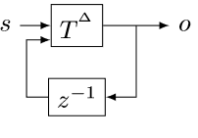
The cycle rule
$$⇔$$
Allows us to recursively incrementalize circuits with feedback
All our circuits are built from:
Sequential composition
Feedback loops
We get a structural recursion scheme for incrementalizing any circuit

Slide 58
Multiset union (can have duplicates)
SELECT * FROM T1 UNION ALL SELECT * FROM T2
T1
+
V
T2

Slide 59
Set union (no duplicates)
SELECT * FROM T1 UNION SELECT * FROM T2
T1
+
$$distinct$$
V
T2

Slide 60
Set difference
SELECT * FROM T1 EXCEPT SELECT * FROM T2
T1
+
$$distinct$$
V
T2
-
Recall: distinct removes elements with negative weights

Slide 61
Query composition
SELECT … FROM (SELECT … FROM T)
T
$$Q_{1}$$
$$Q_{2}$$
V
Query composition is circuit chaining (function composition).

Slide 62
We have barely begun
Distributed execution
Formal verification
Persistence
Fault-tolerance
Load-balancing
Runtime queries
Cloud service
Integration in existing systems (SQL, Spark, Rust, etc.)
Applications

Slide 63
Set intersection
SELECT * FROM T1 INTERSECT SELECT * FROM T2
O(x) :- T1(x), T2(x).
This is a disguised JOIN. We will see it soon.

Slide 64
Projection
SELECT Age FROM T
In DDlog:
O(age) :- T(_, age).
The weight of $t$ = sum of weights of all tuples that project to $t$
$$π_{C}\left(m\right)\left[t\right]=\sum_{\begin{aligned}x∈m \\ π_{C\left(x\right)}=t\end{aligned}}{m[x]}$$
$$T$$
$${↑π}_{C}$$
$$distinct$$
$$V$$
Name | Age | Weight
Mike | 10 | 1
John | 12 | 3
Amy | 8 | -1
Chris | 10 | 2
Age | Weight
10 | 1+2
12 | 3
8 | -1
SELECT Age

Slide 65
Selection (filtering)
SELECT * FROM T WHERE predicate
O(t) :- T(t), predicate(t).
Name | Age | Weight
Mike | 10 | 1
John | 12 | 3
Amy | 8 | -1
Chris | 10 | -2
Name | Age | Weight
Mike | 10 | 1
John | 12 | 3
Chris | 10 | -2
WHERE Age >= 10

Slide 66
Selection (filtering)
SELECT * FROM T WHERE predicate
V(t) :- T(t), predicate(t).
$$σ:ℤ\left[T\right]→ℤ[T]$$
$$σ\left(m\right)[t]=\left\{\begin{aligned}m\left[t\right], if predicate(t) \\ 0, otherwise\end{aligned}\right.$$
$$T$$
$$↑σ$$
V
$σ$ keeps all tuples for which the predicate is true.

Slide 67
Cartesian products
V(t1, t2) :- T1(t1), T2(t2).
SELECT T1.*, T2.* FROM T1, T2
Name | Age | Weight
Mike | 10 | 1
John | 10 | 3
Amy | 10 | -1
Chris | 10 | 2
Mike | 12 | 3
John | 12 | 9
Amy | 12 | -3
Chris | 12 | 6
Name | Weight
Mike | 1
John | 3
Amy | -1
Chris | 2
Age | Weight
10 | 1
12 | 3
x
=
Multiply weights.

Slide 68
Cartesian products
V(t1, t2) :- T1(t1), T2(t2).
SELECT T1.*, T1.* FROM T1, T2
$m_{1}∈ℤ\left[T_{1}\right],$ $m_{2}∈ℤ\left[T_{2}\right]$, ($m_{1}×m_{2})\left[\left(t_{1}, t_{2}\right)\right]≝m_{1}\left[t_{1}\right]⋅m_{2}\left[t_{2}\right]$
T1
$$↑×$$
V
T2

Slide 69
(Equi)Joins
SELECT Name, Age FROM T1 JOIN T2 ON T1.Name=T2.Name
O(Name, Age) :- T1(Name, Age), T2(Name, _).
T1
$$↑×$$
$$↑σ$$
V
T2
Cartesian product followed by filtering.

Slide 70
Optimizing distinct
Distinct is idempotent: $distinct∘distinct=distinct$
For many relational queries $Q$ the following holds ($Q$ one of select, project, join, map, flatmap, union, intersection)
For Q in join, product, filter, select we have
$$⇔$$
$$⇔$$

Slide 71
Incremental distinct
$$⇔$$
Work proportional to $|d|!$

Slide 72
Related work
Incremental View Maintenance
Streaming Databases
Streaming languages
Functional Languages
Category theory
Dataflow machines
Synchronous circuits

Slide 73
Materialized View Update Problem
We essentially cover this whole space
IEEE Data Engineering Bulletin, 1995

Slide 74
The ring of weights ($ℤ)$
The multiplication of $ℤ$ shows up in the join implementation …
… where weights of matching keys are multiplied
That’s why joins are bilinear (because $×$ distributes over $+$)

Slide 75
Additional SQL operations
Map (select)
Group-by (nested relations)
Flatmap
Aggregation
Order-by: not a particularly efficient model in DBSP

Slide 76
map_keys(f)
Generalization of SQL SELECT
Given $f:A→B$ the operator map_keys$\left(f\right):ℤ\left[A\right]→ ℤ[B]$ is: map_keys$\left(f\right)\left(i\right)=\sum_{x∈i}{i\left[x\right]⋅f(x)}$
Apply $f$ to each key and “weigh” the result
map_keys$(f)$is linear for any function $f$
Weight of $x$

Slide 77
Groupings
A grouping maps a key to a $ℤ$-set: $K→ℤ\left[A\right]$
Given a key, return a $ℤ$-set
This structure is $ℤ\left[A\right]\left[K\right]$
This is a mathematical group!
Weight
Key | Z-set
K1
K2
K3

Slide 78
Group-by
Given a type of keys $K$ and a function $k: A→K$, groupby$\left(k\right): ℤ\left[A\right]→ℤ\left[A\right]\left[K\right]$ builds a grouping from a $ℤ$-set
groupby is a linear function!
Each tuple in the input delta will affect only one grouping
So ($↑$groupby)$Δ =$ ($↑$groupby)

Slide 79
flatmap_keys
Given $f:A→ℤ[B]$, define flatmap_keys$\left(f\right):ℤ\left[A\right]→ ℤ[B]$ as: flatmap_keys$\left(f\right)\left(i\right)≝\sum_{x∈i}{i\left[x\right]⋅f(x)}$
flatmap_keys is linear for any $f$!
Substitute$ℤ[B][K]$ for $A$, and id: $ℤ\left[B\right]→ ℤ[B]$ for$f$
flatmap_keys(id):$ℤ\left[B\right]\left[K\right]→ℤ[B]$is the right-inverse of group-by
Weight of $x$

Slide 80
Aggregation
Aggregation functions such as weighted SUM and COUNT are linear functions $ℤ\left[ℝ\right]→ℝ$!
$a_{SUM}(s)=\sum_{x∈s}{x×s\left[x\right]}$
(But not linear as functions $ℤ\left[ℝ\right]→ℤ[ℝ]$!)
SELECT SUM(c) FROM I
makeset converts a $ℝ$scalar into a singleton $ℤ$-set
makeset(5) = $\{ 5↦1 \}$
makeset is not linear, but it is not expensive to incrementalize

Slide 81
Non-linear aggregations
E.g., min, max
… or their generalization, top-K
These are not linear on a group structure (they are linear on a monoid… but can’t handle negation)
Implemented using the “brute force” formula:
$${(↑Q)}^{Δ}= D∘(↑Q)∘I$$
The integral is there to “remember” the full set
Can be built efficiently (log work in $|I|$) using a priority queue

Slide 82
Group-By + Aggregate
The composition of
Group-by
map_weights(aggregate)
map_weights applies a function to each grouping
Not to be confused with map_keys from before
Linear if the aggregate function is linear

Slide 83
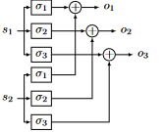
Parallelization
Join on two threads
Volcano “exchange” operator (from 2 threads to 3 threads)

Slide 84
Outline
Streaming queries in DBSP

Slide 85
Convolutions
Window-based computation
Window is defined by the input transactions (not by the contents of the data stream)

Slide 86
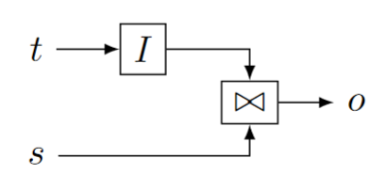
Streaming joins
$t$ are changes to a table
$s$ is a stream
Table $I(t)$ is joined with every stream value in $s$
$o$ is also a stream

Slide 87
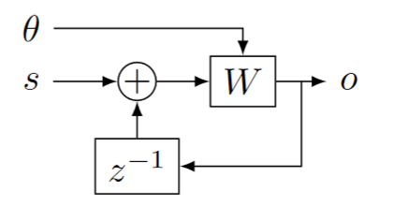
Streaming window queries
$θ$ is a stream of wall-clock values (time)
$s$ is a stream of timestamped data
$W$ window function, filters data in $s$ based on timestamp and time

Slide 88
Alternative window definition
In each transaction
$A$ = what is added
$S$ = what is subtracted from window

Slide 89
Outline
Datalog in DBSP

Slide 90
Datalog rules
Rule head
Rule body
sibling(x, y) :- parent(z, x), parent(z, y).
Head relation = circuit output
Relations in body = circuit inputs
Rule body = circuit contents
Conjunctions in rule body = edges in circuit
Turnstyle = projection
Compiled to
proj
sibling
parent

Slide 91
Negation
Stratified: non-recursive
Implemented as either
Subtraction
Anti-join

Slide 92
Recursive computations
Reach(x, y) :- Edge(x, z), Reach(z, y).
The semantics iterates until convergence
To implement “loops” we introduce two new operators:
$δ_{0}$ (enter)
$∫$(exit)

Slide 93
Creating streams from scalars
$$δ_{0}:A→S_{A}$$
$$δ_{0}\left(a\right)\left[t\right]≝\left\{\begin{aligned}a, t=0 \\ &0, t>0\end{aligned}\right.$$
Linear!
scalar
stream
9
9, 0, 0, 0, 0, 0, …

Slide 94
Creating scalars from streams
Only defined for streams that are zero almost everywhere:
$$∫{ :S}_{A}→A$$
$$∫\left(s\right) ≝ \sum_{t≥0}{s\left[t\right]}$$
Linear!
stream
scalar
1, 2, 3, 0, 0, 0, …
6

Slide 95
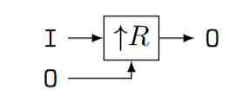
Implementing recursion (1)
Start with a recursive query O = R(I, O) where I and O are relations, and R is a query (on $ℤ$-sets)
Implement R as a (non-recursive) circuit $R:$
Lift to compute on streams:

Slide 96
Implementing recursion (2)
(3) Connect recursive output to input using a delay
(4) Bracket as follows:

Slide 97
Typing
Scalars (not streams!)
Streams

Slide 98
Inputs
a,0,0,0,…
a,a,a,a,…
a

Slide 99
Theorem: this circuit computes fixed-point of $R$
Denote by $S\left(x\right)=λx.R(a, x)$, where $a$ is the value of input I
$o\left[0\right]=R\left(a, 0\right)=S(0)$
$o\left[1\right]=R\left(a, o\left[0\right]\right)= S\left(o\left[0\right]\right)=S\left(S\left(0\right)\right)$
$o\left[k\right]=S^{k+1}\left(0\right)$
If $o[k] = o[k+1]$, then $∀i≥0 o\left[k+i\right]=o[k]$
Starting from $k$ all outputs of $D$ are 0
(But computation may never converge)

Slide 100
Two kinds of streams
Streams were used previously to model time-evolution of a system
Now we use streams to model the execution of a loop
The stream values are consecutive values of the variables in the loop body

Slide 101
Example: Transitive closure
reach(x, y) :- edge(x, y).
reach(x, y) :- edge(x, z), reach(z, y).
edge
reach
edge
join(edge, reach)

Slide 102
Semi-naïve evaluation
$$⇔$$
Cycle rule => correctness of semi-naïve Datalog evaluation

Slide 103
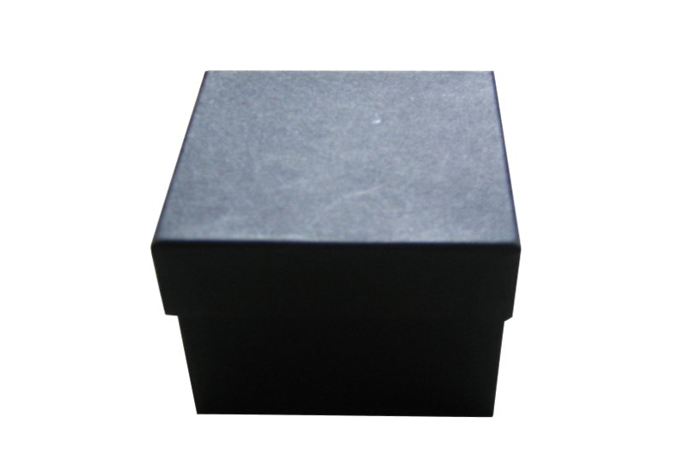
Streaming, incremental, recursive queries
So far we have implemented a recursive non-streaming query
To make it incremental we apply the same recipe as before…
… treating the non-streaming query as a black-box

Slide 104
Lifting and loops
A circuit like implements a query $Q$
Use the definition: ${(↑Q)}^{Δ}≝ D∘\left(↑Q\right)∘I$ by treating the entire circuit like a scalar operator!
Theorem: lifting a circuit is the same a lifting every operator
Works even for loops
$$P$$
$$↑( )$$
$$⇔$$

Slide 105
Streaming incremental recursive queries
Non-incremental streaming
recursive query
Incremental streaming
recursive query
Apply chain and cycle rules

Slide 106
Streams of Streams
$S_{A}$ is defined for any group $A$
$S_{A}$ itself is a group
$S_{S_{A}}$ is a group!

Slide 107
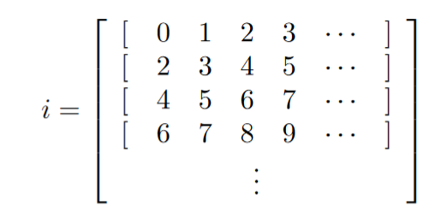
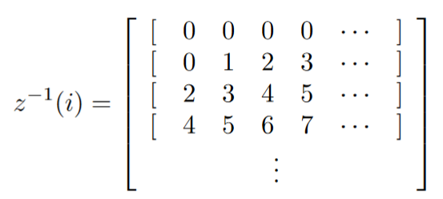
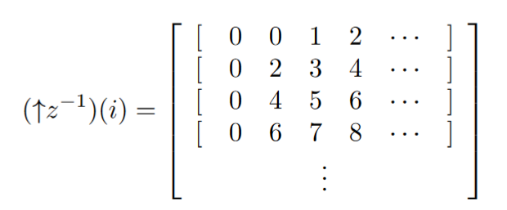
Streams of streams
Loop iterations
The math works out fine
Even for higher dimensions
But it becomes less intuitive
In particular, $z^{−1}$and $↑z^{−1}$ are very different
Transactions
Shift right
Shift down

Slide 108
Example: Transitive, reflexive closure
input relation E(h: Node, t: Node)
output relation R(s: Node, t: Node)
R(x, x) : - E (x, _). R(x, x) : - E (_, x). R(x, y) : - E (x, y). R(x, y) : - E (x, z), R(z, y).

Slide 109
Transitive, reflexive closure: circuit
Non-recursive query
Recursive version

Slide 110
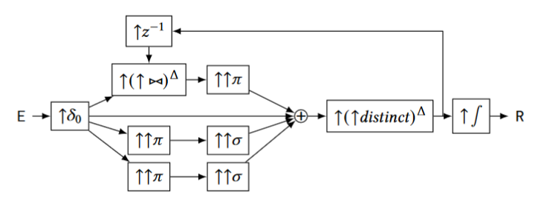
Transitive, reflexive closure: incrementalize
Lifted (streaming)
Incrementalized

Slide 111
Transitive, reflexive closure: optimize
Incrementalized
(previous)
Apply chain, cycle
nonlinear

Slide 112
Transitive, reflexive closure: (bi)linearity
$${\left(↑{\left(↑⋈\right)}^{Δ}\right)}^{Δ}$$
$$↑(↑distinc{t)}^{Δ}$$
$${\left(↑{\left(↑distinct\right)}^{Δ}\right)}^{Δ}$$

Slide 113
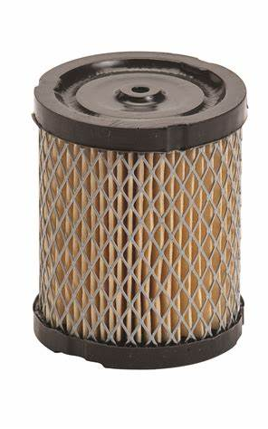
DSP Filters
Most circuits in DSP are composed of linear, time-invariant blocks
These have some very nice mathematical properties
In particular, their output is fully described by their response to an “impulse” (the stream 1,0,0,0…)
Given their impulse response R and an input signal S, the output is R * S – the convolution of R and S
$I$ is an IIR filter – Infinite Impulse Response (1,1,1,1,…)
$D$ is a FIR filter – Finite Impulse Response (1,-1,0,0,….)
However, many of the computations we will need are not linear
So most of the beautiful DSP theory does not apply

Slide 114
Relation to synchronous digital circuits
Combinational logic (acyclic graphs)
“Instantaneous” propagation
Flip-flops or latches (memory elements)
Clocked elements
Remember value from previous clock
This is our delay element $z^{−1}$
Sequential circuits
Combinational logic
All back-edges must go through a latch
clock
input
Combinational
circuit
output
state

Slide 115
Synchronous circuits ideas
The entire state is stored in latches
State summarizes the entire history of the circuit
State = checkpoint.
Optimizations such as retiming can be used to minimize state
Retiming moves around latches without changing the circuit semantics

Slide 116
DBSP vs Differential Dataflow
DBSP is inspired by DD
https://github.com/TimelyDataflow/differential-dataflow
DBSP is much simpler than DD
DD has the notion of “change” built-in
In DBSP the changes are obtained by using $D$ and $I$
DD is more general
DBSP requires that input changes are streamed in time order
In DD changes can be made at any time, not just in time order

Slide 117
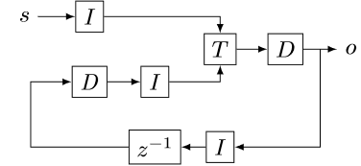
Proof of the cycle rule
$$⇔$$
$$⇔$$

