Slide 1
Unifying databases and streaming systems
Mihai Budiu – .

Slide 2
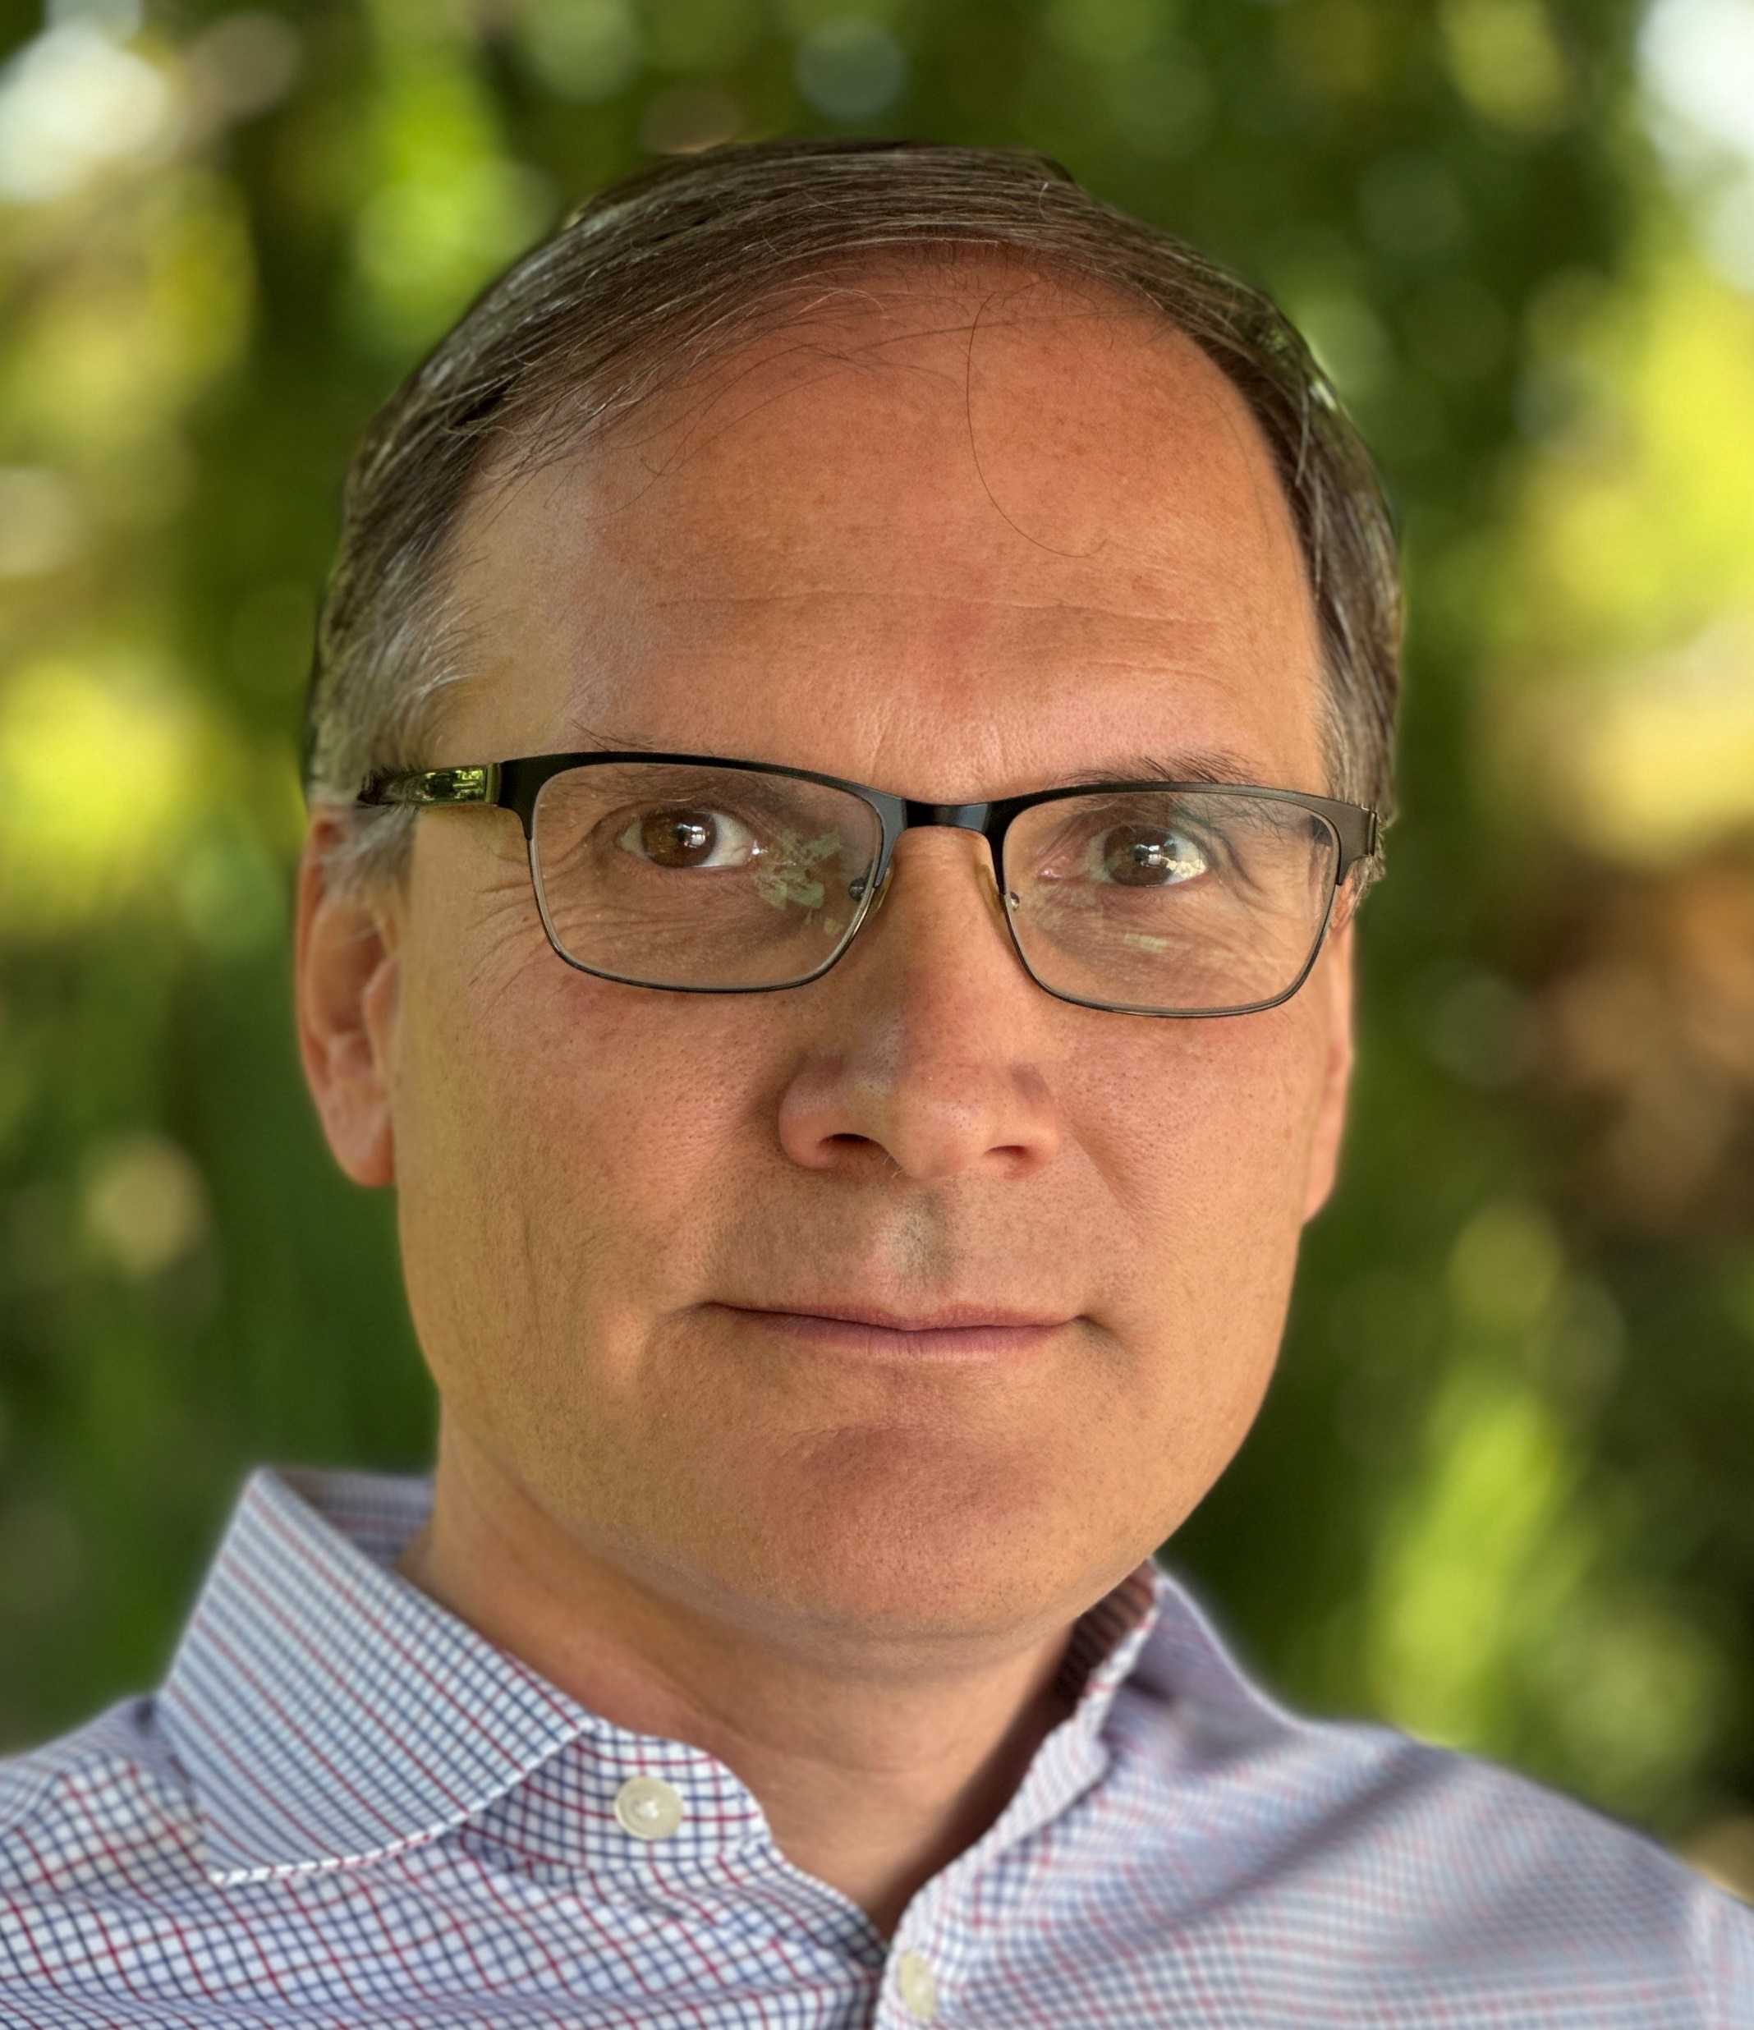
Mihai Budiu - Short bio
Ph.D. from Carnegie Mellon University
Previous: Microsoft Research Silicon Valley, Barefoot Networks, VMware Research
Currently: feldera.com – chief scientist
Apache Calcite PMC member
https://mihaibudiu.github.io

Slide 3
Streaming
Streaming media
Streaming data

Slide 4
Streaming
system
Streams = (ordered) collections of events | Tables = collections of rows
New events appear in streams | Rows are inserted/deleted/updated
Stream analytics | Data analytics
Custom languages => SQL | SQL
Computation changes infrequently | Queries and views
Custom state management | State in tables + indexes
Low latency | High throughput

Slide 5
Streaming
system
Streaming systems | Databases | Future Databases
Streams = (ordered) collections of events | Tables = collections of rows
New events appear in streams | Rows are inserted/deleted/updated
Stream analytics | Data analytics
Custom languages => SQL | SQL
Computation changes infrequently | Queries and views
Custom state management | State in tables + indexes
Low latency | High throughput

Slide 6
Unified systems = streams and data
Batch-style updates
Streaming updates

Slide 7
No compromises!
Any SQL queries
Any mix of data sources
Any changes to tables/streams, inputs/outputs
Incremental (effort = size of change)
Computations on unbounded streams

Slide 8
The science
ACM SIGMOD 2024 Research
Highlights
Award
DBSP: Automatic Incremental View Maintenance for Rich Query Languages Mihai Budiu, Tej Chajed, Frank McSherry, Leonid Ryzhyk, Val Tannen
github.com/feldera/feldera
Best paper award

Slide 9
Presentation Outline
Introduction
+Incremental computation
+Changes
+Streams
=Streaming databases

Slide 10
1. Incremental computation

Slide 11
A database and a query
Example:
Result = table with funds for each customer
Query = available funds SUM(deposits) GROUP BY customer
Database = charges and deposits for all customers
(charges are negative deposits)
$$Q$$

Slide 12
Keep the result up-to-date
CREATE VIEW V AS …
V
V
V
V
V
$$Q$$
$$Q$$
$$Q$$
$$Q$$
$$Q$$
$Δ$DB
$$ΔDB$$
$$ΔDB$$
$$ΔDB$$
$$ΔDB$$
~100 rows
~1B rows
Time
transactions
$Δ$ (delta) = change

Slide 13
Incremental computation
When a new deposit occurs
Update the funds for the corresponding person
Do not recompute funds for everyone

Slide 14
Incremental View Maintenance
1B / 100 = 10 million times faster!
V
V
V
V
V
$$ΔV$$
$$ΔV$$
$$ΔV$$
$$ΔV$$
$Δ$V
$$Q$$
$$Q^{Δ}$$
$$Q^{Δ}$$
$$Q^{Δ}$$
$$Q^{Δ}$$
$$Q^{Δ}$$
$$ΔDB$$
$$ΔDB$$
$$ΔDB$$
$$ΔDB$$
$$ΔDB$$
Time

Slide 15
2. Changes

Slide 16
What is a change?
$$Δ$$
Table
Change
Table
Databases understand these
But struggle with these

Slide 17
Changes should be first class-objects!

Slide 18
Z-sets = tables + weights
Each row has an integer weight
How many copies of the row are in the table
The weight can be positive, zero, or negative
Just a table with an extra column
Name | Age | Weight
Mike | 10 | 1
John | 12 | 3
Amy | 8 | -1
Chris | 10 | 2
rows

Slide 19
A standard table is a Z-set too!
Can even represent duplicate rows
+1
+1
+1
+1
+1

Slide 20
Z-sets are magic
Can represent both tables and changes to tables
Positive weights = rows added
Negative weights = rows removed
A negative weight is just like a negative deposit!

Slide 21
Z-sets could be everywhere!
V
V
Tables and views
Table and view changes
Change Data Capture streams
Database logs
INSERT and DELETE statements
Transactions
$$ΔV$$
$$Q$$
$$Q^{Δ}$$
$$ΔDB$$
Z-sets should be the standard data exchange format

Slide 22
Data lakes could use Z-sets too!
Come see my talk about this at Community Over Code (ex Apachecon) in Minneapolis in September!

Slide 23
3. Streams

Slide 24
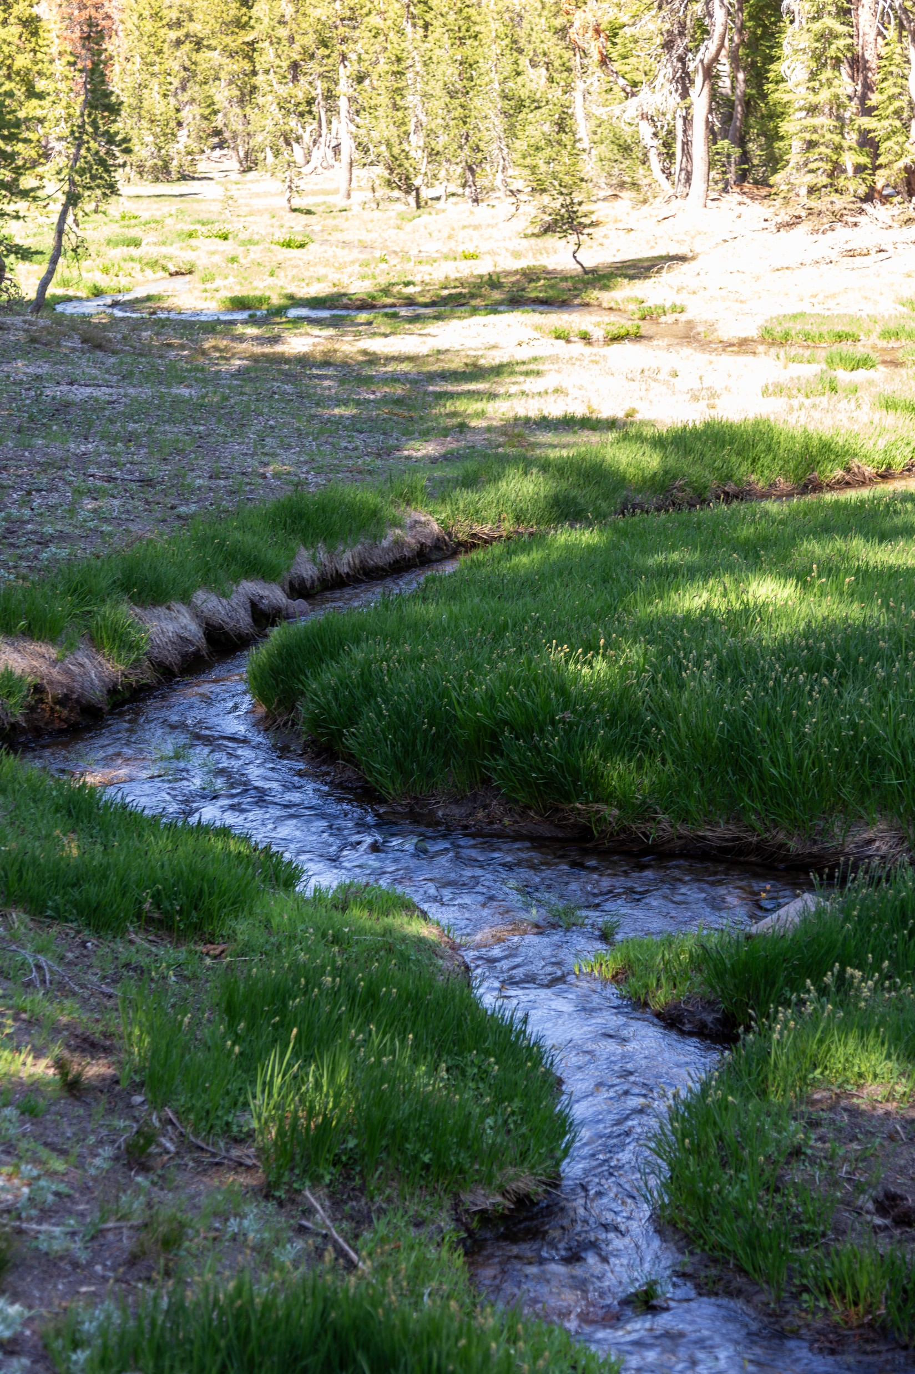
Streams
Infinite sequences
-1
-2
-1
0
1
2
…
Time

Slide 25
Some interesting streams
Stream of database
snapshots
DB[0]
DB[1]
DB[2]
DB[3]
$$ΔDB[0]$$
$$ΔDB[1]$$
$$ΔDB[2]$$
$$ΔDB[3]$$
… transactions
V[0]
V[1]
V[2]
V[3]
… view
snapshots
$ΔV$[0]
$ΔV$[1]
$$ΔV[2]$$
$$ΔV[3]$$
… view
changes

Slide 26
Stream computations
Inputs and outputs are streams
Computation

Slide 27
Views = stream computations
View

Slide 28
Stream Integration
DB+= $Δ$
$$Δ[2]$$
$$Δ[1]$$
$$Δ[0]$$
Stream of experiences

Slide 29
Stream integration
Integrate
$$ΔDB$$
$$ΔDB$$
$$ΔDB$$
$$ΔDB$$
This is what a database has always been doing!
Database = integral of the transactions stream

Slide 30
What is new?
DB-prev (DB)
$$Δ[2]$$
$$Δ[1]$$
$$Δ[0]$$
Communication Stream (ideas, words, sounds)

Slide 31
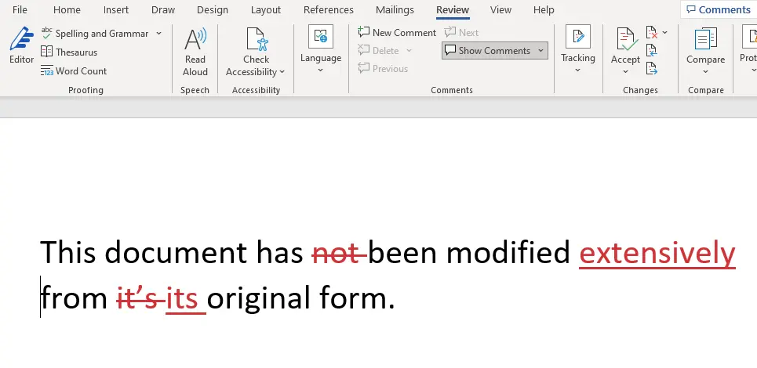
Computing changes
Changes
$$ΔDB$$
$$ΔDB$$
$$ΔDB$$
$$ΔDB$$
Incremental backups
git
diff
MS word

Slide 32
How to compute ${ Q}^{Δ}$ in 3 easy steps
Integrate
$$ΔDB$$
$$ΔDB$$
$$ΔDB$$
$$ΔDB$$
View
Changes
$ΔV$[0]
$ΔV$[1]
$$ΔV[2]$$
$$ΔV[3]$$

Slide 33
Build automatically $Q^{Δ}$ from $Q$
A 40+-year old problem
Partial solutions
We have a solution that works for any query $Q$
$$Q$$
$$Q^{Δ}$$
Compiler

Slide 34
Why hasn’t anyone done this yet?
Today’s DBs cannot handle negative changes (Z-sets)

Slide 35
We built such an engine!
Open-source SQL compiler a runtime (MIT license)
Operating on any combination of streams and tables
Accepting any kinds of changes (insertions/deletions/updates)
No compromises!

Slide 36
Demo try.feldera.com

Slide 37
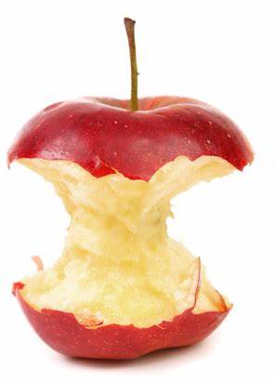
Core ideas
Changes and data can be represented using Z-sets
Everything is a stream: database snapshots, views, transactions
Incremental computations consume and produce changes

Slide 38
Streaming
system
Streaming systems | Databases | Future Databases
Streams = (ordered) collections of events | Tables = collections of rows | Table = Z-sets
New events appear in streams | Rows are inserted/deleted/updated | Events = changes = Z-sets
Stream analytics | Data analytics | Analytics on Z-sets
Custom languages => SQL | SQL | SQL
Computation changes infrequently | Queries and views | Queries and Incremental views
Custom state management | State in tables + indexes | State in tables + indexes
Low latency | High throughput | Low latency views + high throughput queries

Slide 39
Incremental View Maintenance Service
$$Q^{Δ}$$
$$ΔDB$$
$$ΔDB$$
$$ΔDB$$
$$ΔDB$$
$ΔV$[0]
$ΔV$[1]
$$ΔV[2]$$
$$ΔV[3]$$
Will be a service offered by databases
Create view
Subscribe to view changes
Post changes to DB, receive updates from view

Slide 40
try.feldera.com
github.com/feldera/feldera
www.feldera.com/community

Slide 42
Database queries work on Z-sets!
Boxes = computations
Arrows = Z-sets
$$i1$$
$$σ$$
$$⋈$$
o
$$i2$$
$$π$$

Slide 43
Incremental queries are stateful streaming systems
$$Q^{Δ}$$
…
$$i_{2}$$
$$i_{1}$$
$$i_{0}$$
$$Q^{Δ}$$
…
$$o_{2}$$
$$o_{1}$$
$$o_{0}$$
state
$Q^{Δ}$ is a streaming system:
it runs forever
it maintains internal state (even if $Q$ is stateless)

Slide 44
Automatic Incremental View Maintenance
$$Q$$
V
V
$Q$ plan
$$ΔV$$
$$Q$$
$$Q^{Δ}$$
Compiler
$$ΔDB$$
$$ΔDB$$
$$ΔV$$
$$ΔDB$$
$$Q^{Δ}$$
plan
$$ΔV$$
$$ΔDB$$
$$Q^{Δ}$$
$$ΔV$$
$$ΔDB$$
$$ΔV$$

Slide 45
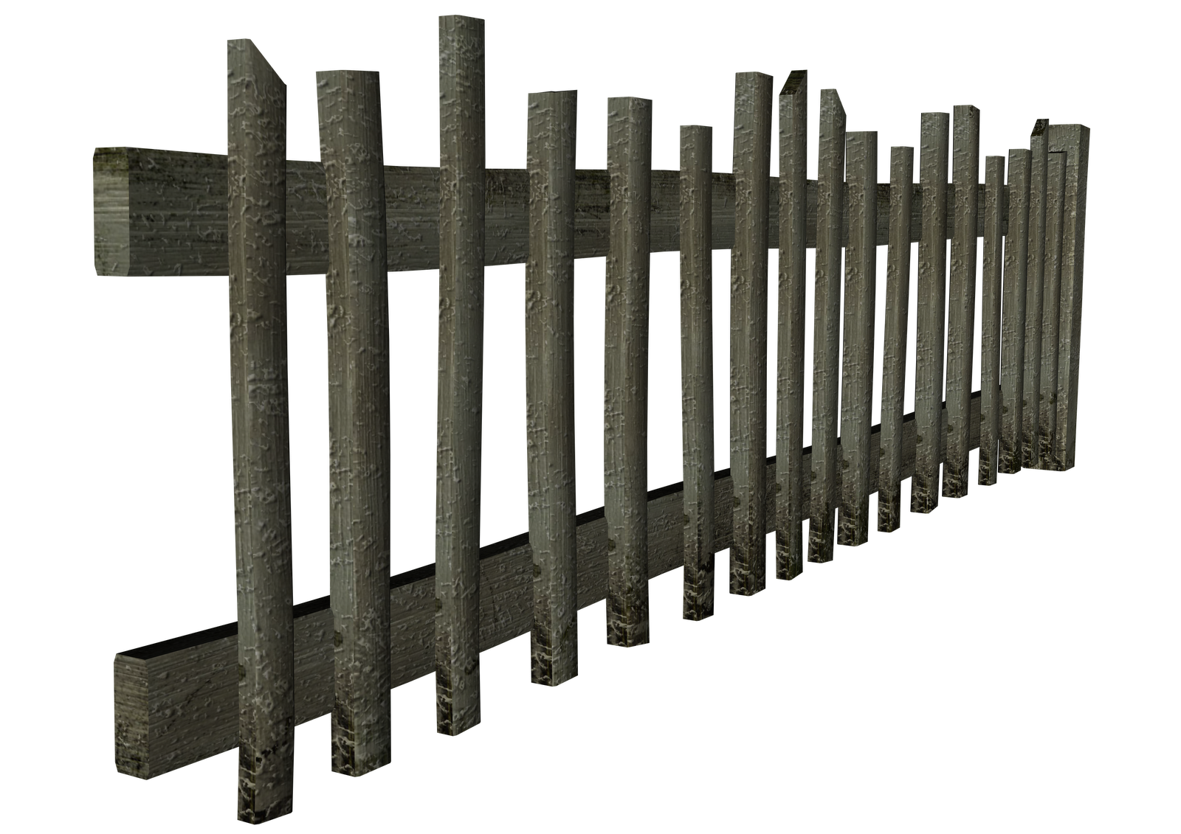
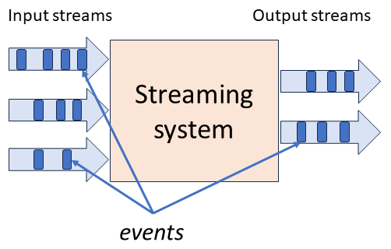
stream
DB
Incremental
Computation
Database

