Slide 1
Streaming Incremental View Maintenance with Apache Calcite
Mihai Budiu – .com
October 7, 2023
Halifax, Nova Scotia, Canada

Slide 2
kill(speaker, SIGINT)
I will be happy to answer questions at any time

Slide 3
What is incremental computation?
Consider a program $P$
Change $I$ “slightly”
In general, this is hard to even define precisely
But it works great for databases:
Databases have a natural notion of “changes”
$P$ is a query, $I$ is a set of tables, and $ΔI$ is a transaction, $O$ is a view
Usually $\left|ΔI\right|≪|I|$ and $\left|ΔO\right|≪|O|$
Database people call this “Incremental View Maintenance”
$$I$$
$$P$$
$$O$$
reuse
$$I+ΔI$$
$$P$$
$$O+ΔO$$

Slide 4
Outline
Theory: streaming incremental computations
Practice: SQL streaming implementation using Calcite

Slide 5
If you want to know more
DBSP: Automatic Incremental View Maintenance for Rich Query Languages Mihai Budiu, Tej Chajed, Frank McSherry, Leonid Ryzhyk, Val Tannen VLDB 2023
Best paper award

Slide 6
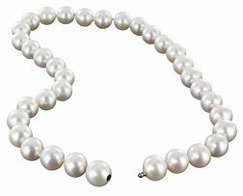
A simple streaming language called DBSP
Four (4) operators
A new definition of incremental computation using DBSP
An algorithm converting an arbitrary DBSP program to an incremental DBSP program
A recipe implementing queries in DBSP
2 operators needed for SQL
2 for recursive queries (not in this talk)

Slide 7
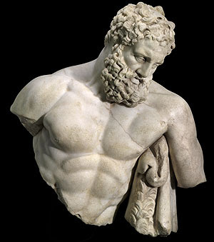
DBSP is powerful
It can model a rich class of database queries:
Relational (select, project, join, union, difference)
Computations on sets, bags, multisets
Nested relations (group-by, unnest)
Aggregation
Recursion (monotonic and non-monotonic)
Stratified negation
Streaming computations (joins, window aggregates)
More?
Corollary: we get automatically incremental evaluation for all these
SQL
Datalog

Slide 8
Streams
Infinite vectors
…
$S_{A}$= streams with elements of type $A$
Assume that $A$ has $+$, $−,$and 0 (zero)
($A$ is a commutative group)
0
1
2
1
0
-1
-2
-1
time

Slide 9
Stream operators
Arrows = streams
boxes = operators
$$i_{0}$$
$$i_{1}$$
$$i_{2}$$
…
$$Q$$
$$o_{0}$$
$$o_{1}$$
$$o_{2}$$
…
…
$$T$$
…
…

Slide 10
Lifting
Convert a function $f:A→B$ into a stream operator $↑f:S_{A}→S_{B}$
$$a$$
$$b$$
$$c$$
…
$$↑f$$
$$f(a)$$
$$f(b)$$
$$f(c)$$
…

Slide 11
Chaining operators into circuits
“Dataflow graphs”
$$i1$$
$$A$$
$$B$$
$$C$$
o
$$i2$$
$$D$$

Slide 12
Delay ($z^{−1}$ )
Output is input stream delayed by one step
First value is 0
$$a$$
$$b$$
$$c$$
$$d$$
…
$$z^{−1}$$
$$0$$
$$a$$
$$b$$
$$c$$
…

Slide 13
Computing changes (deltas)
$$o\left[t\right]=s\left[t\right]–s\left[t−1\right]$$
o
o is the stream of changes of s
$$1$$
$$2$$
$$3$$
$$2$$
…
$$D$$
$$1$$
$$1$$
$$1$$
$$−1$$
…
stream of deltas

Slide 14
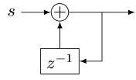
Integration
$o[0] =s[0]$
$o[t] =s[t] + o[t−1]$
$o\left[t\right]=s\left[0\right]+s\left[1\right]+ …+s[t]$
o
If s is a stream of changes…
… then o is the original stream
$$1$$
$$1$$
$$1$$
$$−1$$
…
$$I$$
$$1$$
$$2$$
3
$$2$$
…
stream of changes

Slide 15
$D$ and $I$ are inverses
$$Δs$$

Slide 16
All databases are streaming databases!
Consider a database $DB$, a set of tables
A committed transaction is a change to $DB$
The set of linearized transactions define $T,$ a stream of changes to $DB$
$T[k]$is the $k$-th transaction
$DB$ is a stream of database snapshots
$DB[k]$ is the contents of the database after $k$ transactions have been committed
$DB[k] = I(T)[k$]
A database (stream) is the integral of a transaction stream
$$T_{0}$$
$$T_{1}$$
$$T_{2}$$
$$T_{3}$$
…
$$I$$
$${DB}_{0}$$
$${DB}_{1}$$
$${DB}_{2}$$
$${DB}_{3}$$
…

Slide 17
Views are lifted queries
Let $Q$ be a query defining a view $V$, e.g.:
CREATE VIEW V AS SELECT * FROM T WHERE Age >= 10
$V[k]=Q\left(DB[k]\right)$
$V$ is a stream of view snapshots:
$$V= ↑Q(DB)$$
$$↑Q$$
$$V_{0}$$
$$V_{1}$$
$$V_{2}$$
$$V_{3}$$
…
Versions of $V$
Versions of $DB$
$${DB}_{0}$$
$${DB}_{1}$$
$${DB}_{2}$$
$${DB}_{3}$$
…

Slide 18
Incremental view maintenance of view $V$
This is our definition of IVM
The standard DB definition does not include the last D
This definition is much better:
It is compositional
Inputs and outputs are both deltas
$${(↑Q)}^{Δ}$$
$$T_{0}$$
$$T_{1}$$
$$T_{2}$$
$$T_{3}$$
…
$$I$$
$$↑Q$$
D
$$ΔV_{0}$$
$$ΔV_{1}$$
$$ΔV_{2}$$
$$ΔV_{3}$$
…
Changes to $DB$
Changes to $V$
$$V_{0}$$
$$V_{1}$$
$$V_{2}$$
$$V_{3}$$
…
Versions of $V$
Versions of $DB$
$${DB}_{0}$$
$${DB}_{1}$$
$${DB}_{2}$$
$${DB}_{3}$$
…

Slide 19
Incremental queries are streaming systems
$${Δi}_{0}$$
$${Δi}_{1}$$
$${Δi}_{2}$$
$${Δi}_{3}$$
…
$$Q^{Δ}$$
$$Δo_{0}$$
$$Δo_{1}$$
$$Δo_{2}$$
$$Δo_{3}$$
…
state
$Q^{Δ}$ is a streaming system:
it runs forever
it maintains internal state (even if $Q$ is stateless)
the state is stored in the delay operators (inside $I$ and $D$)

Slide 20
Change Data Capture and DB replication
$$T_{0}$$
$$T_{1}$$
$$T_{2}$$
$$T_{3}$$
…
$$I$$
DB
$$D$$
…
DB
Changes to $DB$
binlog/redolog
CDC
data
analysis
…
These streams have contents of the same nature
They should use the same formats
The DB should have APIs to publish streams of changes for any view

Slide 21
The chain rule (structural recursion)
$$(Q_{2}{∘Q_{1})}^{Δ}=Q_{2}^{Δ}∘Q_{1}^{Δ}$$
Proof by pictures:
$$⇔$$
$$⇔$$
$$⇔$$

Slide 22
Incremental operators
$(Q_{2}{∘Q_{1})}^{Δ}=Q_{2}^{Δ}∘Q_{1}^{Δ}$
If we know $Q^{Δ}$ for all primitive operations… …then we can incrementalize any query
For all standard primitive DB operations we know efficient incremental versions

Slide 23
Let’s apply this to a DB
We need +, -, and 0 operations for a database

Slide 24
$ℤ$-sets (also called $ℤ$-relations)
Each row has an integer weight
The weight can be positive, zero, or negative
Can represent both tables and changes to tables
Positive weight => row added
Negative weight => row removed
Generalize sets and multisets
Classic DB table = $ℤ$-set where all weights are 1
Form a commutative group
Name | Age | Weight
Mike | 10 | 1
John | 12 | 3
Amy | 8 | -1
Chris | 10 | 2
tuples

Slide 25
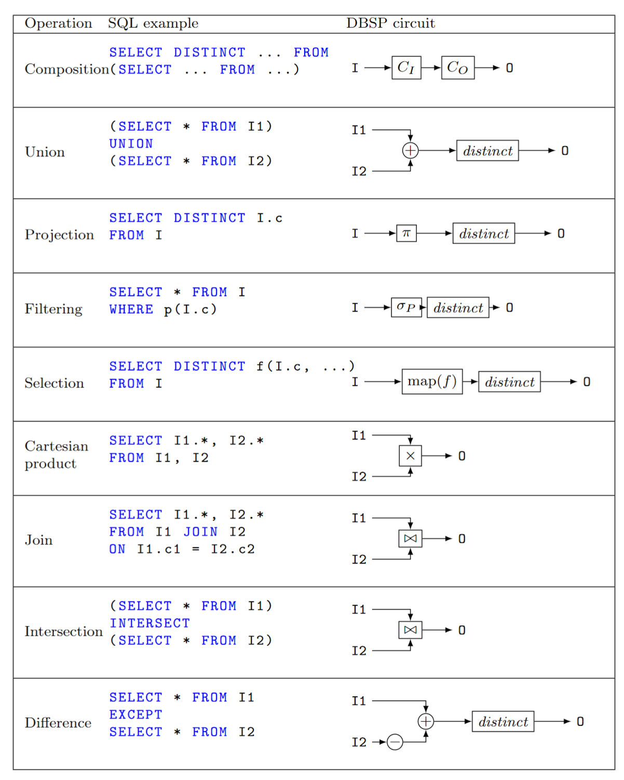
Relational algebra using $ℤ$-set operations
Recursively defined on query structure
Many operations require a $distinct$
(But many can be removed)
The other operations are all linear or bilinear

Slide 26
Algorithm for incremental view maintenance
Translate recursively a DB query into a circuit $Q$ on $ℤ$-sets
1.5 Eliminate some distinct calls
Lift circuit to compute on streams: $↑Q$
Build incremental version of lifted circuit:
$${(↑Q)}^{Δ}≝D∘↑Q∘I$$
Optimize $Q^{Δ}$ using structural recursion:
$$(Q{∘R)}^{Δ}=Q^{Δ}∘R^{Δ}$$
This algorithm is deterministic. There are no heuristics.

Slide 27
Example
CREATE VIEW V AS SELECT DISTINCT a.x, b.y FROM ( SELECT t1.x , t1.id FROM t1 WHERE t1.a > 2 ) a JOIN ( SELECT t2.id , t2.y FROM t2 WHERE t2.s > 5 ) b ON a.id = b.id
Inputs and outputs are collections, not streams

Slide 28
Example: Remove distinct calls
⬄
⬄
⬄

Slide 29
Example: Lift and incrementalize
Inputs and outputs are streams
Inputs and outputs are streams of changes

Slide 30
Example: optimize incremental circuit
Chain rule and linearity
Expand join and distinct

Slide 31
Outline
Theory: streaming incremental computations
Practice: SQL streaming implementation using Calcite

Slide 32
Apache project founded in 2015
“provides an industry standard
SQL parser and validator,
a customisable optimizer with
pluggable rules and
cost functions, logical and
physical algebraic operators,
various transformation algorithms from
SQL to algebra
(and the opposite), and
many adapters for executing SQL queries”

Slide 33
DBSP Library
https://crates.io/crates/dbsp
MIT license
Rust framework to describe DBSP circuits
Support for relational algebra, nested relations, aggregates, etc.
Implementation of the basic incremental operators
Multi-core execution
Currently in-memory
In progress:
persistent state
scale-out

Slide 34
SQL to DBSP compiler
https://github.com/feldera/feldera/tree/main/sql-to-dbsp-compiler
MIT license
Generates Rust/native code programs using DBSP as a runtime
Based on Apache Calcite

Slide 35
Example input program
-- create a table
CREATE TABLE Products ( ProductName VARCHAR NOT NULL, Price INT NOT NULL );
-- statements separated by semicolons
-- create a view
CREATE VIEW “Products Above Average Price” AS SELECT ProductName, Price FROM Products WHERE Price > (SELECT AVG(Price) FROM Products)

Slide 36
Streaming systems in SQL
CREATE VIEW V AS SELECT …
CREATE TABLE T ( … ) CREATE TABLE S ( … )
T
V
Dataflow graph
CREATE VIEW W AS SELECT …
S
W

Slide 37
Compilation workflow
Calcite SQL parser (DDL)
SqlToRel
Optimize
CalciteTo DBSP Compiler
Inc. &
Opt.
Rust backend
SQL
JIT backend
Schema
Calcite IRs
DBSP IR
Implemented in Java

Slide 38
Compilation workflow: Rust output
Semantics of SQL (e.g., NULLs)
SQL runtime
$Δ$T
Compiler
rustc
SQL
Rust
exe
$Δ$V
DBSP runtime
Language-independent streaming lib
(rustc is sloooooow)

Slide 39
Compilation workflow: JIT output
$Δ$T
Compiler
JIT exec
Written in Rust
using Cranelift
SQL
JSON
DBSP runtime
$Δ$V

Slide 40
What’s hardest about building a compiler?
Testing
You need many, many, many tests
Calcite does not have enough
Many tests do not cover corner cases

Slide 41
Sql Logic Test
From sqlite, public domain https://www.sqlite.org/sqllogictest/doc/trunk/about.wiki
5-7M+ tests
No corner cases; only INTEGER, STRING, and DOUBLE
We use a real database for DDL & DML
Used Postgres and HSQLDB
We only compile and test the queries (not the statements)
Takes several weeks to run all tests using DBSP
Most of the time is spent in Rust compilation
Factored out into a separate Java project https://github.com/hydromatic/sql-logic-test
Contributed to Calcite
Takes a few hours to run all tests on Calcite
Finds many bugs, most still open

Slide 42
Postgres test suite
https://github.com/postgres/postgres/blob/master/src/test/regress/expected
Input-output pairs
~240 test files in source
Not 100% compatible with Calcite SQL dialect
Require manual translation for each test case
Found lots of bugs in Calcite

Slide 43
How to add lots of tests quickly
toSql()
RelToSql
Calcite SQL parser (DDL)
SqlToRel
Optimize
SQL
SqlNode
RelNode
RelNode
ParserTests
OperatorTests
PlannerTests
8 bugs found
~ 50 bugs found
(not all filed)
> 10 bugs found

Slide 44
Summary
Streaming systems run forever
A table is the integral of a stream
A transaction is the delta of a database
The right definition of IVM: computing changes to views given changes to tables
IVM systems are streaming systems
Almost any query has an efficient incremental implementation
The algorithm to incrementalize a given query is plan trivial:
Just incrementalize each primitive operator in the query
(Recursive queries get a bit more complicated.)
We built all this stuff as O/S
If you have a streaming or IVM problem, consider trying DBSP/Feldera

Slide 45
stream
DB
IVM
IVM

Slide 46
Extra slides

Slide 47
$ℤ$-set addition
Name | Weight
Mike | 1
John | 3
Amy | -1
Chris | 2
Name | Weight
Mike | -1
Dan | 1
Chris | 1
Name | Weight
Dan | 1
John | 3
Amy | -1
Chris | 3
+
=

Slide 48
Linear operators: $Q(a+b) = Q(a) + Q(b)$
For a linear operator $Q$ we have $Q=Q^{Δ}$
Why is this better?
Optimized:
A speedup of $O(\left|DB\right|/|T|)$
$$T_{0}$$
$$T_{1}$$
$$T_{2}$$
$$T_{3}$$
…
$$I$$
$$Q$$
D
$$ΔV_{0}$$
$$ΔV_{1}$$
$$ΔV_{2}$$
$$ΔV_{3}$$
…
$${DB}_{0}$$
$${DB}_{1}$$
$${DB}_{2}$$
$${DB}_{3}$$
…
$$T_{0}$$
$$T_{1}$$
$$T_{2}$$
$$T_{3}$$
…
$$Q$$
$$ΔV_{0}$$
$$ΔV_{1}$$
$$ΔV_{2}$$
$$ΔV_{3}$$
…

Slide 49
Example linear query
CREATE VIEW V AS SELECT * FROM T WHERE Age >= 10
“Shardable” queries
You don’t need to know what’s in T to compute the changes to V
Most relational queries use linear operators!

Slide 50
The distinct operator
“Converts” a $ℤ$-set into a set
Throws away rows with negative weights
Name | Weight
Dan | 1
John | 3
Amy | -1
Chris | 3
Name | Weight
Dan | 1
John | 1
Chris | 1
$$distinct\left( \right)=$$

Slide 51
Bilinear operators
(Lifted) join
From distributivity:$Δ\left(A×B\right)=\left(A×ΔB\right)+\left(ΔA×B\right)+\left(ΔA×ΔB\right)$
Speed-up is $O(\frac{\left|A\right|}{\left|ΔA\right|}+\frac{\left|B\right|}{\left|ΔB\right|})$
$$⇔$$

Slide 52
Time-Space Trade-off
We can compute the output changes fast
But we use as much memory as the non-incremental computation
Index of the entire collection

Slide 53
DBSP can also express
Nested collections
Group-by (linear!)
Flatmap (linear!)
Aggregation (almost linear!)
Recursive queries (fixed points; aka graph queries)
Streaming joins, streaming windows

Slide 54
Optimizing Query Plans
Streaming systems generate plans before data is available!
No cost model or data statistics
Whatever plan you pass to DBSP, that’s what it runs!
In principle any optimizer would work
Currently applying Calcite optimizations:
Decorrelate queries
Join order
Constant folding (*_REDUCE_EXPRESSIONS)
Empty collections (PruneEmptyRules)
Distinct aggregates to joins
Dead code (*_REMOVE)

Slide 55
Status
Support for all of “core” SQL
Some window operators (OVER)
Under construction
“exotic” datatypes: DATE WITH TIMEZONE, BLOBS, JSON, Geospatial, Maps
Recursive queries
Support for other streaming notions (watermarks, finalization, etc.)
More complex window operators (tumbling, hopping, session, etc)
More functions in the SQL runtime
Supporting some UDF language

Slide 56
Static and dynamic semantics
Constant expressions are evaluated by Calcite
Using a Java-based evaluator
Which depends on the Java type system
So it is difficult to add non-Java datatypes, e.g., UNSIGNED
Other expressions are evaluated by the runtime
The results should agree
The runtime cannot unilaterally choose a semantics

Slide 57
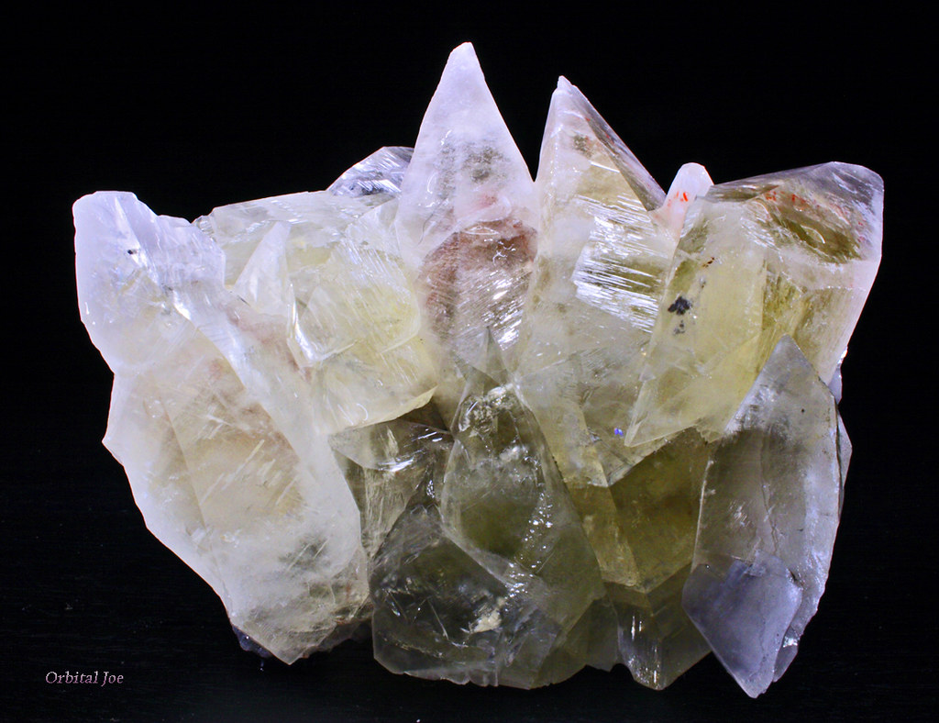
Calcite bug taxonomy
Type inference bugs
Incorrect semantics for functions
Calcite expects to have implementations for all SQL library functions!
Incorrect optimization rules
Timeout during query optimization
Incorrect source code generation (source-to-source translation)
Hardwired assumptions about SQL behaviors (e.g., max TIME precision)
Redundant data structures

Slide 58
Projection
SELECT Age FROM T
In DDlog:
O(age) :- T(_, age).
The weight of $t$ = sum of weights of all tuples that project to $t$
$$π_{C}\left(m\right)\left[t\right]=\sum_{\begin{aligned}x∈m \\ π_{C\left(x\right)}=t\end{aligned}}{m[x]}$$
$$T$$
$${↑π}_{C}$$
$$distinct$$
$$V$$
Name | Age | Weight
Mike | 10 | 1
John | 12 | 3
Amy | 8 | -1
Chris | 10 | 2
Age | Weight
10 | 1+2
12 | 3
8 | -1
SELECT Age

Slide 59
Selection (filtering)
SELECT * FROM T WHERE predicate
O(t) :- T(t), predicate(t).
Name | Age | Weight
Mike | 10 | 1
John | 12 | 3
Amy | 8 | -1
Chris | 10 | -2
Name | Age | Weight
Mike | 10 | 1
John | 12 | 3
Chris | 10 | -2
WHERE Age >= 10

Slide 60
Cartesian products
V(t1, t2) :- T1(t1), T2(t2).
SELECT T1.*, T2.* FROM T1, T2
Name | Age | Weight
Mike | 10 | 1
John | 10 | 3
Amy | 10 | -1
Chris | 10 | 2
Mike | 12 | 3
John | 12 | 9
Amy | 12 | -3
Chris | 12 | 6
Name | Weight
Mike | 1
John | 3
Amy | -1
Chris | 2
Age | Weight
10 | 1
12 | 3
x
=
Multiply weights.

Slide 61
Optimizing distinct
Distinct is idempotent: $distinct∘distinct=distinct$
For many relational queries $Q$ the following holds ($Q$ one of select, project, join, map, flatmap, union, intersection)
For Q in join, product, filter, select we have
$$⇔$$
$$⇔$$

Slide 62
Incremental distinct
$$⇔$$
Work proportional to $|d|!$

Slide 63
map_keys(f)
Generalization of SQL SELECT
Given $f:A→B$ the operator map_keys$\left(f\right):ℤ\left[A\right]→ ℤ[B]$ is: map_keys$\left(f\right)\left(i\right)=\sum_{x∈i}{i\left[x\right]⋅f(x)}$
Apply $f$ to each key and “weigh” the result
map_keys$(f)$is linear for any function $f$
Weight of $x$

Slide 64
Groupings
A grouping maps a key to a $ℤ$-set: $K→ℤ\left[A\right]$
Given a key, return a $ℤ$-set
This structure is $ℤ\left[A\right]\left[K\right]$
This is a mathematical group!
Weight
Key | Z-set
K1
K2
K3

Slide 65
Group-by
Given a type of keys $K$ and a function $k: A→K$, groupby$\left(k\right): ℤ\left[A\right]→ℤ\left[A\right]\left[K\right]$ builds a grouping from a $ℤ$-set
groupby is a linear function!
Each tuple in the input delta will affect only one grouping
So ($↑$groupby)$Δ =$ ($↑$groupby)

Slide 66
flatmap_keys
Given $f:A→ℤ[B]$, define flatmap_keys$\left(f\right):ℤ\left[A\right]→ ℤ[B]$ as: flatmap_keys$\left(f\right)\left(i\right)≝\sum_{x∈i}{i\left[x\right]⋅f(x)}$
flatmap_keys is linear for any $f$!
Substitute$ℤ[B][K]$ for $A$, and id: $ℤ\left[B\right]→ ℤ[B]$ for$f$
flatmap_keys(id):$ℤ\left[B\right]\left[K\right]→ℤ[B]$is the right-inverse of group-by
Weight of $x$

Slide 67
Aggregation
Aggregation functions such as weighted SUM and COUNT are linear functions $ℤ\left[ℝ\right]→ℝ$!
$a_{SUM}(s)=\sum_{x∈s}{x×s\left[x\right]}$
(But not linear as functions $ℤ\left[ℝ\right]→ℤ[ℝ]$!)
SELECT SUM(c) FROM I
makeset converts a $ℝ$scalar into a singleton $ℤ$-set
makeset(5) = $\{ 5↦1 \}$
makeset is not linear, but it is not expensive to incrementalize

Slide 68
Non-linear aggregations
E.g., min, max
… or their generalization, top-K
These are not linear on a group structure (they are linear on a monoid… but can’t handle negation)
Implemented using the “brute force” formula:
$${(↑Q)}^{Δ}= D∘(↑Q)∘I$$
The integral is there to “remember” the full set
Can be built efficiently (log work in $|I|$) using a priority queue

Slide 69
Group-By + Aggregate
The composition of
Group-by
map_weights(aggregate)
map_weights applies a function to each grouping
Not to be confused with map_keys from before
Linear if the aggregate function is linear

Slide 70
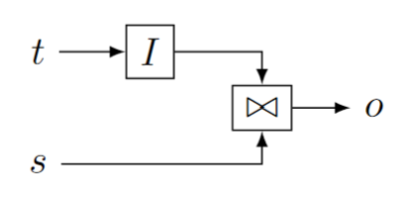
Streaming joins
$t$ are changes to a table
$s$ is a stream
Table $I(t)$ is joined with every stream value in $s$
$o$ is also a stream

Slide 71
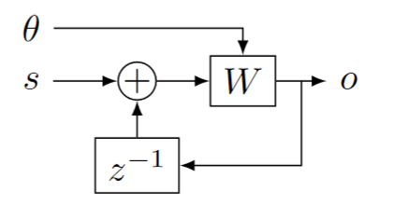
Streaming window queries
$θ$ is a stream of wall-clock values (time)
$s$ is a stream of timestamped data
$W$ window function, filters data in $s$ based on timestamp and time

Slide 72
Alternative window definition
In each transaction
$A$ = what is added
$S$ = what is subtracted from window

Slide 73
Recursive computations
Reach(x, y) :- Edge(x, z), Reach(z, y).
The semantics iterates until convergence
To implement “loops” we introduce two new operators:
$δ_{0}$ (enter)
$∫$(exit)

Slide 74
Creating streams from scalars
$$δ_{0}:A→S_{A}$$
$$δ_{0}\left(a\right)\left[t\right]≝\left\{\begin{aligned}a, t=0 \\ &0, t>0\end{aligned}\right.$$
Linear!
scalar
stream
9
9, 0, 0, 0, 0, 0, …

Slide 75
Creating scalars from streams
Only defined for streams that are zero almost everywhere:
$$∫{ :S}_{A}→A$$
$$∫\left(s\right) ≝ \sum_{t≥0}{s\left[t\right]}$$
Linear!
stream
scalar
1, 2, 3, 0, 0, 0, …
6

Slide 76
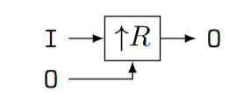
Implementing recursion (1)
Start with a recursive query O = R(I, O) where I and O are relations, and R is a query (on $ℤ$-sets)
Implement R as a (non-recursive) circuit $R:$
Lift to compute on streams:

Slide 77
Implementing recursion (2)
(3) Connect recursive output to input using a delay
(4) Bracket as follows:

Slide 78
Typing
Scalars (not streams!)
Streams

Slide 79
Inputs
a,0,0,0,…
a,a,a,a,…
a

Slide 80
Theorem: this circuit computes fixed-point of $R$
Denote by $S\left(x\right)=λx.R(a, x)$, where $a$ is the value of input I
$o\left[0\right]=R\left(a, 0\right)=S(0)$
$o\left[1\right]=R\left(a, o\left[0\right]\right)= S\left(o\left[0\right]\right)=S\left(S\left(0\right)\right)$
$o\left[k\right]=S^{k+1}\left(0\right)$
If $o[k] = o[k+1]$, then $∀i≥0 o\left[k+i\right]=o[k]$
Starting from $k$ all outputs of $D$ are 0
(But computation may never converge)

Slide 81
Two kinds of streams
Streams were used previously to model time-evolution of a system
Now we use streams to model the execution of a loop
The stream values are consecutive values of the variables in the loop body

Slide 82
Example: Transitive closure
reach(x, y) :- edge(x, y).
reach(x, y) :- edge(x, z), reach(z, y).
edge
reach
edge
join(edge, reach)

Slide 83
Semi-naïve evaluation
$$⇔$$
Cycle rule => correctness of semi-naïve Datalog evaluation

Slide 84
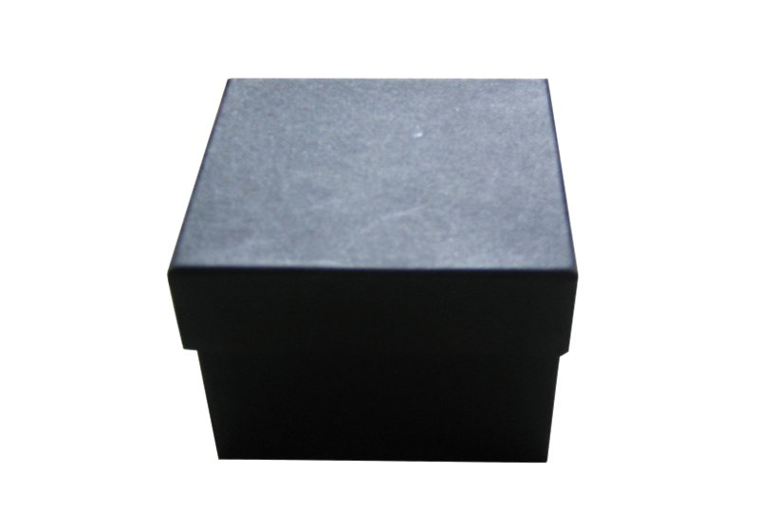
Streaming, incremental, recursive queries
So far we have implemented a recursive non-streaming query
To make it incremental we apply the same recipe as before…
… treating the non-streaming query as a black-box

Slide 85
Lifting and loops
A circuit like implements a query $Q$
Use the definition: ${(↑Q)}^{Δ}≝ D∘\left(↑Q\right)∘I$ by treating the entire circuit like a scalar operator!
Theorem: lifting a circuit is the same a lifting every operator
Works even for loops
$$P$$
$$↑( )$$
$$⇔$$

Slide 86
Streaming incremental recursive queries
Non-incremental streaming
recursive query
Incremental streaming
recursive query
Apply chain and cycle rules

Slide 87
Example: Transitive, reflexive closure
input relation E(h: Node, t: Node)
output relation R(s: Node, t: Node)
R(x, x) : - E (x, _). R(x, x) : - E (_, x). R(x, y) : - E (x, y). R(x, y) : - E (x, z), R(z, y).

Slide 88
Transitive, reflexive closure: circuit
Non-recursive query
Recursive version

Slide 89
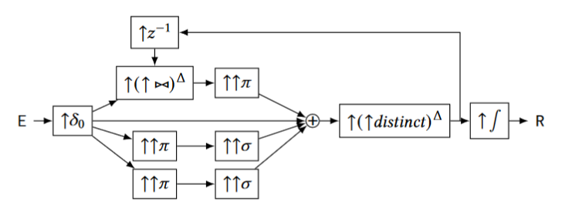
Transitive, reflexive closure: incrementalize
Lifted (streaming)
Incrementalized

Slide 90
Transitive, reflexive closure: optimize
Incrementalized
(previous)
Apply chain, cycle
nonlinear

Slide 91
Transitive, reflexive closure: (bi)linearity
$${\left(↑{\left(↑⋈\right)}^{Δ}\right)}^{Δ}$$
$$↑(↑distinc{t)}^{Δ}$$
$${\left(↑{\left(↑distinct\right)}^{Δ}\right)}^{Δ}$$

Slide 92
SQL Semantics
The SQL spec has many undefined behaviors
Many dialects don’t even seem to respect the standard
In a streaming system you don’t really want runtime exceptions
We prefer a semantics where bad computations return NULL instead
Our pipelines are fully deterministic
We do not want to support NOW() or RAND()
These can be transformed into input streams instead, perhaps automatically

